Slide 1
Professor Sue Charlesworth (PI, WP1 lead)

Slide 2
Project outline
Aim:
To map and reduce waste in the urban food-energy-water nexus
Objectives:
Map resource flows
Identify critical dysfunctional linear pathways
Agree the appropriate local response: identify suitable interventions
Model market and non-market economic value of each intervention
Engage with decision-makers to close the loop
“Test beds” in 4 Urban Living Labs

Slide 3
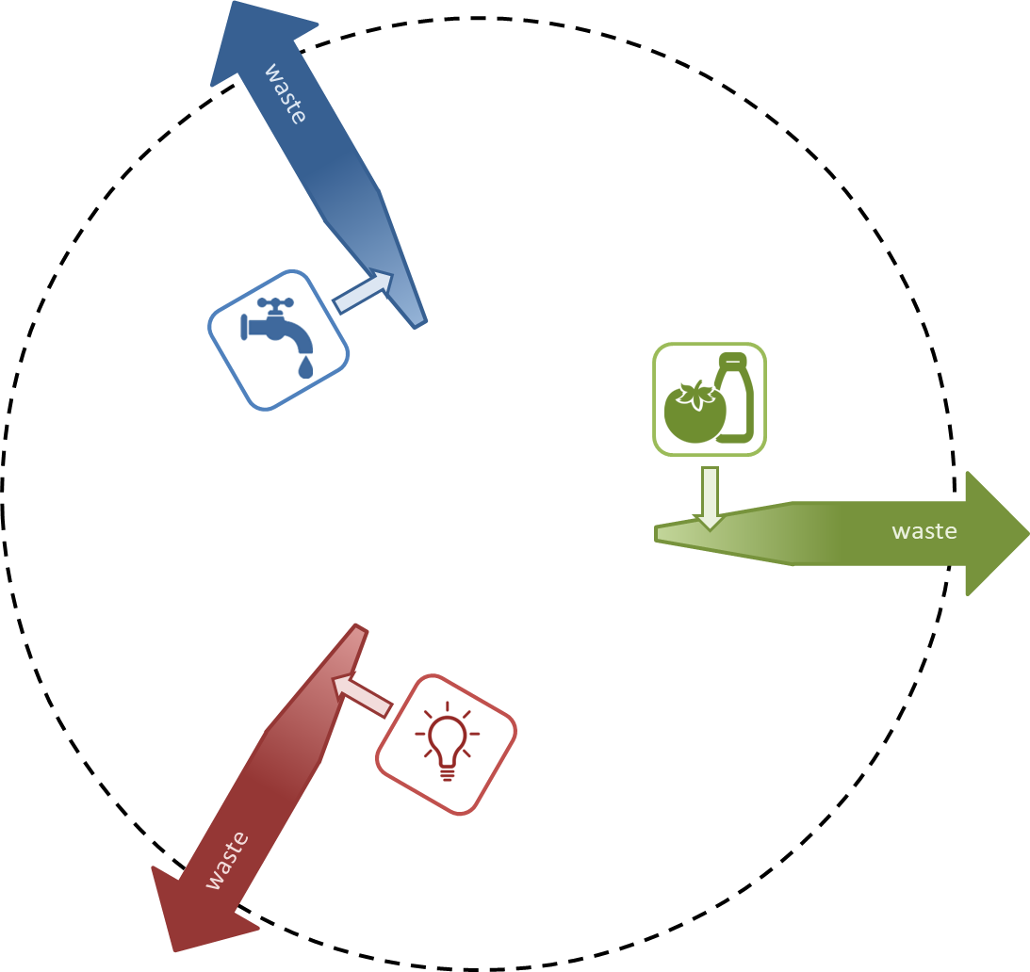



waste
waste
waste

Slide 4
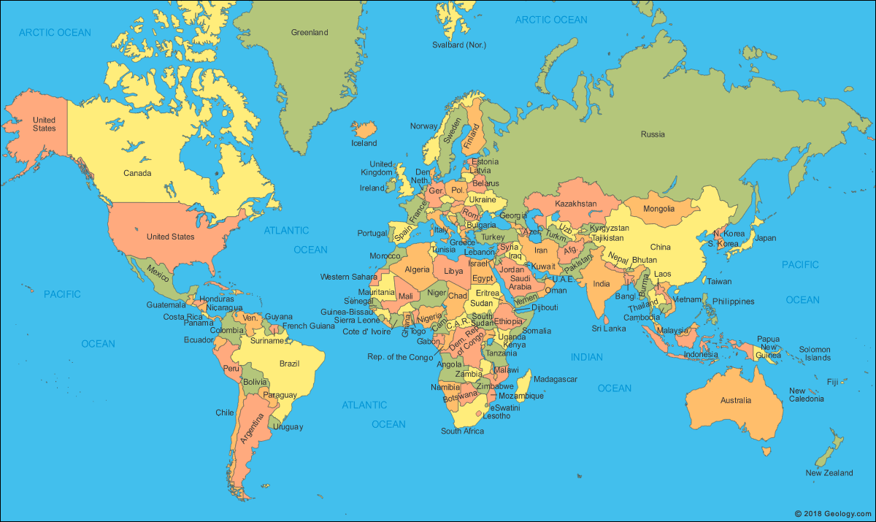
Goals for this meeting
Project progress:
4 Urban Living Labs
Plans for stakeholder engagement
“Open” each ULL with stakeholder groups
Access data to determine resource efficiencies in the ULL
Map waste and agree the site-specific focus
Where economic evaluation fits, identification and collection of impact, knowledge dissemination and communication.
Networking and collaboration
Rotterdam:
Rachel Greer
DRIFT
Bristol:
Daniel Black
Sao Paulo:
Ester Dal-Poz
University of Campinas
Western Cape:
Kevin Winter,
University of Cape Town

Slide 5
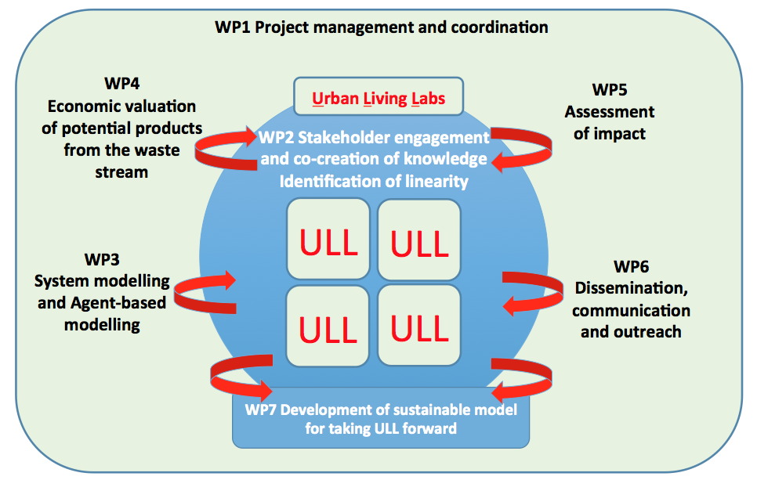
Workpackage structure and responsibilities
Sue Charlesworth:
Coventry University
Taoyuan Wei:
CICERO
Daniel Black:
db+a/
Coventry University
Marco Van De Wiel: Coventry University
WP7
Adina Paytan:
University of California,
Santa Cruz, USA
WP6
Rachel Greer: DRIFT

Slide 6

Management structure – WP1
Consortium Agreement
Julia Stew and Joanne Noone: Sharepoint for documents
Reports: Annual report and ResearchFish update (Year 1-3 Q4) for the UK
Budget: final expenditure statement (Year 3 Q4)
Convene UK-based Steering Group: ULL leads, WP leads
2nd consortium meeting (Year 1 Q4) for networking
Overview of key performance indicators
Coventry/UK has overall project responsibility, through WP1,
Each ULL is responsible for its own deliverables via the ULL lead,
Economic valuation by CICERO/Norway and
Outreach by UoSC/USA
Communication
ULLs
Economic Group
Impact Group
Post graduates
US-based Steering Group
Adina

Slide 7
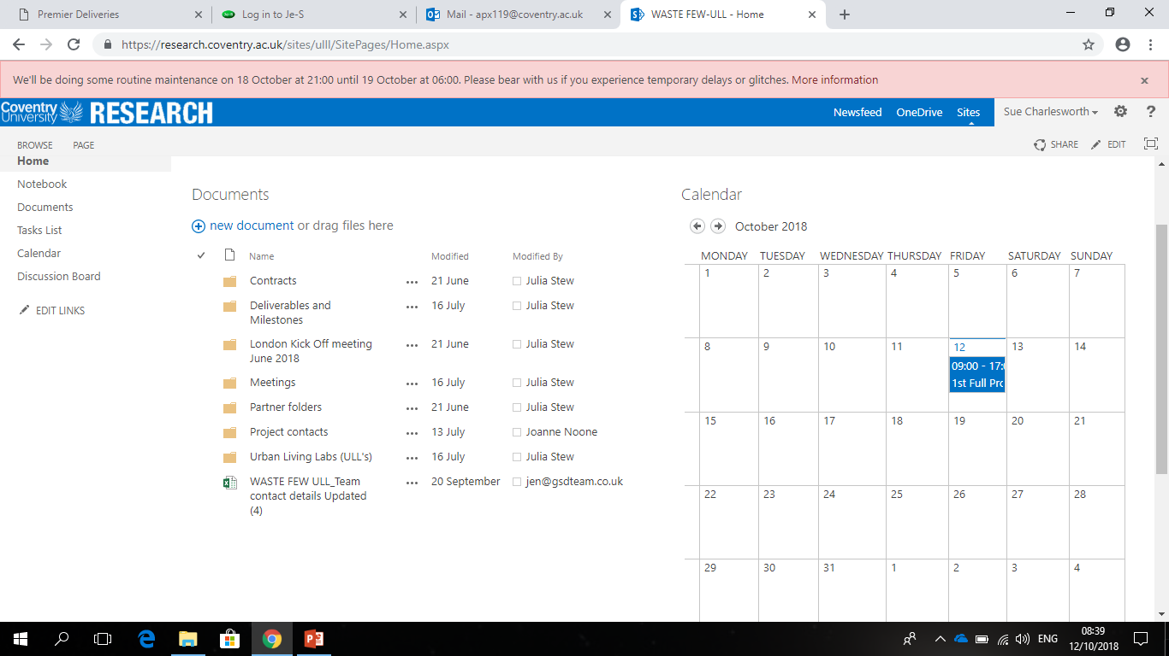

Slide 8
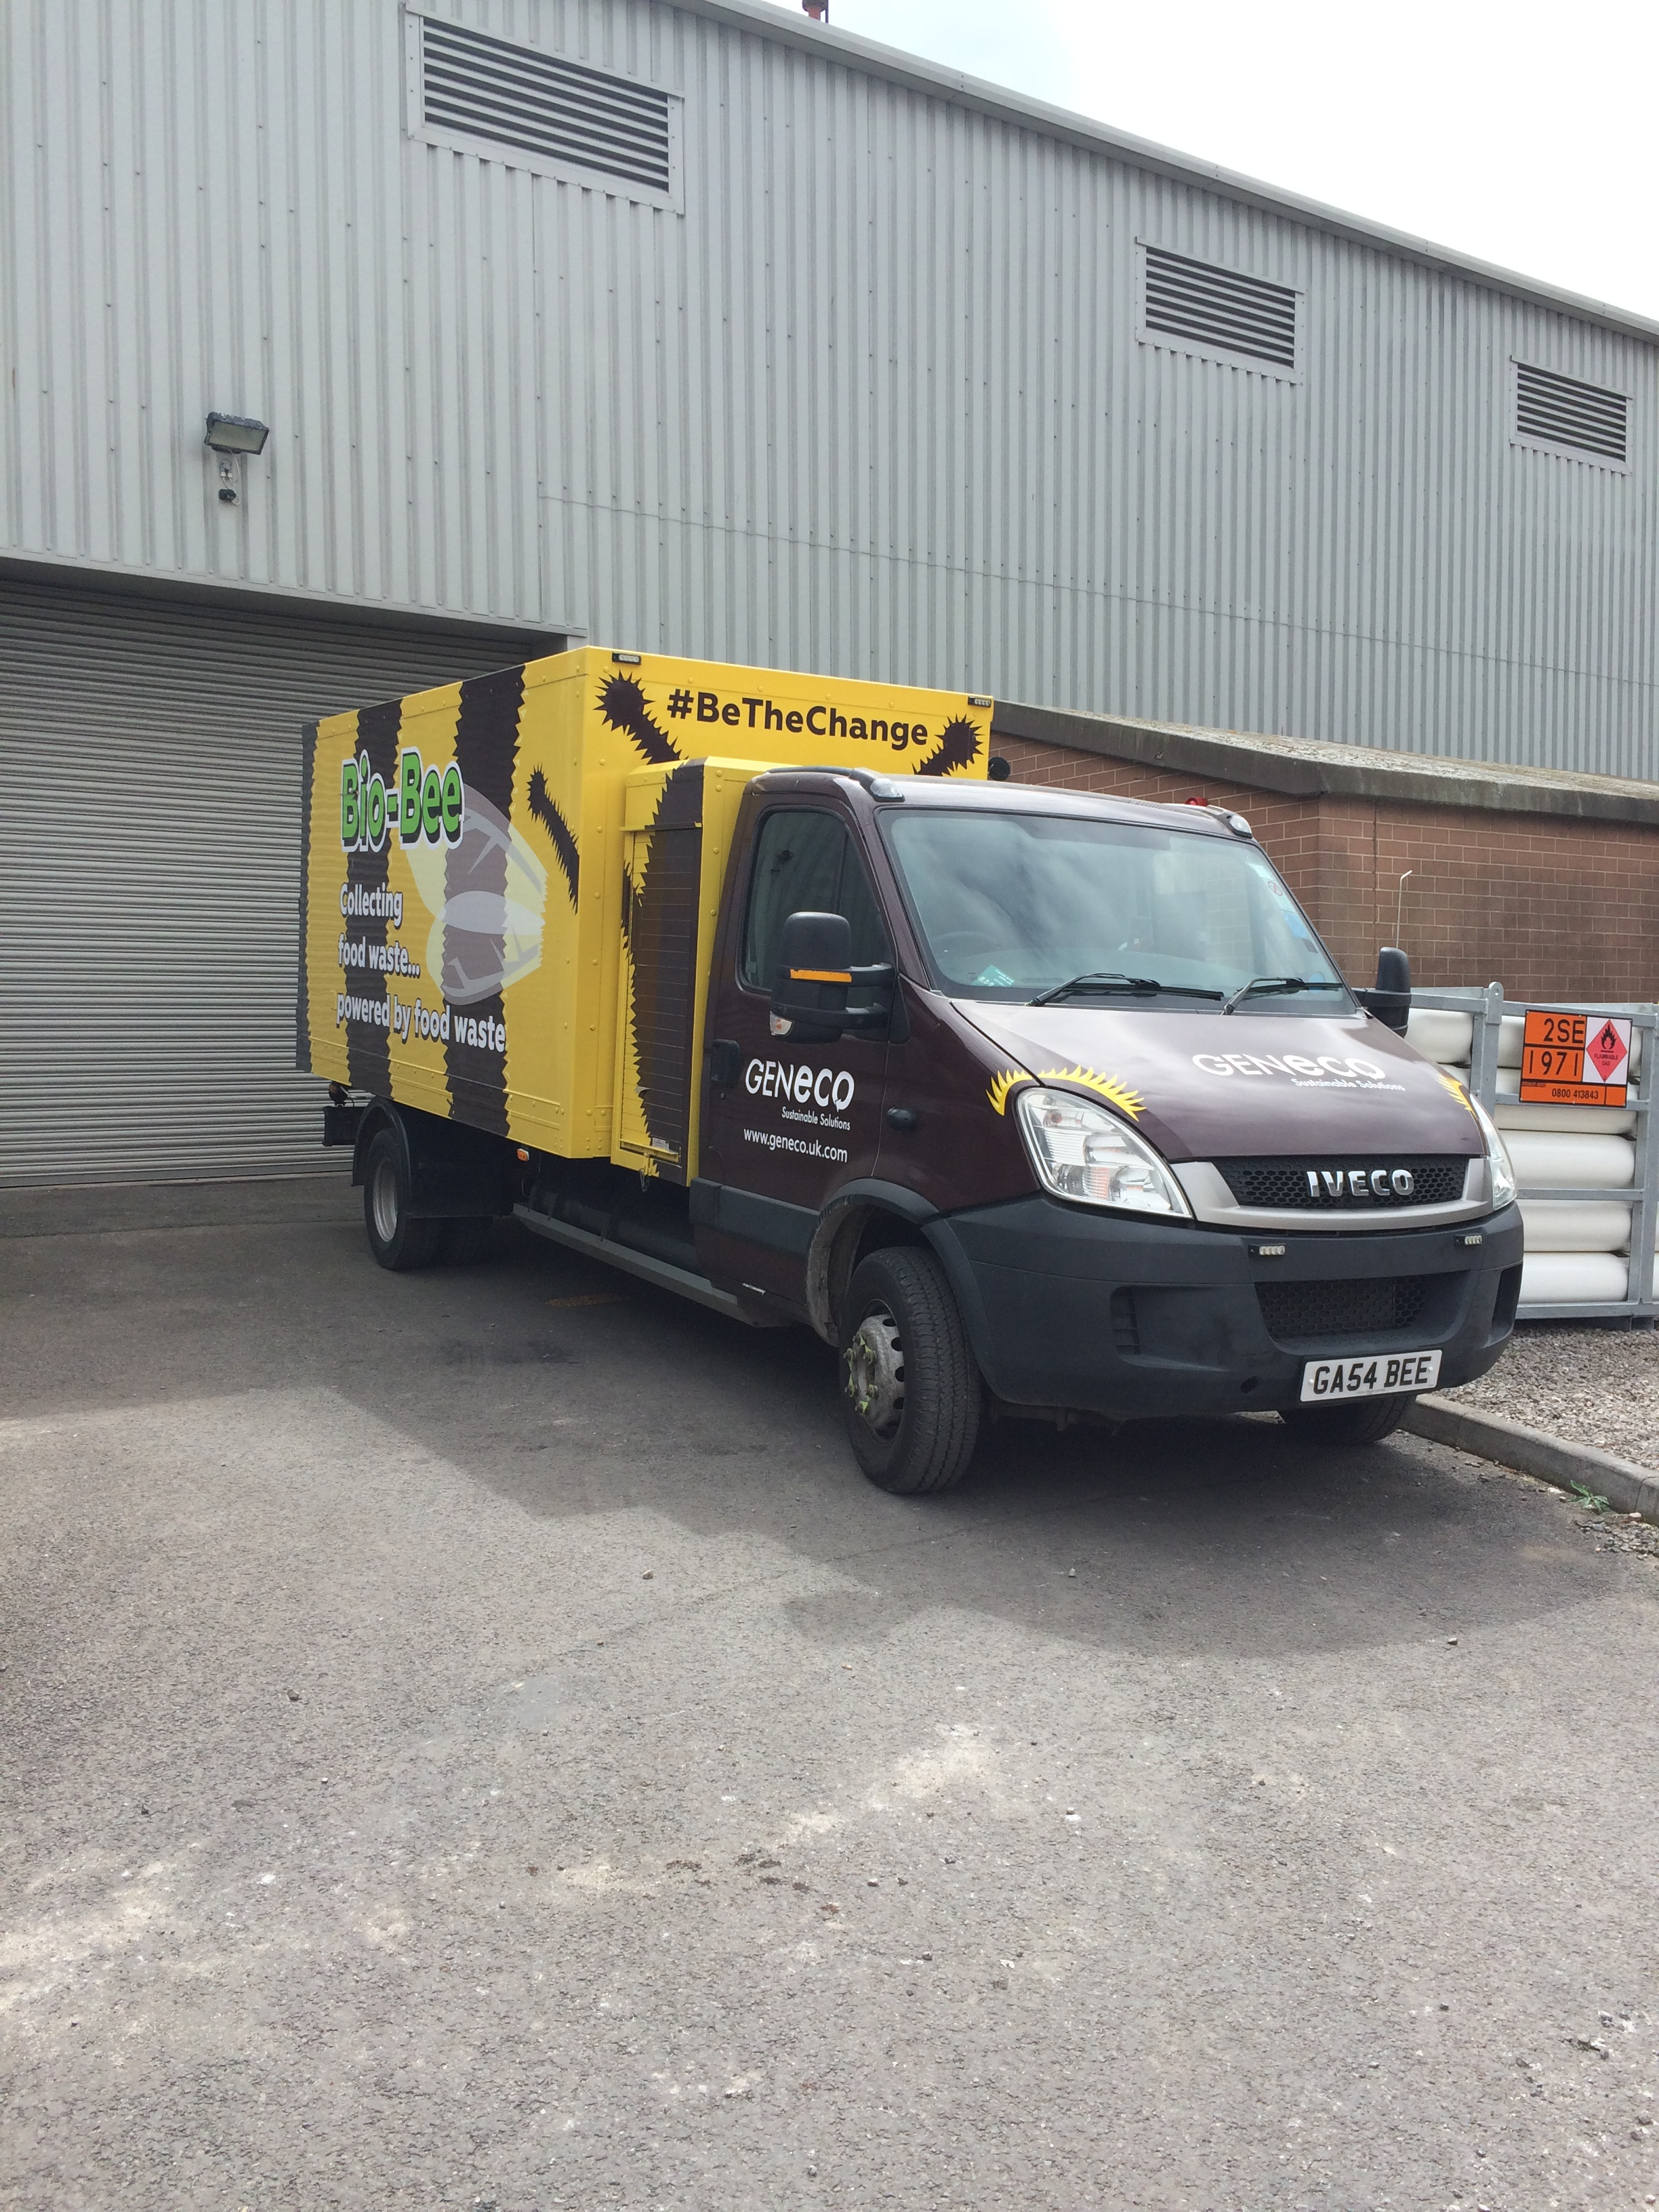
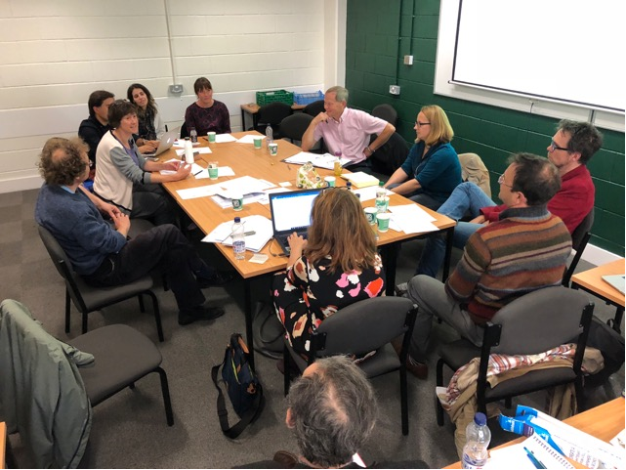
Activities to date
Project start date: 1 June 2018
London SUGI Nexus “kick-off” meeting, 11-12 June 2018 (3 attendees)
2 x Bristol ULL meetings
1st International meeting

Slide 9
Outcomes
Impact (Daniel), from the baseline
Identification and development of potential economically feasible markets in each ULL
Knowledge exchange between academics, stakeholders and practitioners, and the potential for policy and practice change

Slide 10
Timetable of activities
Project started 1 June 2018
Gantt chart

Slide 11
Deliverables by December 2018
 | Deliverable name | Due
1 | WP2 ULL kick-off meeting document for each ULL | 12/2018
2 | WP 2 One methodology document per ULL on stakeholder engagement process | 12/2018
3 | WP 3 Materials for workshop on systems mapping and problem solving | 12/2018
4 | WP 5 Impact Plan (inc. stakeholder analysis and tracking document, policy briefings) | 12/2018
Combine these
Upload documents to Sharepoint

Slide 12
Deliverables up to end of Y2
 | Deliverable name | Due
5 | WP 3 Post workshop formal mapping | 12/2019
6 | WP 6 Waste FEW ULL global website and resource repository | 6/2019
7 | WP 4 Working report on potential national costs and benefits due to sectoral interactions and market responses induced by ULL activities | 6/2019
8 | WP 1 Annual progress report with description of transnational cooperation, summary of the project status, measurable key performance indicators and ResearchFish update | 6/2019, 6/2020, 6/2021
9 | WP 1 Key performance indicators for project progress and their contribution to the overall aim of the call | 12/2019 6/2021

Slide 13
Milestones
Website
Sharepoint
No | Milestone name | Work package(s) | Time
1 | All ULLs established and kick-off meetings held and first international meeting | All | End Nov 2018
2 | Impact plan and all other project documentation ready and agreed | WP1, WP2, WP5 | End Dec 2018
3 | Waste FEW ULL global website and resource repository ready and running | WP1, WP7 | End May 2019
4 | 1st annual progress report ready | All | End May 2019
5 | Survey with key performance indicators (KPIs) for project conducted | WP1 | End Nov 2019
6 | Draft reports on non-market environmental and health impacts of ULL activities and draft policy briefing ready | WP3, WP4, WP5, WP6 | End May 2020
7 | 2nd annual progress report ready | All | End May 2018
8 | Final ULL analysis and report | WP2, WP3 | End Feb 2021
9 | Final international meeting | All | End Feb 2021
10 | Final Expenditure Statement | WP1 | End May 2021

Slide 14
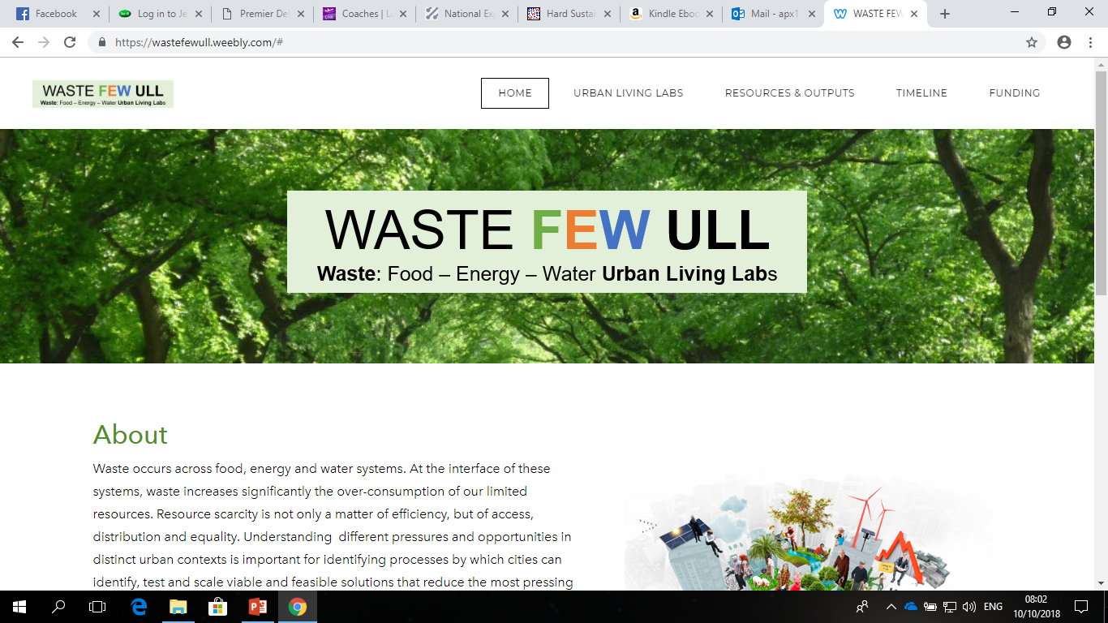
Nadine Heck: nheck@ucsc.edu
Or Adina Paytan

