Slide 1
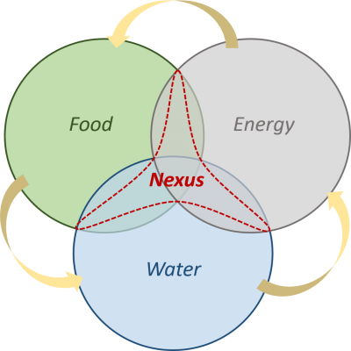
The focus is on Bristol and the interaction with water and energy systems.

Slide 2
What are the problems that we are addressing? – Food wastes, nutrient loss, pollutions, energy wastage, water wastage, other material loss, carbon emissions, public health and well-being … all about urban environments.
Food – can we map the food system of Bristol?
Water – given a food map, what are the water implication, can we combine with a water map for the city?
Energy – ditto for the energy requirements and potentials?
Who is involved, where are the issues, what is changing?
Outcome: use the system maps to look for intervention points and assess potential changes.
The Bristol ULL

Slide 3
Determine initial boundary considerations
Is it just food, energy and water systems?
FEW systems are embedded in a full urban system - particularly consider social and environmental impacts.
How far back up the food supply chain should we look? We need to continually critique the boundary assumptions of the research.

Slide 4
Objectives within a complex system
Efficiency
Sustainability
Resilience
Safety
Health
Well-being
In food waste we may consider the option of many small-scale plants versus one large unit processing all the waste from the city. All three of resilience, sustainability and efficiency interact and other objectives intrude as well.

Slide 5
Actuality
We can then investigate this to look for:
system patterns – canalisation, positive and negative feedback lops, double binds …
areas of greatest impact – economic, environmental, social.
barriers to change – political, legal, physical constraints (PESTEL), vested interests.
conflicts of interests, tensions, discriminations.
opportunities for change – technology, research identification.
Capability
What could we achieve with the system(s) right now if we made obvious changes. (e.g. a campaign to reduce food waste in households).
Potentality
What could be done if we address barriers and challenge existing practices or rules (e.g. change legislation on pre-heating food waste before digestor stage).
Transformability
This is the area of radical change that would require large scale commitments or a strategy for restructuring (e.g. small scale, local food digestors).
Actuality | What we are managing to do now, with existing resources, under existing constraints.
Capability | This is what we could be doing (still right now) with existing resources, under existing constraints, if we really worked at it.
Potentiality | This is what we ought to be doing by developing our resources and removing constraints, although still operating within the bounds of what is known to be feasible.
Transformability | What we could do if we are prepared to challenge the boundaries and consider structural changes.
Systems thinking approaches and thoughts

Slide 6
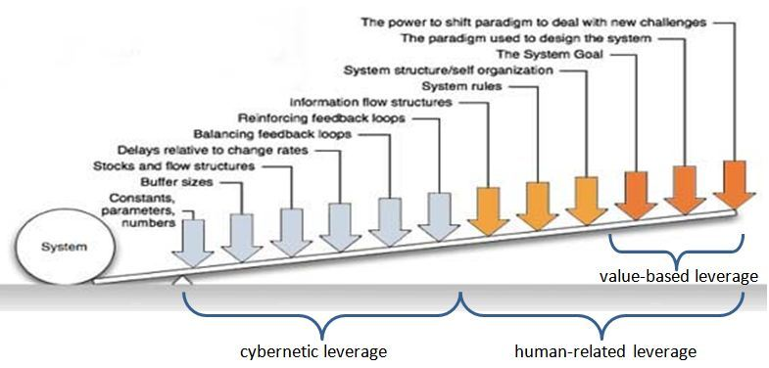

Slide 7
FEW nexus in a broad industrial symbiosis
Management of waste streams (through e.g. capturing, purification, concentrating, sorting, collecting, exchanging or preparation) specifically for the use as resource for other organisations across sectors and/or across value chains
Do this by using local and regional perspectives on infrastructures (e.g. waste and water management, gas networks), communities and energy grids (e.g. district heat integration ), including distributed generation and the role that symbiosis can play in fluctuating energy grids (i.e. grid services, seasonal storage, biomass or heat pumps integration).
Activities
Process (re-)design to integrate and adapt existing processes to enhance industrial symbiosis (energy and material flow coupling, infrastructure and logistics).
Integration of information technology, including artificial intelligence, for the design and the operational management of exchange streams in a dynamic production environment.

Slide 8
System mapping – what does this mean?
Physical flows and stocks of materials (food, sewage, waters etc.) and energy in and out of the system and the flow loops within, taking full account of biological, chemical and physical transformations and the quality of materials.
Overlaying that layer is the human, organisational and information structures and flows including financial transactions.
Above this level is the institutional, legislative and regulatory frameworks.
Finally a critical approach is used to surface and consider boundary judgments, that is, the ways in which people/groups decide what is relevant to the system of concern.

Slide 9
Other considerations
Scaling up and out – are there issues of translating solutions to larger scales or to other regions?
Measurements – new indicators and metrics.
Knowledge exchange and commonalities across the other three ULLs.
Future thinking – how might driving factors change (e.g. supply constraints /price for nutrients in agriculture) [Scenario developments].

Slide 10
Factors = something to consider
Quantity of food coming into the system {food categories: … what do we use? } {variables: … }
Quantity of food that is imported – from outside our boundary, from outside the UK
Maintenance of infrastructure {infrastructure categories: … } {variables: … }
Food waste at different stages:
Primary source
Retail
Domestic
Hospitality
Post consumption waste – faeces into sewage system

Slide 11
The state of a factor
What are the variables at the centre of this factor? Can they be defined or enumerated?
Can the variables be measured or evaluated? What are the measures? Are there any data sources?
Trust in the measurements?
Location – is this universal, global or confined to a certain place?
Scale - is this considered a wide ranging and ubiquitous or local?
Heterogeneity / dispersion – are there clumps, hot spots
History matters - origins, what can we learn from similarities and earlier patterns and path dependencies?
Who is affected?
Critical thinking, look at marginalised groups. Who ought to be considered - individuals, organisations?

Slide 12
Pressure - this is all about the change in the state.
Measurement
How is the change being measured?
Rates of change, smoothness of change v phase shifts, etc. Are there potential tipping points?
Acceleration / deceleration – second order change
Often not easy to distinguish – is there a net positive feedback in action creating a snowball effect or is there a negative feedback in play that regulates change bringing it back to a stable state. What are the factors producing feedback effects?
Time frame – when do we see events occurring, what is the unfolding story’s period? Is change episodic, sporadic, or periodic? Is there a seasonality – natural cycles, are there human culture cycles?
Momentum – how fast could this change, change. Is it a ‘super tanker’ type change that will carry on by itself and would require massive effort to alter course or is it an easily shifted change?
Latency
Is there any sense of latency? The state of existing but not yet being developed or manifest; concealment. Latency describes a delay that takes place during communication over a network some type of bottleneck that results in a delay before the change happens (or is perceived to happen).

Slide 13
Energy for waste water | Technologies
AD from food waste | Policy – governance and regulations
Green gas to grid | Nutrient loss and recovery processes
Energy used in food processes & transport | Pollution – point source and diffuse
Land use, soil health | Food demand by food types
Hydrolysis potential | Energy for waste water treatment
Food waste energy for transport | Water wastage
Consumer behaviour | Population
Food waste infrastructure | Food wastage
Inputs to food production | Carbon emissions
Food preparation processes | Public health
Other material inputs to food – plastics / packaging | Energy transmission
Energy inputs to water processes | Use of gas from AD plant for electricity
Water needs in food processes | Energy for food waste processing
Factor analysis
A random list

Slide 14
The bigger economic picture

Slide 15
Simplistic flows
Systems dynamics model

Slide 16
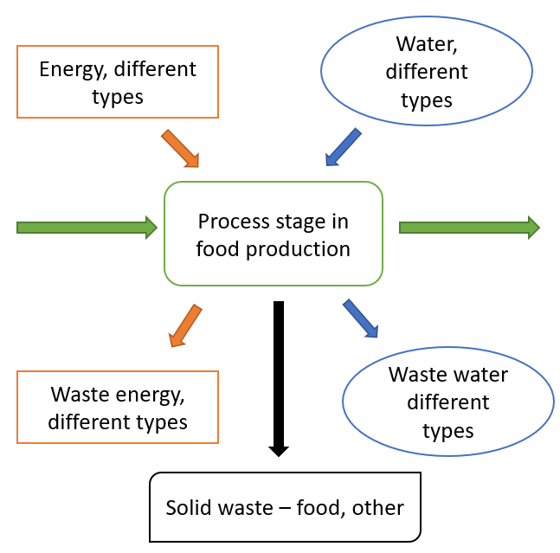
Water, different types
Energy, different types
Process stage in food production
Waste water different types
Waste energy, different types
Solid waste – food, other
Carbon emissions

Slide 17
Place based approach – finer granularity could be developed
‘Soil’
Food on farm
Food processor
Wholesale
Retail & hospitality
Consumer
Sewage
This is where resources like NPK enter
Closing the loops is essential, becoming energy neutral, becoming carbon neutral …

Slide 18
Food Energy Water
Other materials and resources (plastics)
Water, different types
2nd order energy for infrastructure to build and maintain
2nd order energy for infrastructure to build and maintain
Energy, different types
Process stage in food production
incl. transport to next stage or to waste
Material in
Material out
Other waste materials
2nd order energy for infrastructure to build and maintain
Waste water different types
2nd order energy for infrastructure to build and maintain
Waste energy, different types
Solid waste – ‘food’
Sometimes mixed with other wastes
Carbon emissions
2nd order energy for infrastructure to build and maintain

Slide 19
FOOD – Valuing Bristol’s food waste
Bristol is aiming to become a ‘Gold Sustainable Food City’ and reduction of food waste is one of six key focus areas in the ‘Going for Gold’ campaign.
Households are by far the greatest producers of food waste, but difficult to influence directly.
The next greatest producers of waste are the food processing and hospitality companies (e.g. meat processing, catering, major organisations such as healthcare, care homes and universities).
How does reduced food waste link to use of phosphorous, energy and water?
What are the realistic (and desirable) levels of food waste reduction given it produces electricity via the AD plant?
Going for Gold is a Bristol-wide bid to be recognised as a Gold Sustainable Food City.
Sustainable Food Cities is a national programme that celebrates and supports communities that are making positive changes to their food system.

Slide 20
Nutrient loss – a city in a global context

Slide 21
WATER – Valuing phosphate in Bristol’s sewage
Wessex Water and the industry at large recognise the challenge of phosphorous recapture, it is a global challenge.
A good deal of work has already been done in this area, both on phosphorous scarcity and eutrophication.
There are a range of technologies that are being trialled and tested, but other than large-scale reed bed systems, chemical and biological processes have their limitations and side-effects.
Approximately 166 million litres of treated effluent are pumped into the River Severn from Bristol every day. The phosphorous in solid waste is captured. It is uneconomical to capture the remaining 2/3 of the phosphorous, which is in the liquid effluent.

Slide 22
ENERGY – Valuing energy in Bristol’s waste treatment
Two key areas have been identified by our main energy partner, CSE:
Green gas:
The Wessex Water/GENeco AD plant in Avonmouth produces ‘green’ gas, which can be put to a variety of uses, e.g. a) injecting it into the gas distribution network b) using it to fuel vehicles ; c) generating electricity from it; d) or generating heat in district heating schemes.
Energy inefficiency due to regulation:
There are energy inputs to the pre-treatment of waste inputs to the AD plant which may only be required to meet regulatory standards which ignore the ‘treatment’ achieved by the AD plant itself.
Bristol has recently set itself the target to be carbon neutral by 2030 and, along with the development of renewables, the decarbonisation of the gas grid is core to this objective.

Slide 23
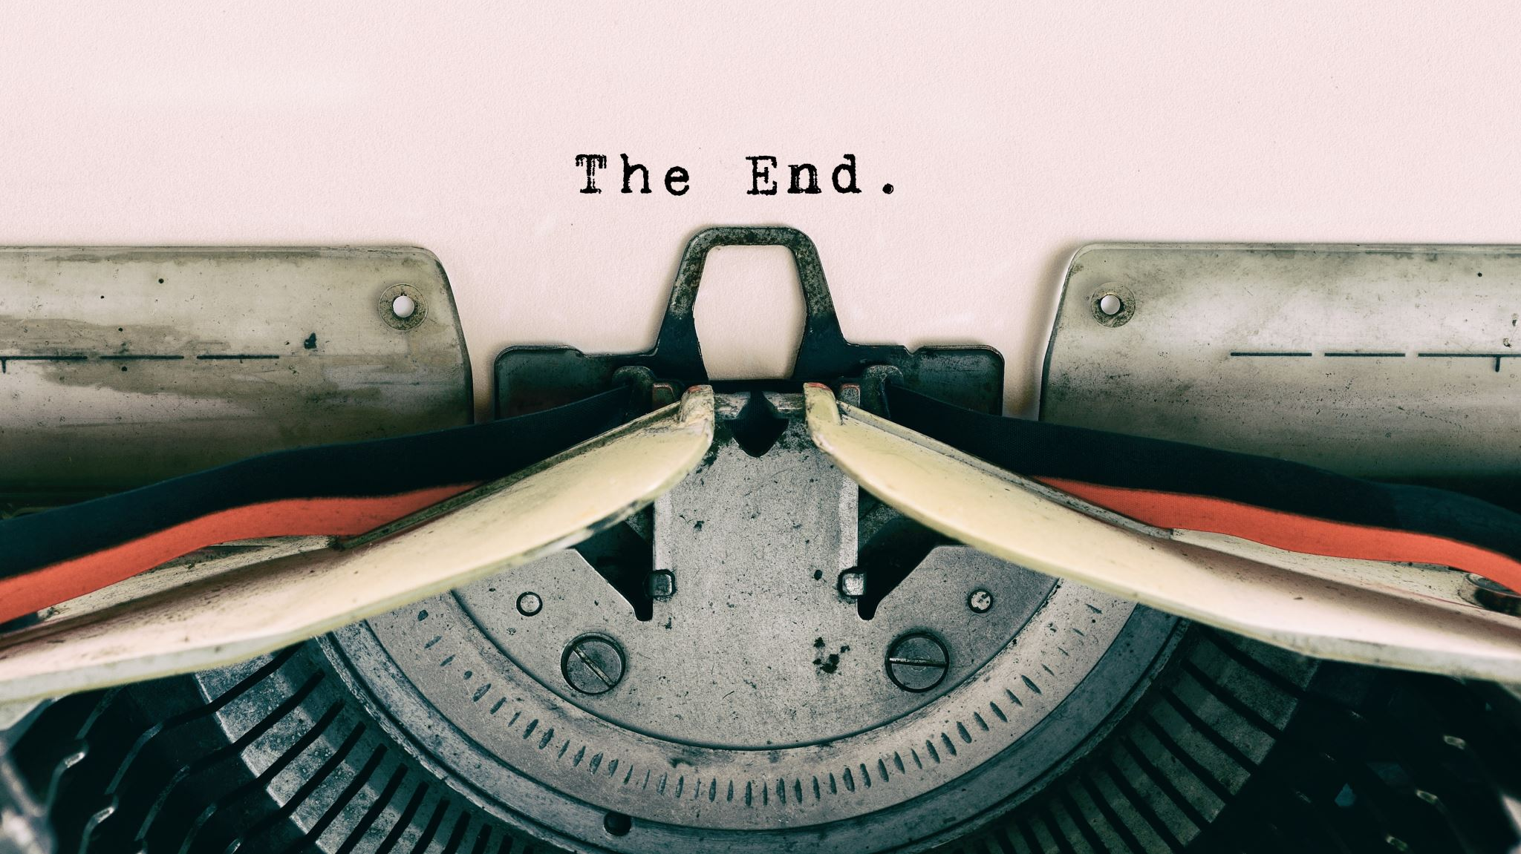
Thank you

Slide 24
Optimising ‘the system’: a few energy issues and questions
Would it be ‘better’ to use the ‘green gas’ output from the Geneco AD plant to inject green gas directly into WWU gas network or use it to fuel renewable electricity generation? (If the latter, could it help local wind & solar generators by acting as back-up/ balancing to create a ’24 hr firm power’ cluster? What would benefits of this be, if any?)
What applications would make best use of ‘green gas’ in terms of efficiency and sustained reductions in greenhouse gas emissions? Bristol’s growing district heating?
What is the energy performance of local housing and its heating? Could that be improved to increase efficiency of green gas usage and achieve social & health benefits?
Regulatory requirements on treating food waste (input to AD plant) require it to be heat treated prior to adding to AD plant, even though the AD process achieves much the same pasteurising effect. So is there a way to avoid this ‘unnecessary’ energy input?
What additional benefits (if any) are available from ‘local energy trading’ (i.e. direct sales) to local consumers, rather than via energy supplier?

