Slide 1
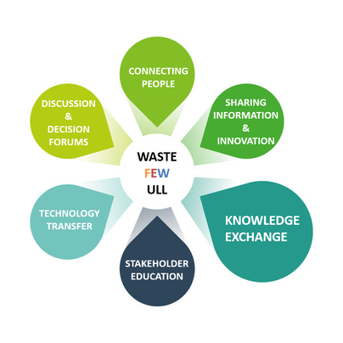
WASTE FEW ULL – Netherlands
Rachel Greer & Timo von Wirth

Slide 2
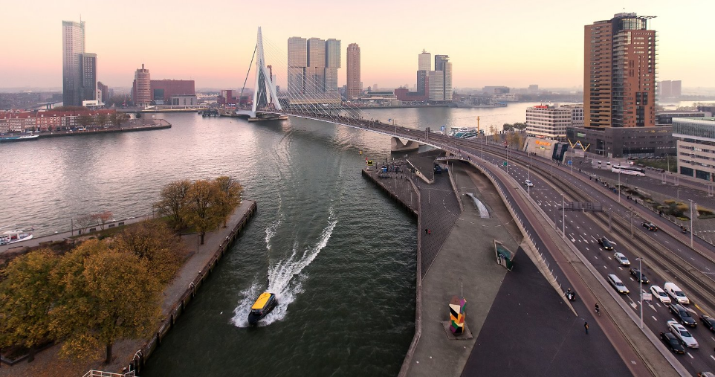
Rotterdam
Where is it?
Source: https://rotterdampartners.nl/

Slide 3
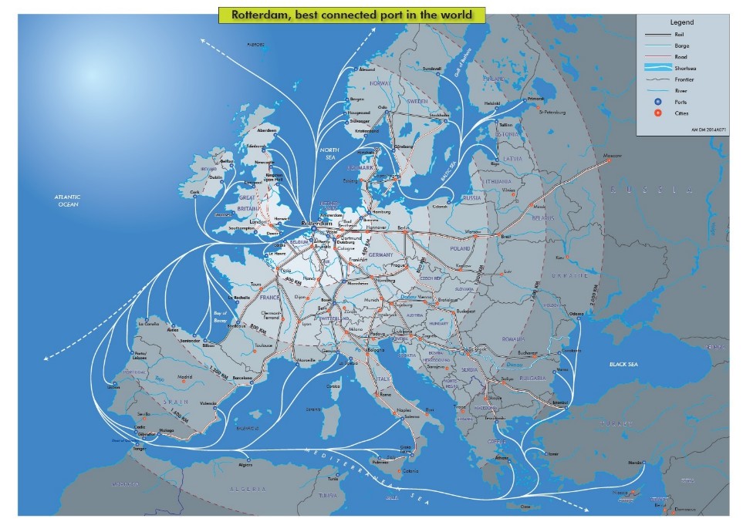
Rotterdam
Where is it?
Source: https://www.portofrotterdam.com

Slide 4
Rotterdam
Largest port of Europe
Key transit point in global logistic chains
“Make it happen” – Experiments for urban regeneration, connecting residents and re-purposing underused infrastructure
Source: https://rotterdampartners.nl/

Slide 5
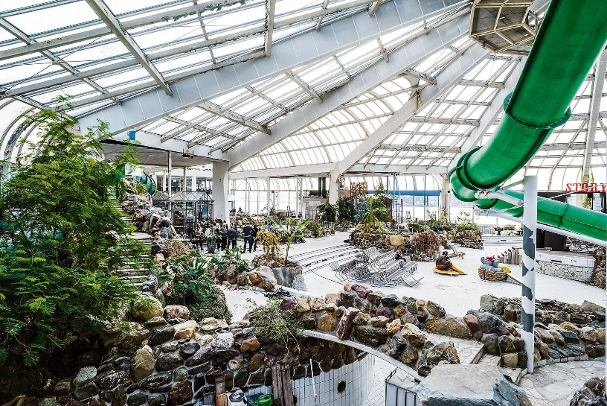
Blue City
What is it?
Incubator for circular entrepreneurs
Reimagined swimming paradise
Cooperation over competition
Source: http://www.bluecity.nl/about-bluecity/

Slide 6
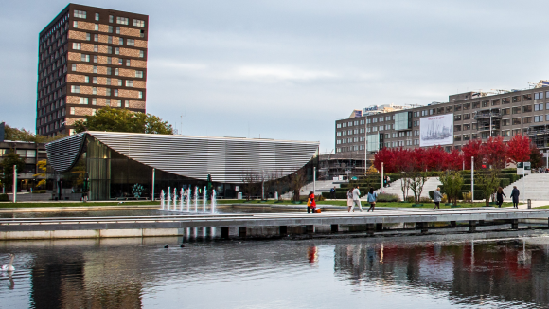
PhD steps:
How to address?
Map energy and resources flowing within and across boundaries
Critically examine for additional symbioses
Evaluate diffusion potential (e.g. upscaling, replication)
Integrate relevant stakeholders
Source: http://https://www.eur.nl/campus/locaties/

Slide 7
Methods & Tools:
MFA
MEFA
+ structural analysis → MFM
Temporal functional unit, or
practical based around event,
i.e. circular catering
Scenario analysis → backcasting
Ideas for variables? E.g. Economy flourishing vs. crashing
~Environmental decision-making (e.g. policy makers, citizens, start-up entrepreneurs)
~ESIA → Norway/UK?
M1 M2
M3 M4
…

Slide 8
Goals:
First steps:
Tour of maker space in BC
Meet entrepreneurs personally
Interviews when possible
Ask to collect energy/material in- and out-flows (consumption and waste) over one month
Status quo MFA
Efficiency analysis
March: focus group (representatives from Metabolic, city, port, Blue City, other start-ups) → exercise in workshop, cluster knowledge

Slide 9
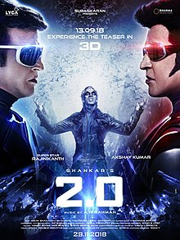
Activities:
Replication in another city
Spin-off / Blue City 2.0, within Rotterdam
Or is it better to scale up the startups within BC? Should BC have a time limit?
Measure impact – 10,000 visitors last year, but does that actually mean anything for sustainability?
Source: wikimedia.org/wikipedia/en/thumb/c/cf/2.0_film_poster.jpg

Slide 10
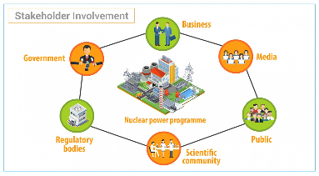
Challenges:
Knowing which stakeholders to integrate when
Media, K-12 teachers, university students, policy makers, municipality, NGOs, museums, local citizens
Connecting with community
Maximizing human resources
Choosing best method(s) for scaling up
Making tangible progress
Source: https://www.iaea.org/

Slide 11
Questions:
Should it only be circular startups from BC?
What are our important factors for comparison?
e.g. city size, population size, population growth, key economic players and industries, national mentality, identifiable drivers and barriers…
Are we trying to create a new city, or testing for individual diffusibility?
Are we looking at entire value chain?

Slide 12
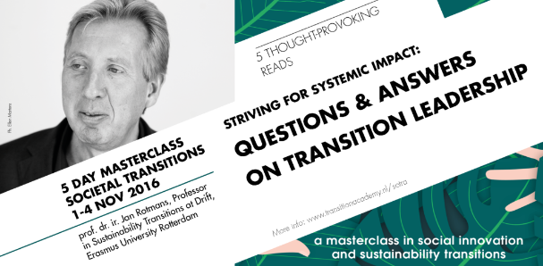
Ideas:
Combine Industrial Ecology assessment tools with transition thinking
Dissemination of outcomes and ideas through press tours, classes (elementary + university)
Create a story map/narrative
Transition Academy @ DRIFT
Paper collaboration comparing methods internationally
Knowledge exchange platform online
Context-specific solutions: Generic vs. local
Agenda setting with corporate partners
Source: http://4dane94f01emxbo733yxewhi-wpengine.netdna-ssl.com
Source: http://amsterdam.impacthub.net

Slide 13
Source: https://s3.amazonaws.com/wordpress-production/

