Slide 1
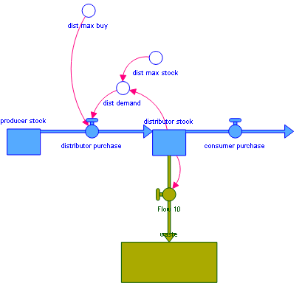
WASTE FEW-ULL Project Meeting, Rotterdam, September 2019
WP3: Systems mapping of the FEW nexus
Marco Van De Wiel
Centre for Agroecology, Water and Resilience
Coventry University

Slide 2
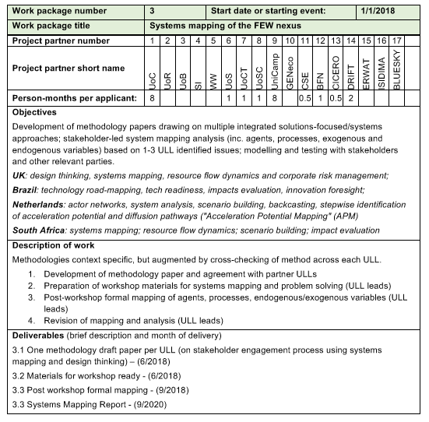

Slide 5
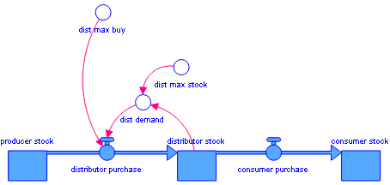

Slide 6
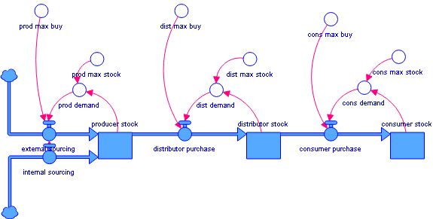

Slide 7
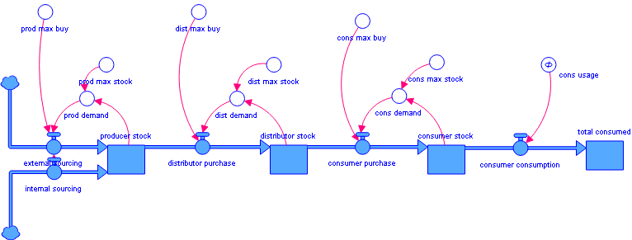

Slide 8
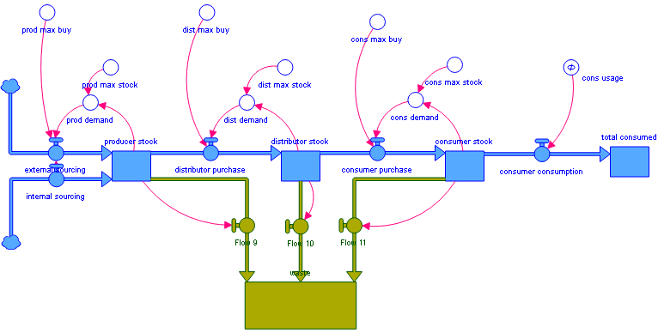

Slide 9
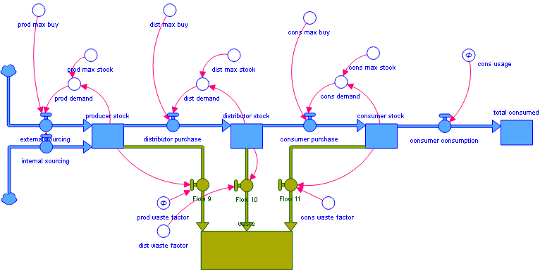

Slide 10
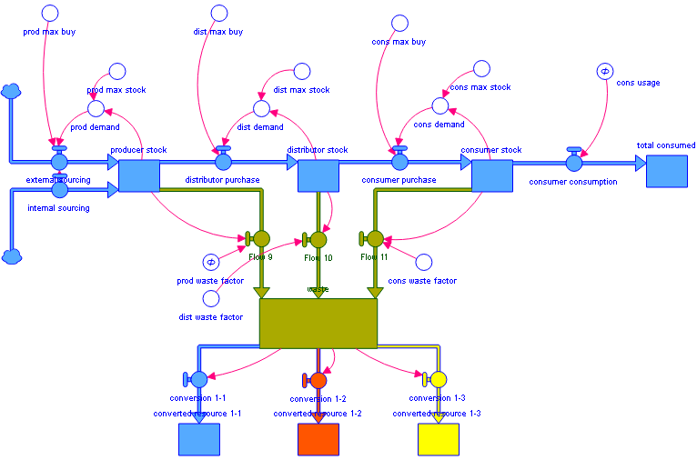

Slide 11
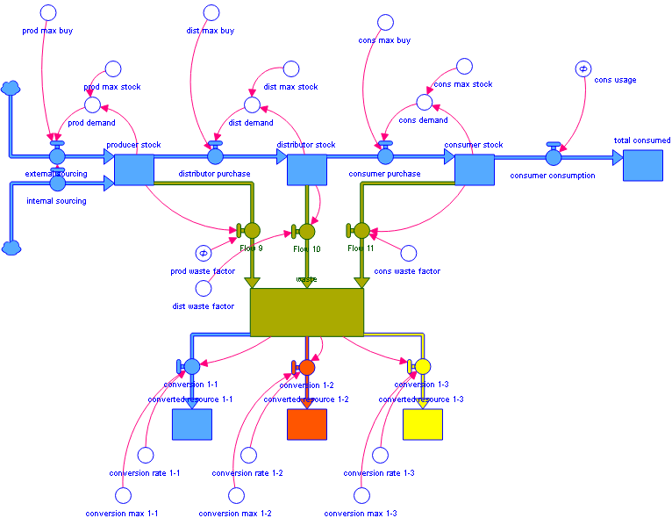

Slide 12
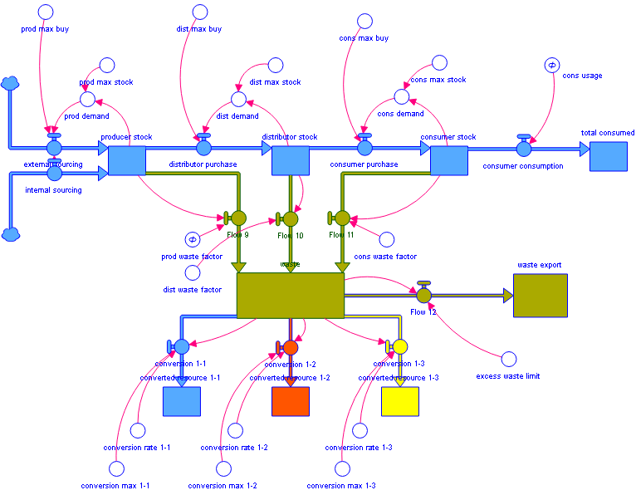

Slide 13
