Slide 1
Macroeconomic benefits: Food waste in the FEW nexus of the Bristol ULL
Taoyuan Wei
First International Conference of the Waste Few ULL Project
University of Bath, 12 October 2018

Slide 2
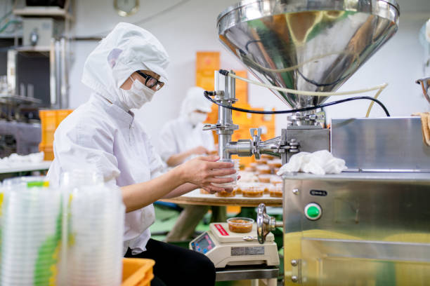
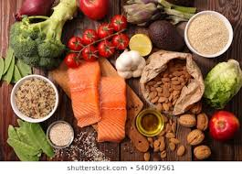
Benefits of food waste reduction in UK: Macro-level
Production
Food
Supply
Generate
Purchase
Generate
Flows to
Households
Income
Sources: Pictures are copied from the internet for illustration.

Slide 3
Benefits of food waste reduction: Macro-level
Production
Food
Supply
Generate
Purchase
?
Generate
Flows to
Households
Income
Sources: Pictures are copied from the internet for illustration.

Slide 4
Benefits of food waste reduction: Macro-level The example of UK households
In 2012, the wasted food ( or editable part of food waste) costs £12.5 bn, accounting for 14% of total spending on food and drinks by households of £92 bn according to the Family Food datasets (WRAP, 2013, p. 60).
The wasted food costs were adjusted upward as £14 bn for 2012 according to WRAP (2018), meaning the share in total spending becomes 15.2%.
The WRAP has set a target to reduce wasted food by 20% in 2025 compared to the 2015 level (WRAP, 2019). If we assume the households follow the reduction target, then the reduced share in total spending of households would be 15.2%*20%= 3.04%.

Slide 5
Benefits of food waste reduction: Macro-level The example of UK households
Total expenditure of households on food amounts to £33.4 bn (IOT2015, ONS2018): products of agriculture (01), fish (03), and produced food (10) and drinks (11) by households.
The 3.04% reduction of food expenditure is equivalent to £1001 million, which is the maximum savings of income.
This income savings correspond to domestic income (value added or sectoral GDP) of £756 million and imported goods of £245 million (based on IOT2015)
If the reduced income from production activities is considered, then the income savings could be as low as £245 million, which can be for other consumptions
So far, not consider: Social and environmental values; Costs to implement the reduction of wasted foods.

Slide 6
Question to discuss: How to combine with the Bristol ULL?

Slide 7
Taoyuan Wei
taoyuan.wei@cicero.uio.no

