Slide 1
Food – Energy – Water Nexus Governance Project
São Paulo in Natura Lab
“OUR LABORATORY IS THE NATURE”
Coordination - Prof. Dr Ester Dal Poz
Renato L. Noronha (PhD student)/ Prof. Dr Bárbara Teruel (Advisor)
University of Campinas
Brazil

Slide 2
Campinas, 7 April 2021

Slide 3
MODELING TOOL FOR WATER RESOURCE QUALITY MONITORING
Renato López Noronha
Engineer in renewable natural resources.
Master in water and soil.
PhD student in agricultural engineering.
Campinas, 7 April 2021

Slide 4
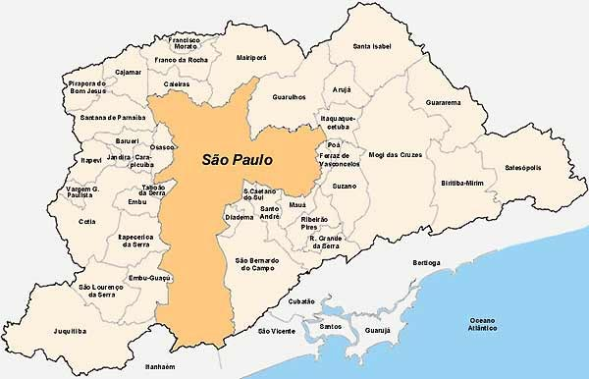
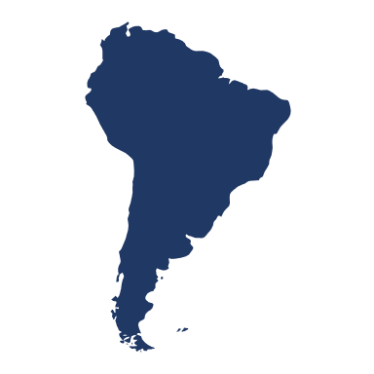
OUR REALITY
METROPOLITAN REGION SÃO PAULO - RMSP
Municipalities: 39
GDP Brazil: 19%
Area: 7 946,84 km²
Population: 21,9 M
Reference: IBOPE, 2020.

Slide 5
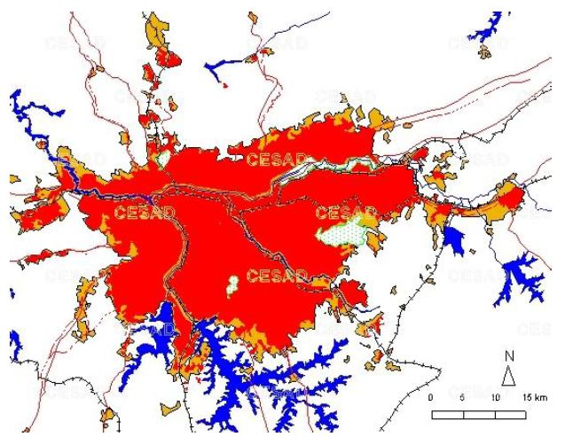
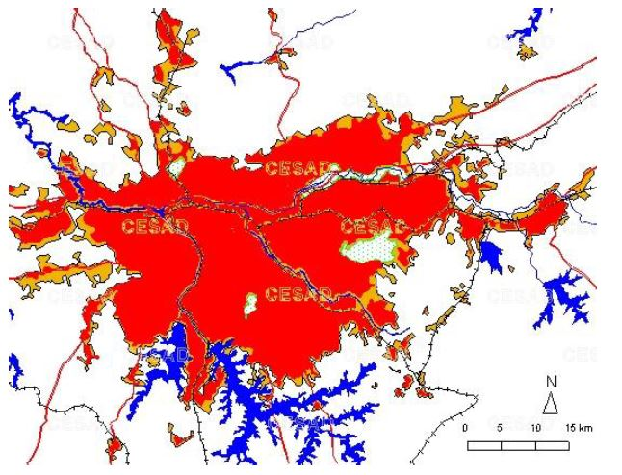
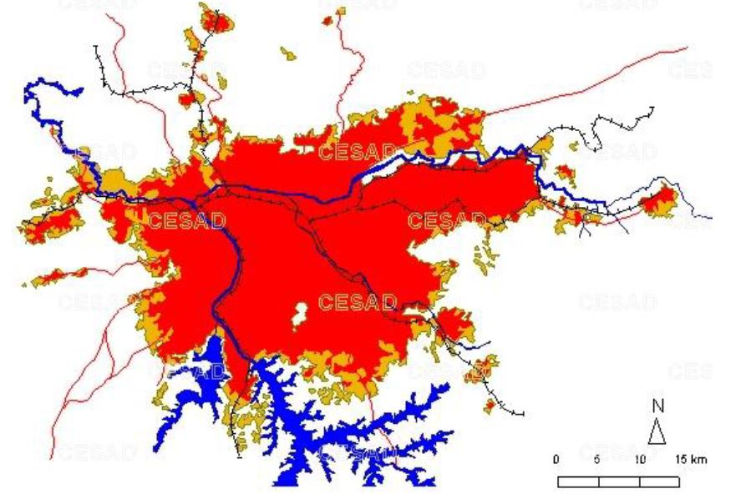
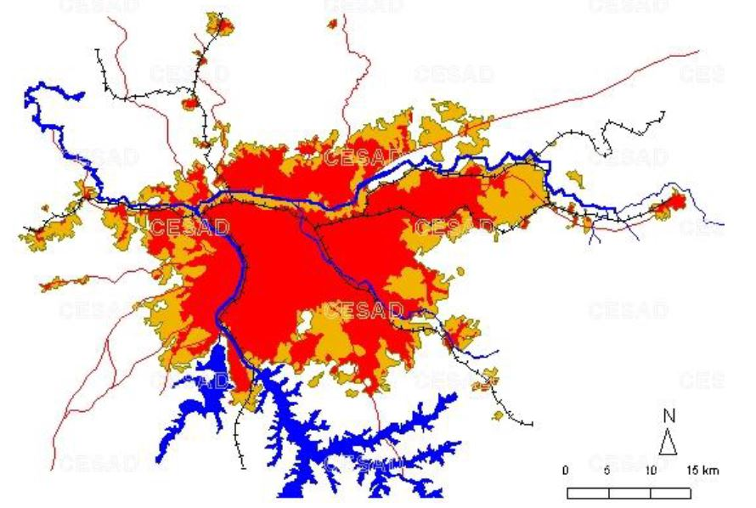
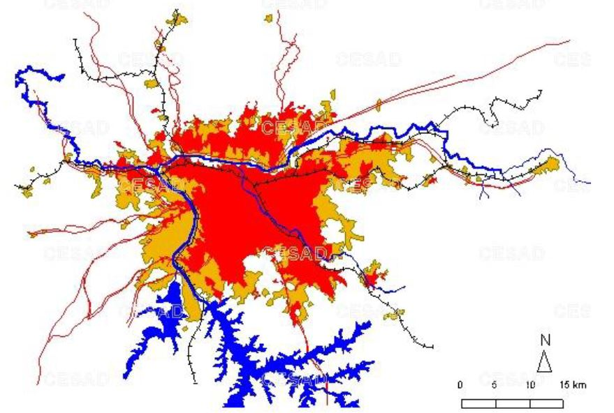
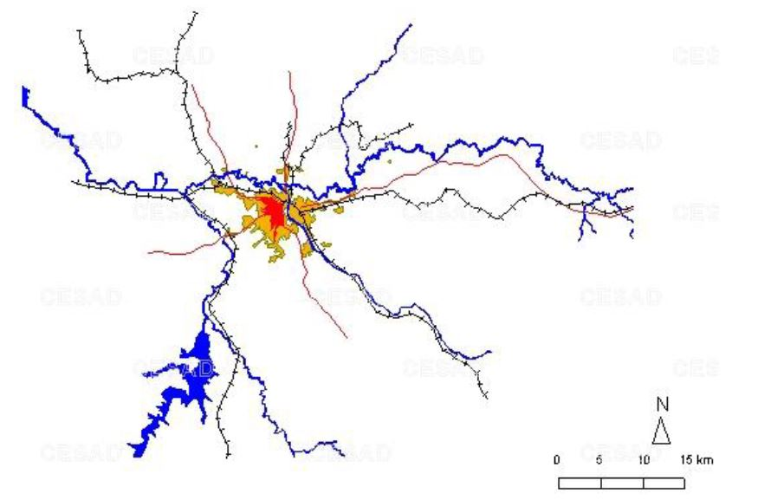
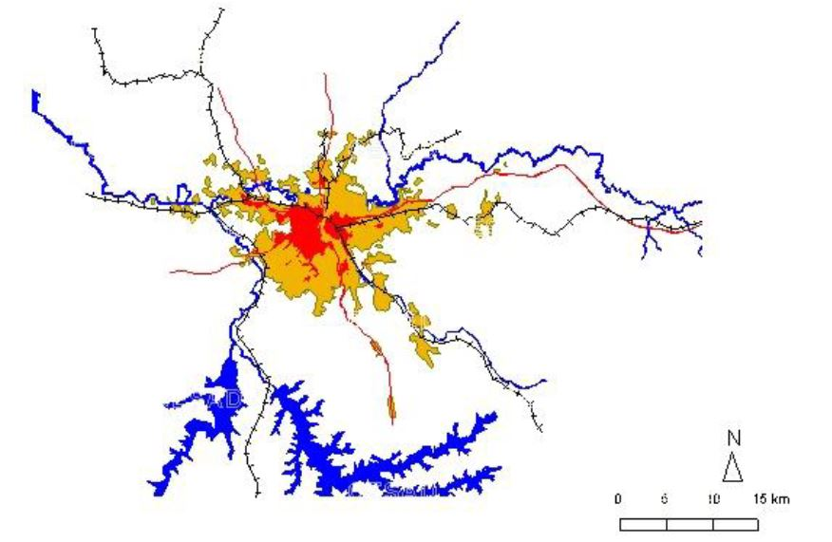
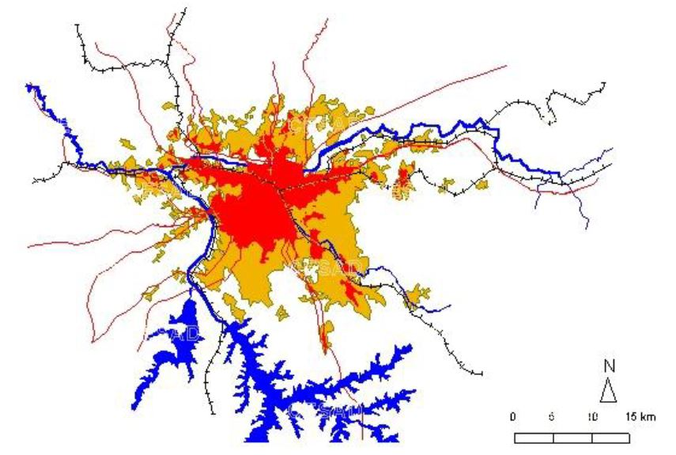
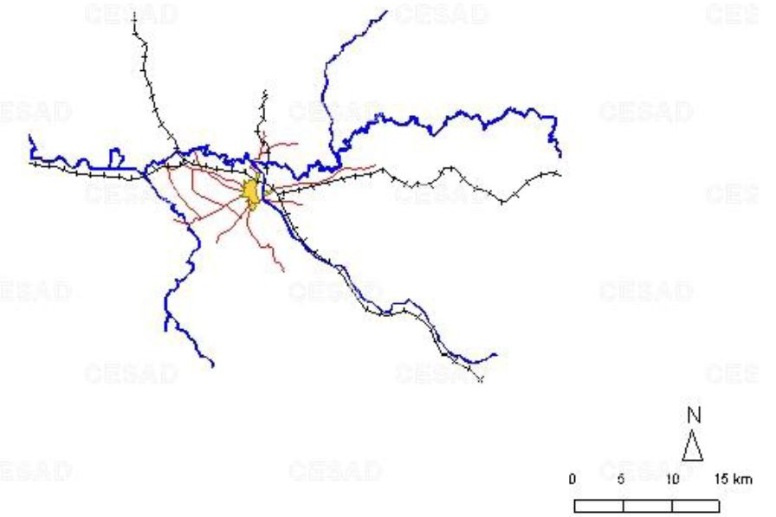
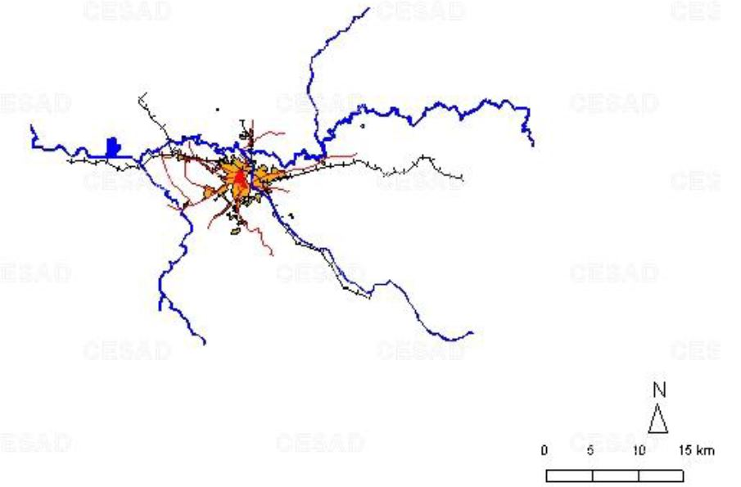
WHAT'S THE PROBLEM?
DEVELOPMENT
RMSP
> Food demand.
1890 - 2011
Population growth.
Industrialization.
> Fertilizer demand
Agriculture.
Water quality
Climate changes.

Slide 6
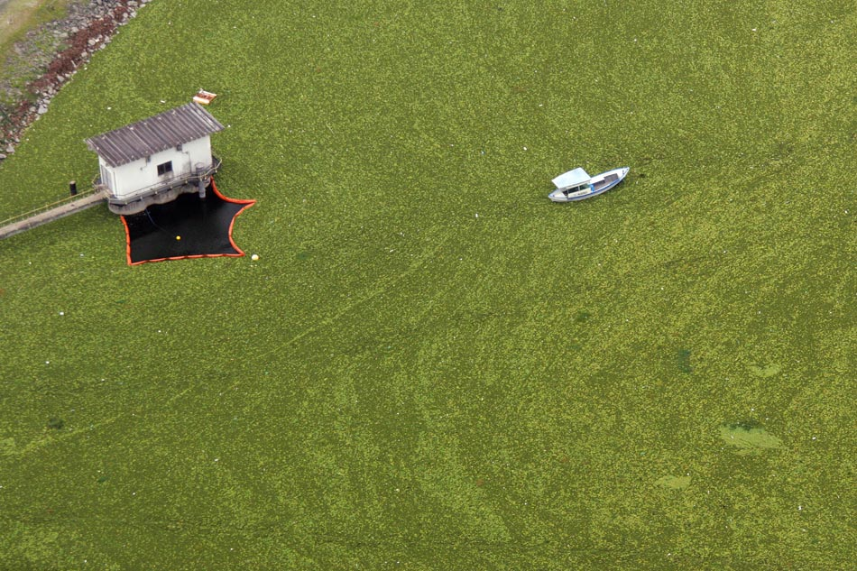
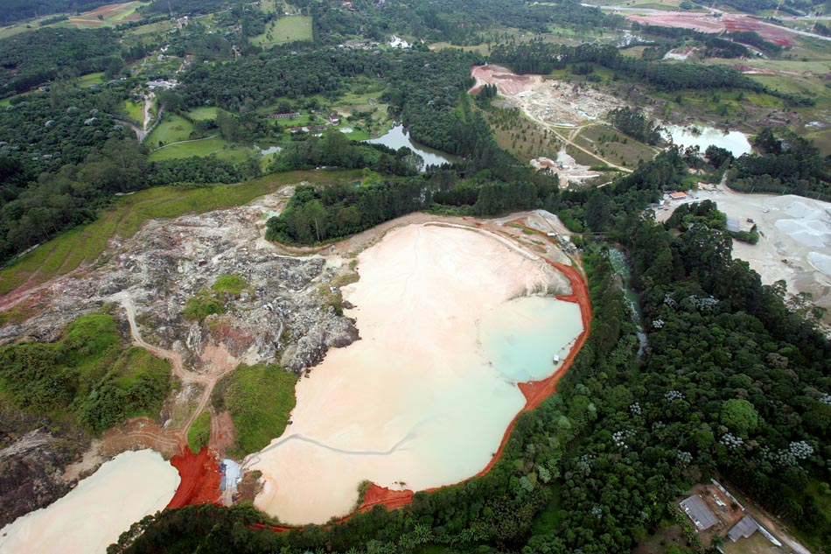
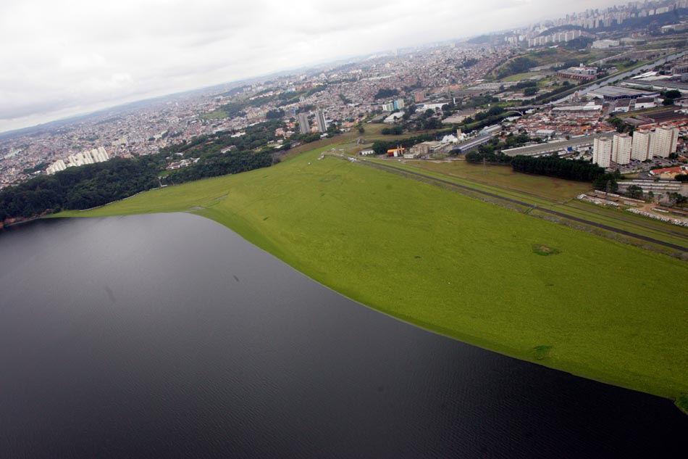
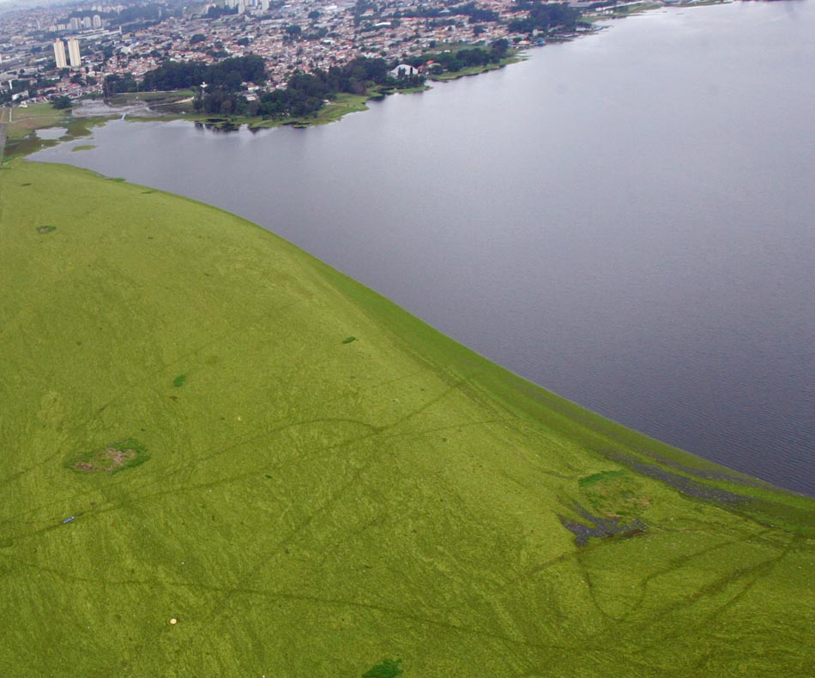
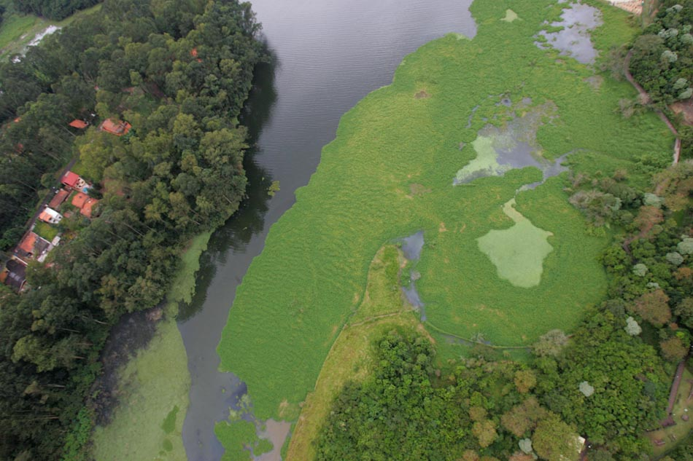
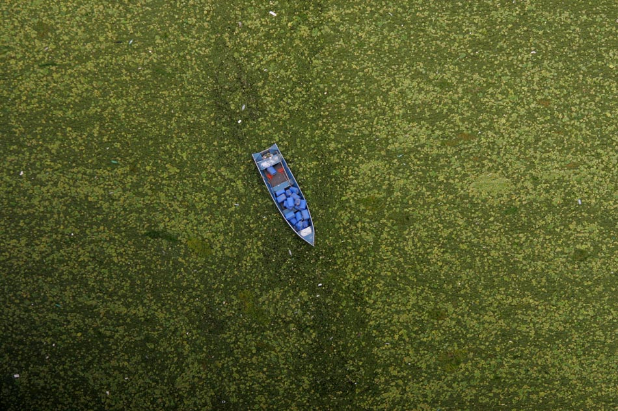
THIS IS THE PROBLEM
EUTROPHICATION
N
P

Slide 7
WHERE IS THE PROBLEM?
Guarapiranga Reservoir
Area: 33,91 km².
Capacity: 171 000 000 m³.
Supply: 5,8 M people.
Managed: SABESP

Slide 8
PROJECT GOAL
MODELING TOOL FOR WATER RESOURCE QUALITY MONITORING
Development a water quality management model, based on system dynamics modeling, using the Guarapiranga reservoir - São Paulo - Brazil as a case study.

Slide 9
APPROACH – STRUCTURE
CHARACTERIZATION
MODELING
MODEL RESOLUTION
Literature research.
Definition of the system to be studied.
System behavior.
System structure.
Simulation.
Validation.
Proposal for decisions.
Adapted from Beiler et al. (2020). Reverse logistics system analysis of a Brazilian beverage company: An exploratory study. Journal of Cleaner Production, 274, 122624.

Slide 10
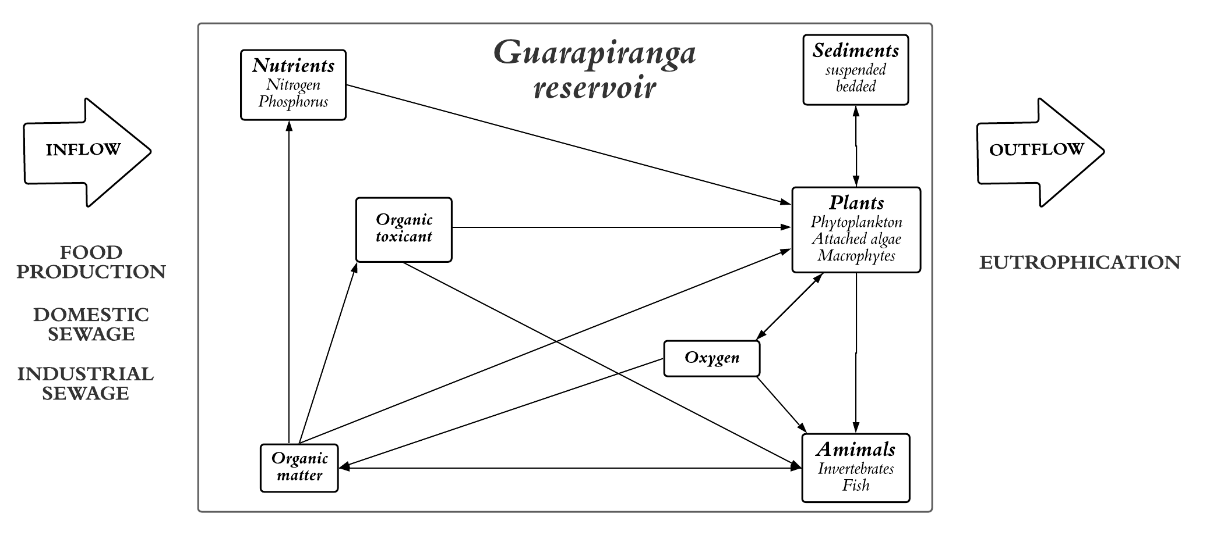
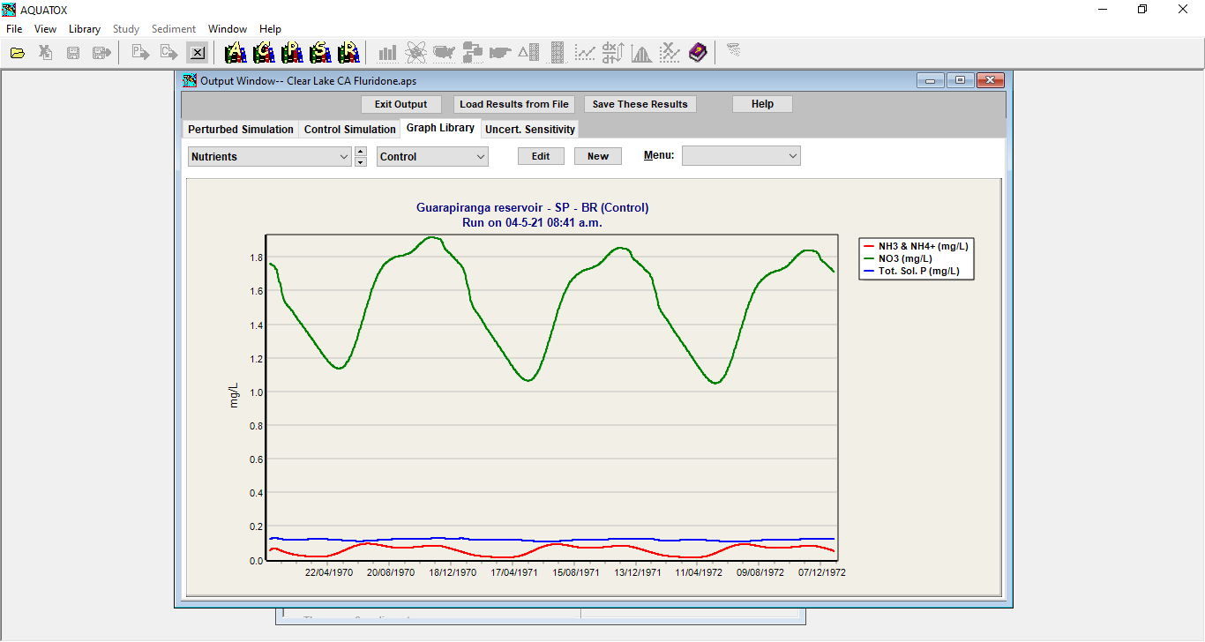
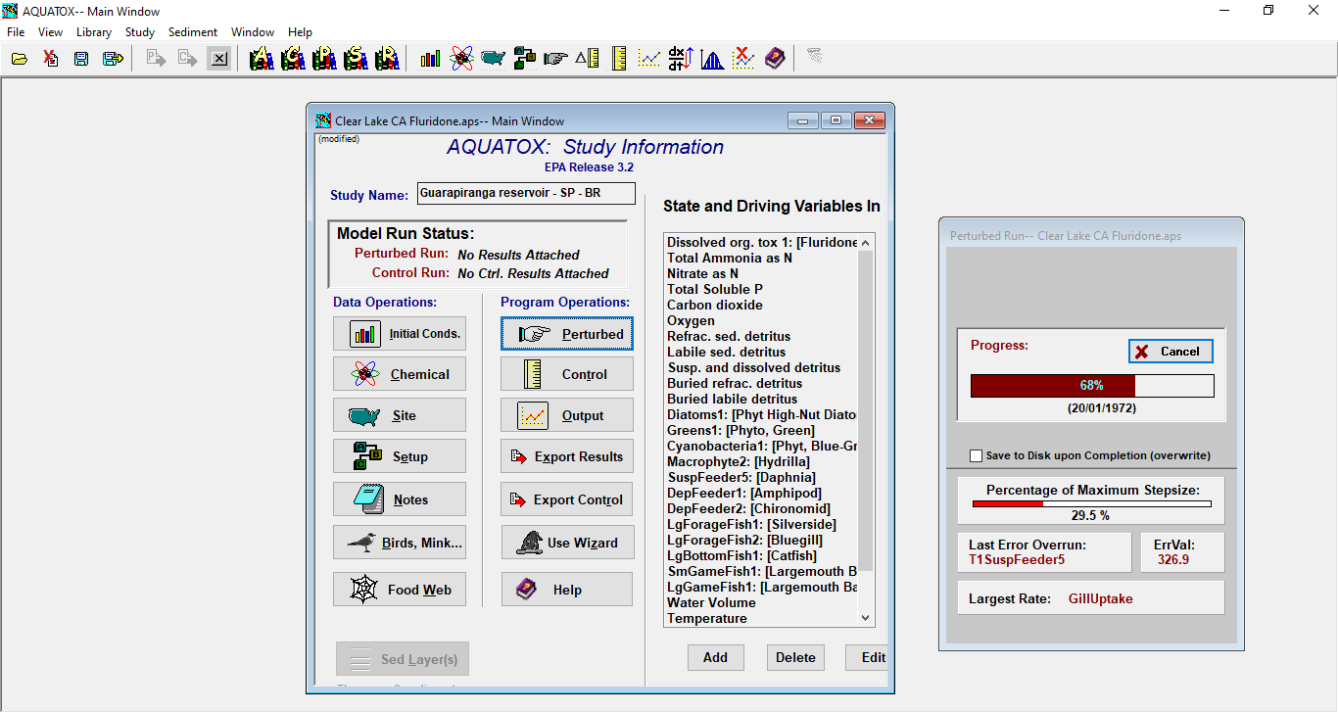
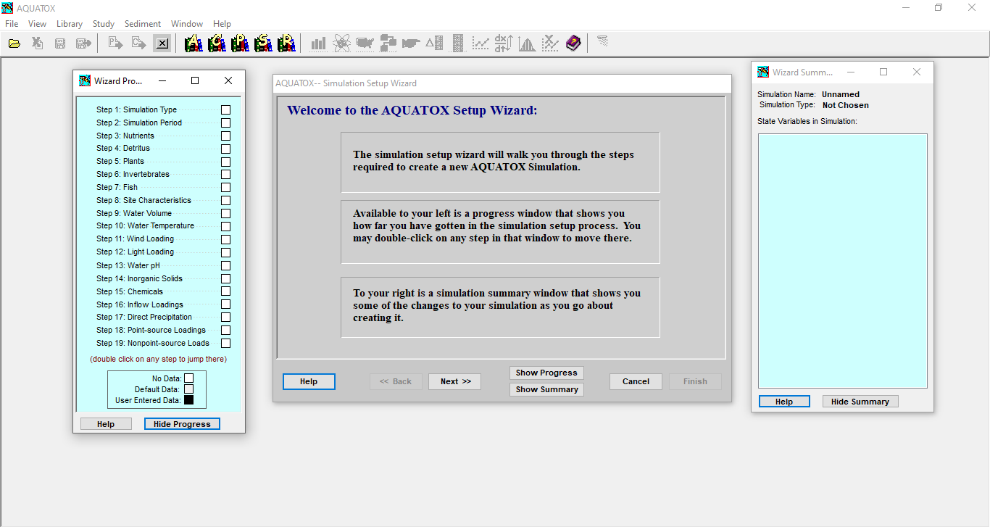
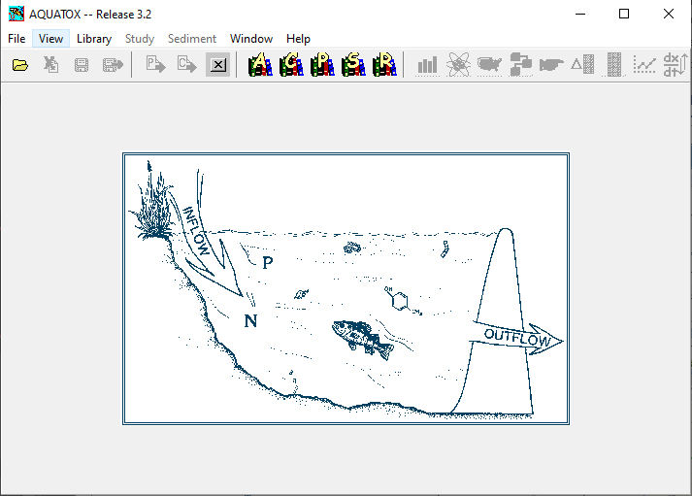
APPROACH – FLUXOGRAM
https://www.epa.gov/ceam/aquatox-basic-information.

Slide 11
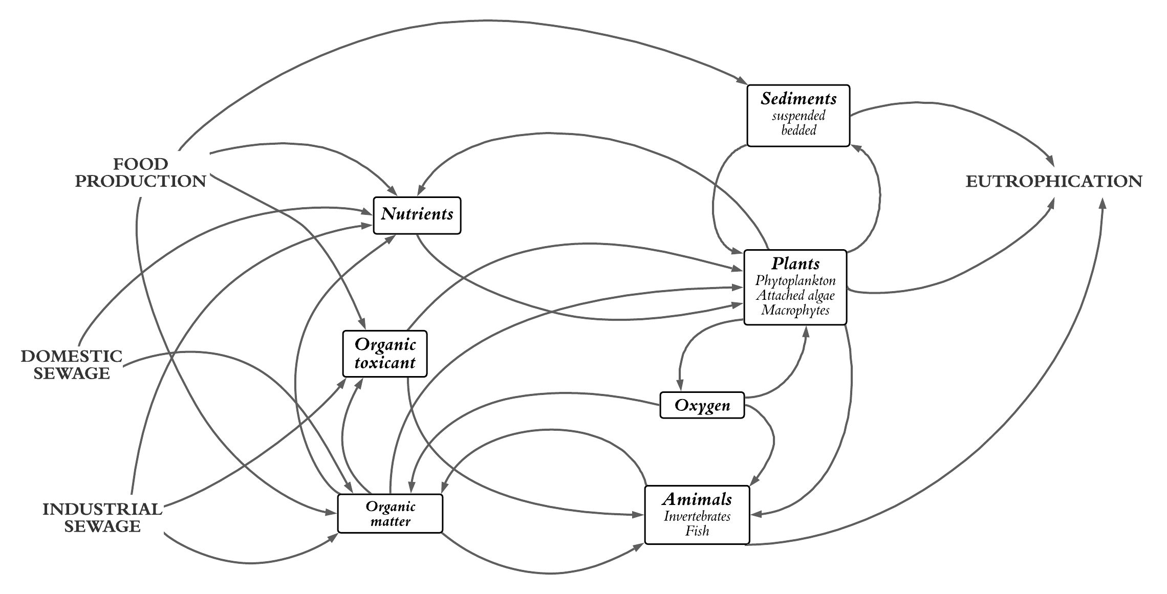
APPROACH – CAUSAL LOOP

Slide 12
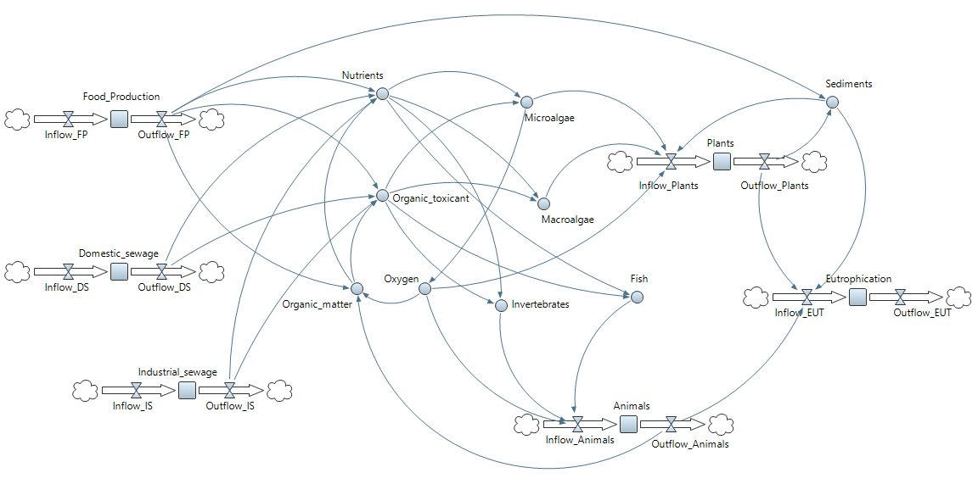
RESULTS – SYSTEM DYNAMICS

Slide 13
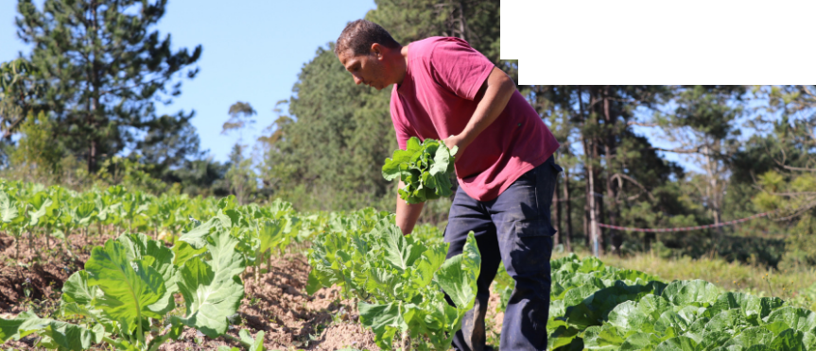
EXPECTED CONTRIBUTIONS
Provide a ROBUST SUPPORT TOOL FOR DECISION-MAKERS.

Slide 14
CONTACT INFO
Renato López Noronha
PhD Student - Agricultural Engineering
School of Agricultural Engineering – FEAGRI
University of Campinas – UNICAMP – Brazil
r190329@dac.unicamp.br
Thank you!

