Slide 1
Progress on Cape Town’s ULL: Water Hub
Photos – telling the story
Next steps
Some gaps identified from FEW nexus literature
References
May 2019

Slide 2
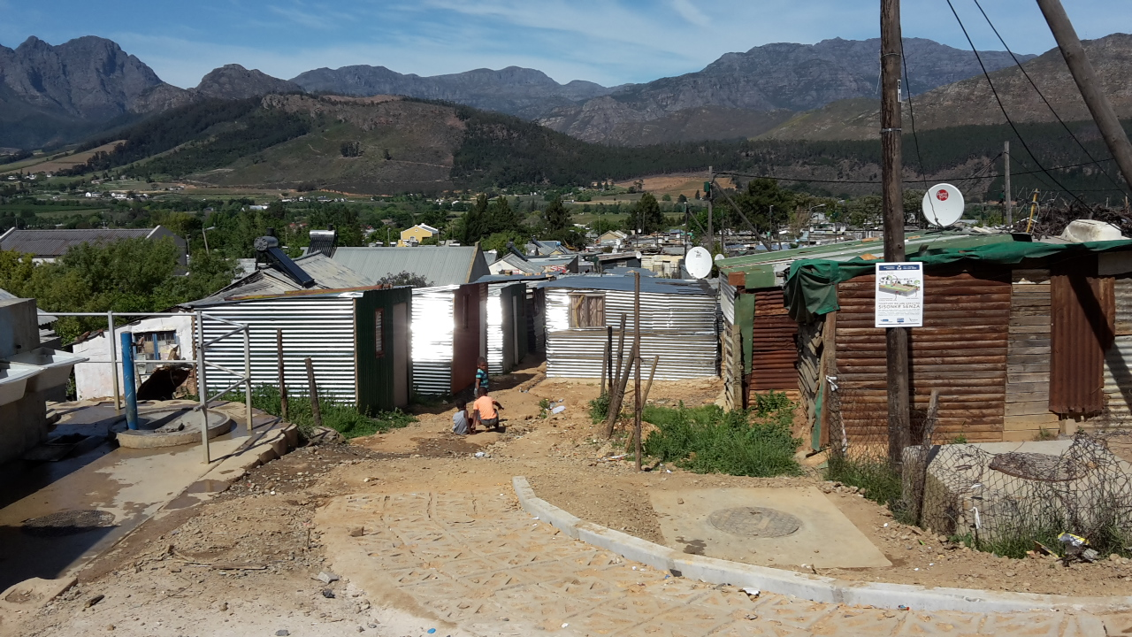

Slide 3
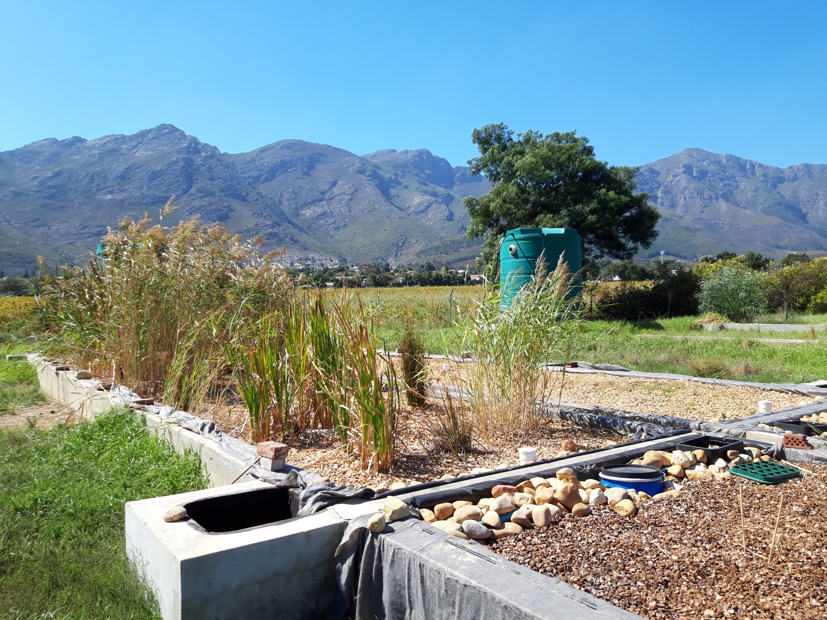

Slide 4
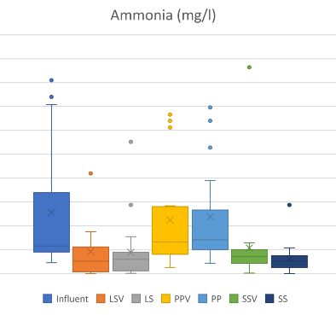
Reduction in Ammonia
Best cells
Input water

Slide 5
Selection of results from biofiter performance (12 month study)
Parameter | Results : influent vs effluent
E.Coli (Counts / 100 ml) cfu | Influent upper range 80 000 -120 000 to <8
Orthophosphate PO₄⁻³ mg/L | Influent upper range 4.5 to 6.5 to <0.8
Ammonia-Nitrogen NH₃-N mg/L | Influent upper range between 30 to 40 to <1.2

Slide 6
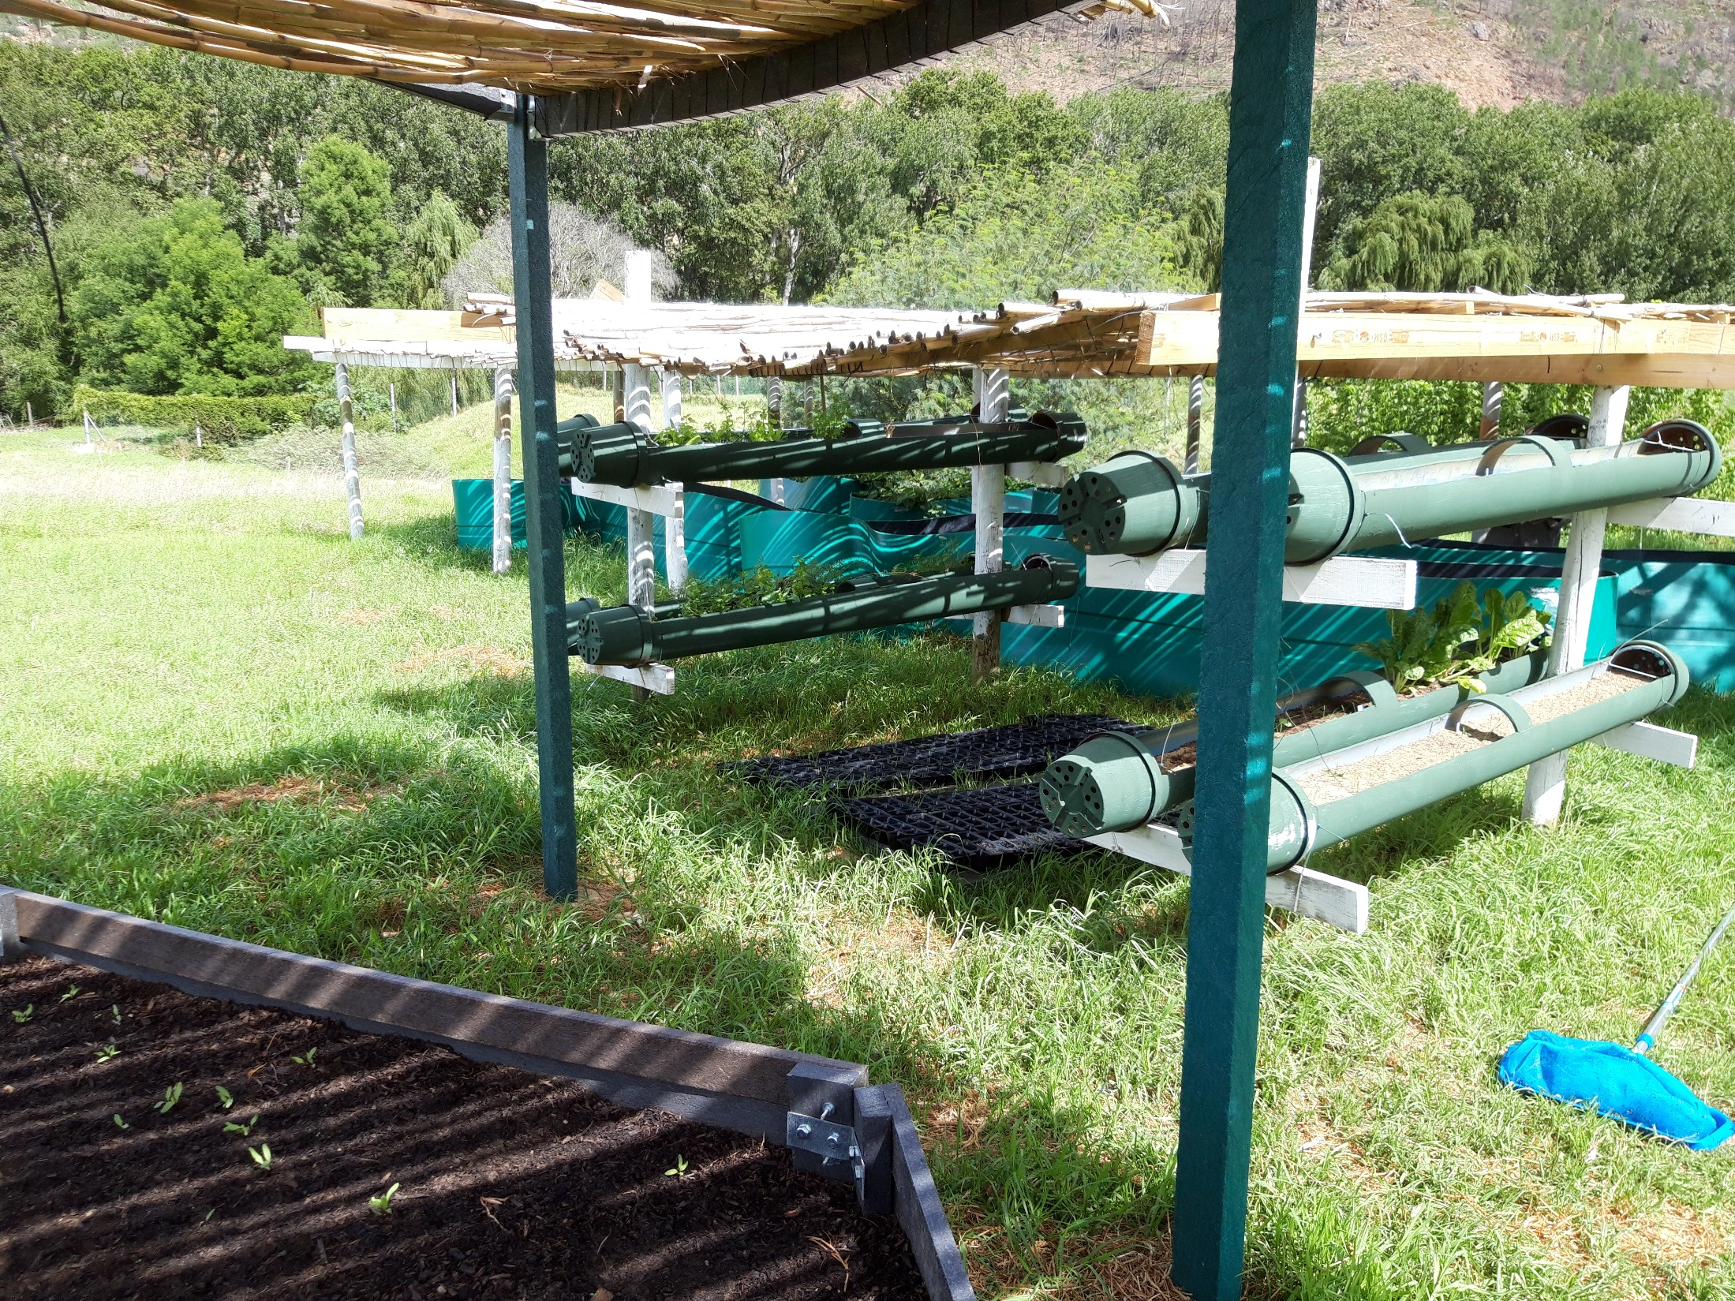

Slide 7
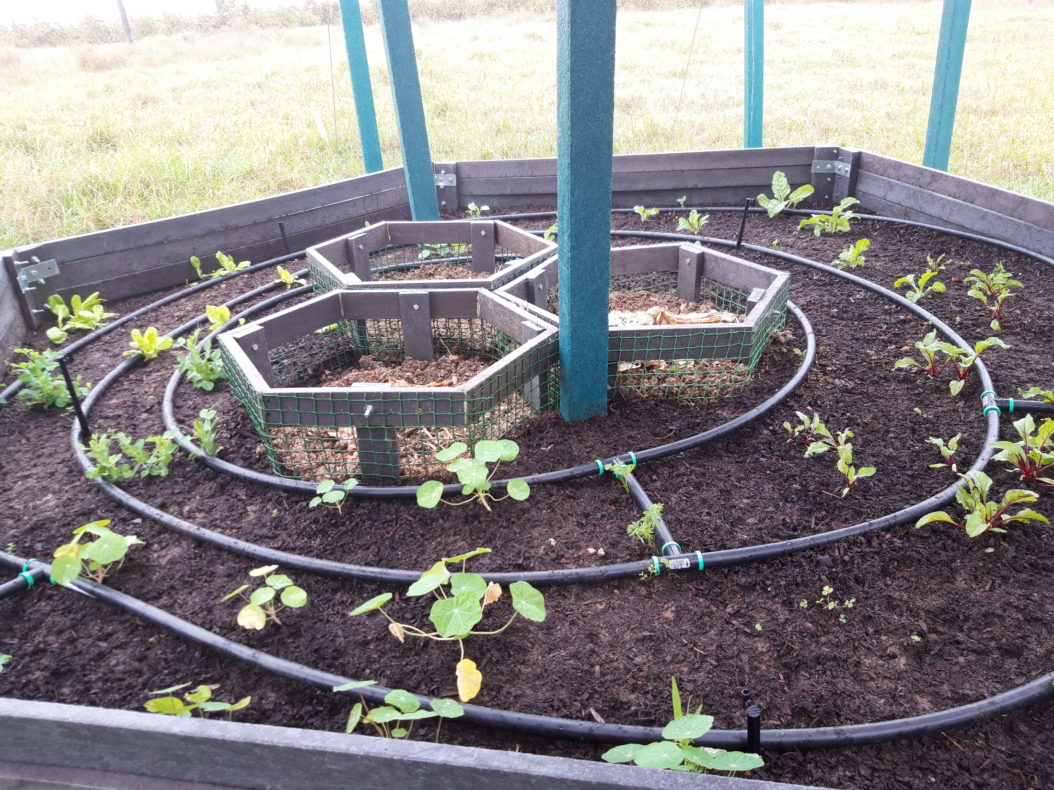

Slide 8
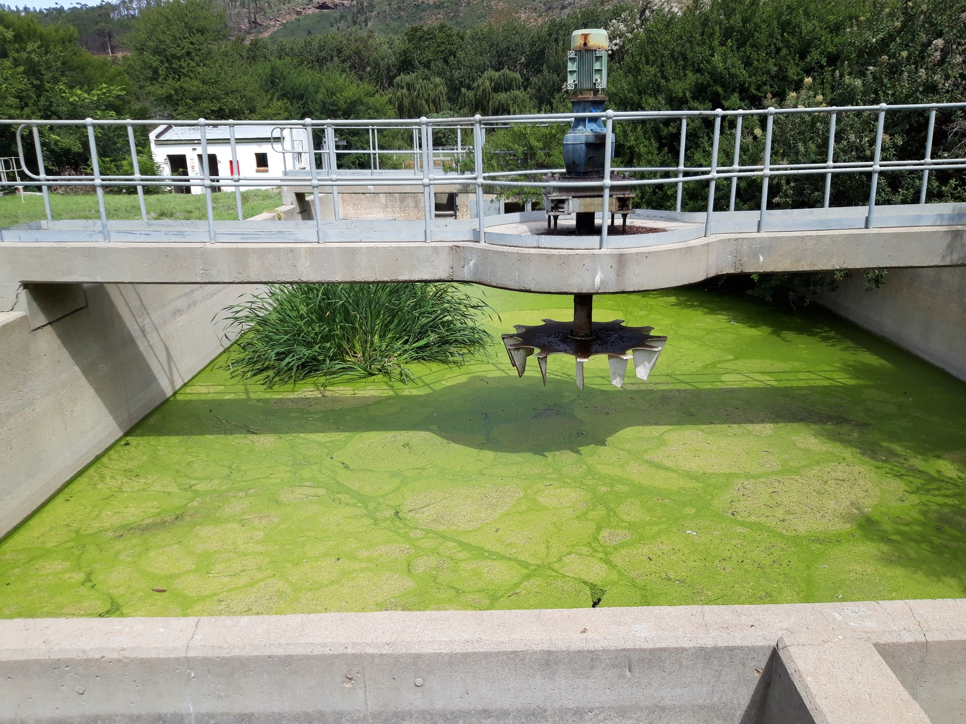

Slide 9
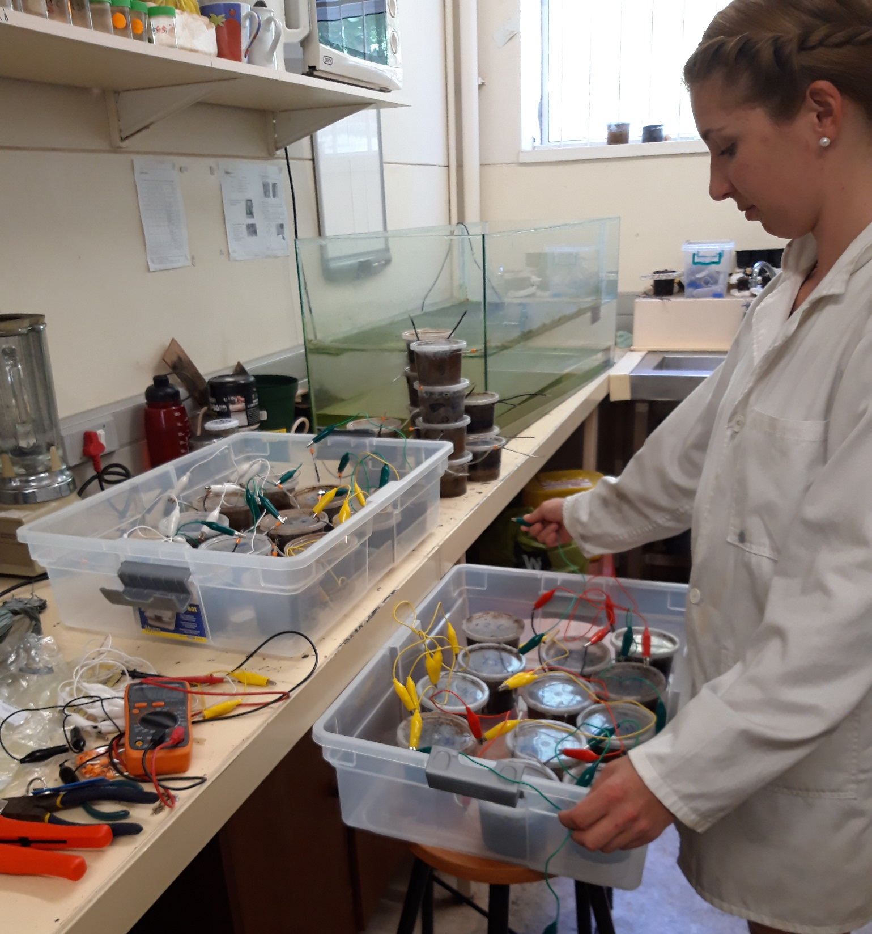

Slide 10
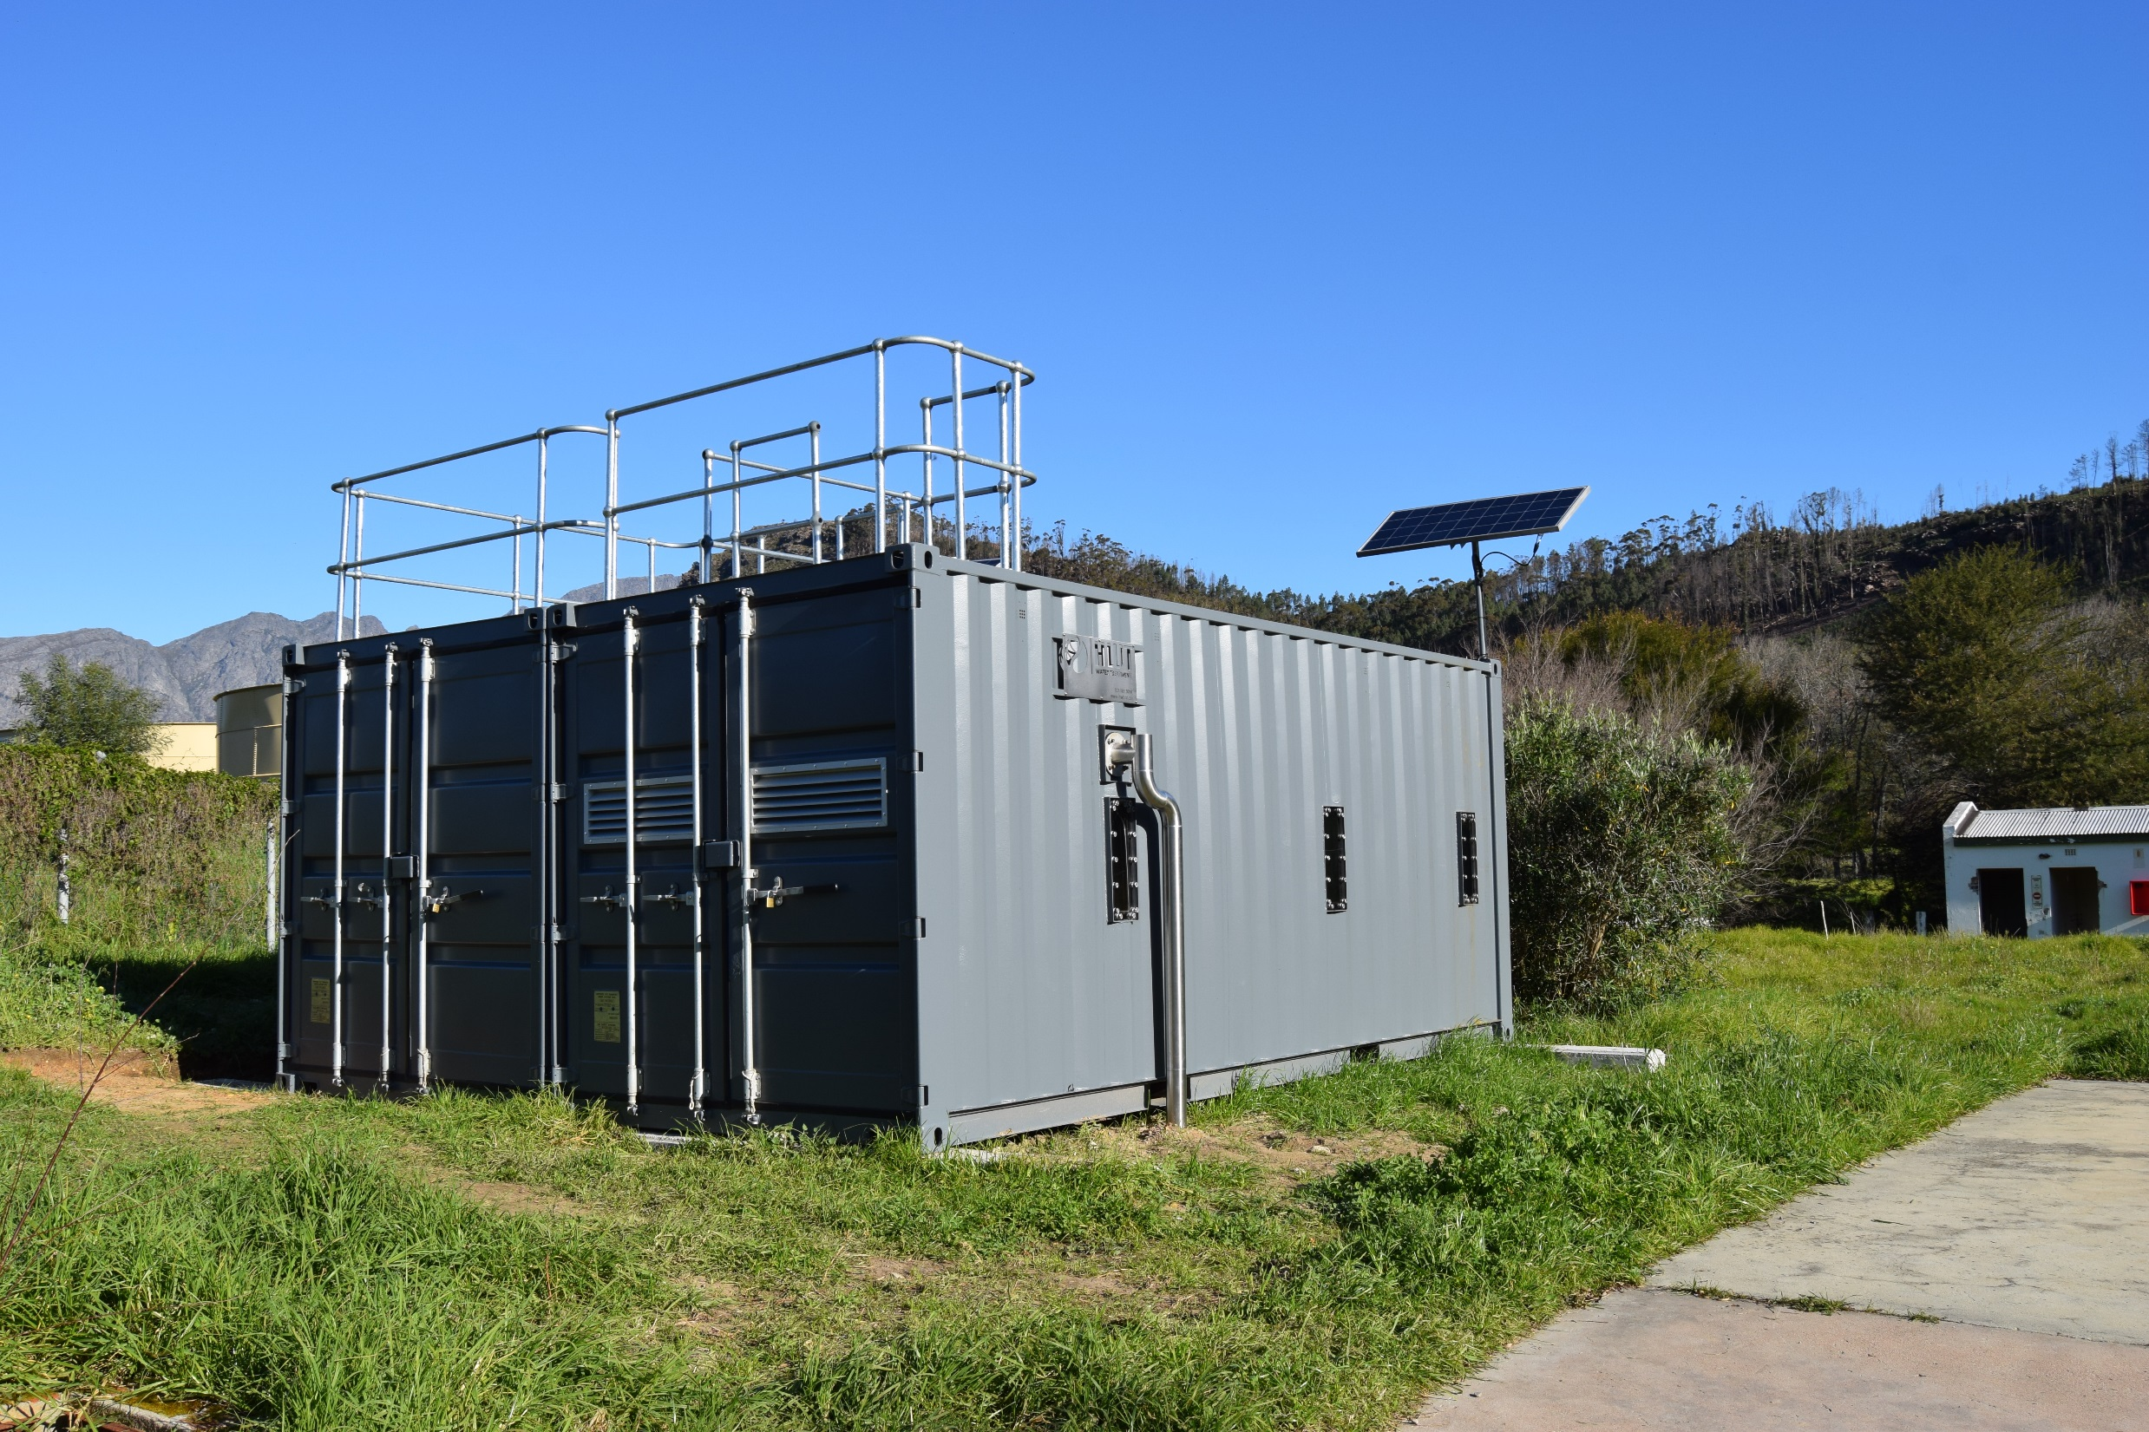

Slide 11
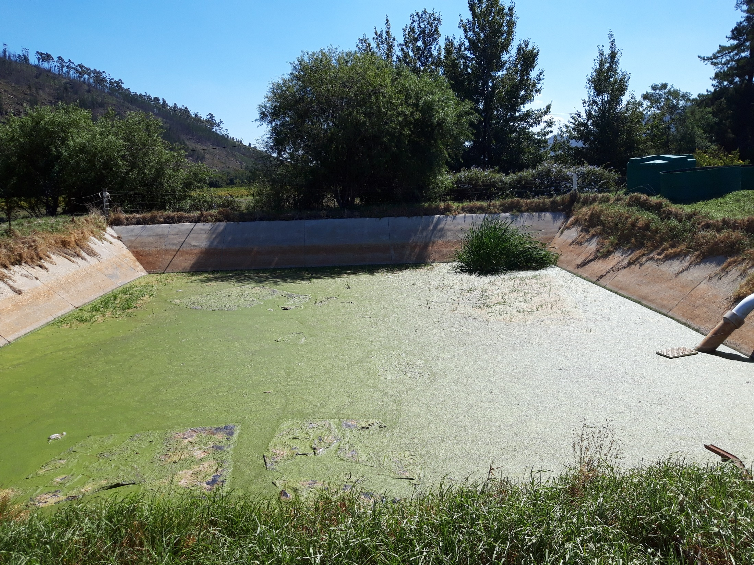

Slide 12
Next steps and longer term
Seek funding for the South African project
Complete demonstration permaculture, hydroponics and aquaponics gardens
Determine health risks of outputs
Enlist interest and commitment from local resident: urban poor living in adjacent informal settlement: collaborate and reach agreement on forms of business model
Training for participants in business enterprise
Map current nexus flows
Build stakeholder interest from local town, businesses and tourism industry, municipality and local farmers
Establish co-operation for local market produce
Develop appropriate analytical tool(s) to assess the FEW nexus and evaluate changing flows
Draft policy for local municipality and includes FEW in SDGs 2, 6 and 7.

Slide 13
Selected of gaps in FEW: identified from recent literature #1
Limited consideration to multi-scalar interactions
Issues of institutional structure, governance, equity resource access and behaviour underdeveloped
Quantification of FEW flows of urban metabolism in isolation rather than a nexus
Political and socio-economic factors shaping flows tend to be ignored
Lack of integration of heterogeneous models and approaches
Limited understanding of linkages between urban consumption and transboundary flows
Role of actors and institutions in shaping resource access, distribution, use and fair trade
Limited case study material in co-production of knowledge with stakeholders
Practices and outcome resulting from interdisciplinary and transdisciplinary collaboration
Role of how informal networks of actors manage FEW resources
Nexus methods fall short of capturing interactions among water, energy and food
Assessment favour a quantitative approach – limited social science methods
Nexus remains largely conceptual: analytical tools are limited
Key features of analytical approach that need attention: innovation; influence of context; collaboration; and implementation

Slide 14
Selected gaps in FEW: identified from recent literature #2
Three governance gaps:
conditions for cross-sector co-ordination and collaboration
Dynamics that influence the nexus beyond cross-sector interactions
Political and cognitive factors as determinants of policy change
Clarity on overarching objectives and guiding principles of nexus concept
Clarity on how policy coherence could be achieved through different pathways and different outcomes for different stakeholders
Need to develop a unifying framework of nexus research to share solution-oriented common goals
Limited application of local to global connected nexus systems
In South Africa a need for:
an integrated model, metrics and indices to assess the nexus
translation of existing knowledge to inform policies for integrated sustainable resource management
participatory research aimed at demonstrating the applicability of the WEF nexus at the local level

Slide 15
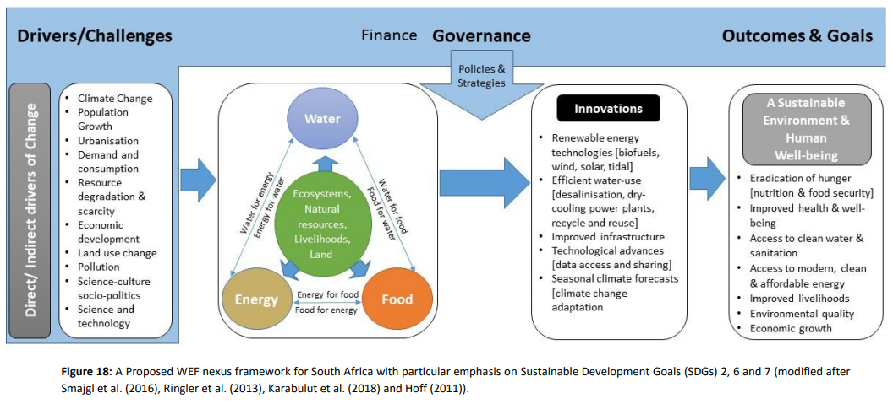

Slide 16
References
A 40-Year Review of Food-Energy-Water Nexus Literature with a Focus on the Urban
Joshua P. Newell, Benjamin Goldstein, and Alec Foster https://iopscience.iop.org/article/10.1088/1748-9326/ab0767
The Water-Energy-Food Nexus: A systematic review of methods for nexus assessment
Tamee R Albrecht, Arica Crootof and Christopher A Scott https://iopscience.iop.org/article/10.1088/1748-9326/aaa9c6
Methods of the Water-Energy-Food Nexus
Aiko Endo, Kimberly Burnett, Pedcris M. Orencio, Terukazu Kumazawa, https://www.mdpi.com/2073-4441/7/10/5806
Present and future of the water-energy-food nexus and the role of the community of practice
Rabi H. Mohtar & Richard Lawford J Environ Stud Sci (2016) 6:192–199
https://link.springer.com/article/10.1007/s13412-016-0378-5
Closing the governance gaps in the water-energy-food nexus: Insights from integrative governance
Nina Weitz, Claudia Strambo, Eric Kemp-Benedict, Måns Nilsson Global Environmental Change 45 (2017) 165–173 https://www.sciencedirect.com/science/article/pii/S0959378017300031
A review of the current state of research on the water, energy, and food nexus Aiko Endo, Izumi Tsurita, Kimberly Burnett, Pedcris M. Orencio Journal of Hydrology: Regional Studies 11 (2017) 20–30 https://www.sciencedirect.com/science/article/pii/S2214581815001251
T Mabhaudhi, G Simpson, J Badenhorst, M Mohammed, T Motongera, A Senzanje and A Jewitt 2018 Assessing the State of the Water-Energy-Food (WEF) Nexus in South Africa WRC Report No KV 365/18 http://www.wrc.org.za/mdocs-posts/kv-365-18/kv-365-18-2/?sf_paged=18

