Slide 1
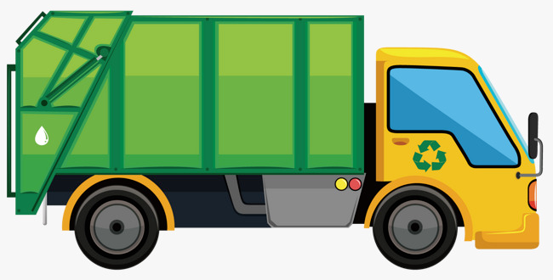
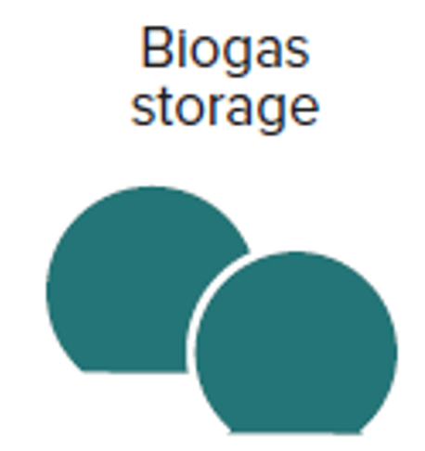
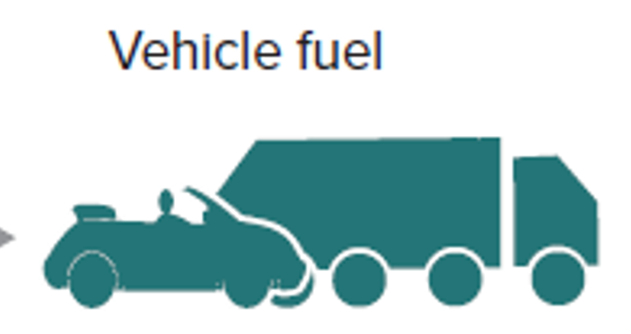
Bristol’s FEW ULL Waste Challenge
Non-market valuation suggests that reducing food waste is significantly more impactful (on GHGs, air pollution and eutrophication) than shifts in recycling
Modelling and testing realistic scenarios of plastic/contaminant removal from food waste and pre-sewage upstream?
Processors
Households
Farms
Modelling / testing energy optimisation (inc. external cost-benefit) from gas usage (e.g. storage/peak load vs transport)
Market Gardens?
Local employment?
Food Waste
Household collections (50%, not commercial) (inc. plastics), abattoirs
Sewage
Phosphates: diet (40%), food additives (29%), laundry (14%)
Recycled to bio-fertiliser
(low quality)
GENeco AD Plant
Cleaned to compost
(high quality)
Food waste
Solid sludge
Liquid sludge
Digestate
Plastics / contaminants
1/3 phosphorous - recovery viable
2/3 phosphorous - recovery unviable
Full CBA (inc. external costs/benefits) of plastic/contaminant removal from food waste and solid sludge?
Full CBA (inc. external costs/benefits) of phosphate recovery from liquid sludge?
XYZ
PROPOSED
XYZ
COMPLETED

Slide 2
Bristol’s FEW ULL Waste Challenge
CURRENT
Non-market valuation suggests that reducing food waste is significantly more impactful (on GHGs, air pollution and eutrophication) than shifts in recycling
Modelling and testing realistic scenarios of plastic/contaminant removal from food waste and pre-sewage upstream?
Processors
Households
Farms
Digestate recycled to land
Food Waste
Household collections (50%, not commercial) (inc. plastics), abattoirs
Sewage
Phosphates: diet (40%), food additives (29%), laundry (14%)
Market Gardens?
Local employment?
Bristol Water Recycling Centre
Modelling / testing energy optimisation (inc. external cost-benefit) from gas usage (e.g. storage/peak load vs transport)
Anaerobic digestion
9mg/l phosphorous
Food waste
4 mg/l phosphorous uptake in sludge
Digestate
Sewage treatment
Plastics / contaminants
Sewage sludge
Electricity generation
Biomethane to gas grid
Biomethane to vehicles
Biogas
Treated effluent
5mg/l phosphorous - recovery neither mandated by regulation nor economically viable in terms of end-product value
XYZ
PROPOSED
Full CBA (inc. external costs/benefits) of plastic/contaminant removal from food waste and solid sludge?
Full CBA (inc. external costs/benefits) of phosphate recovery from effluent and / or anaerobic digestion liquors
XYZ
COMPLETED

