Slide 1
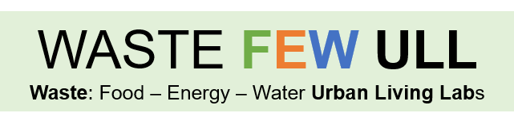
Knowledge Exchange
Adina Paytan
University of California Santa Cruz

Slide 2
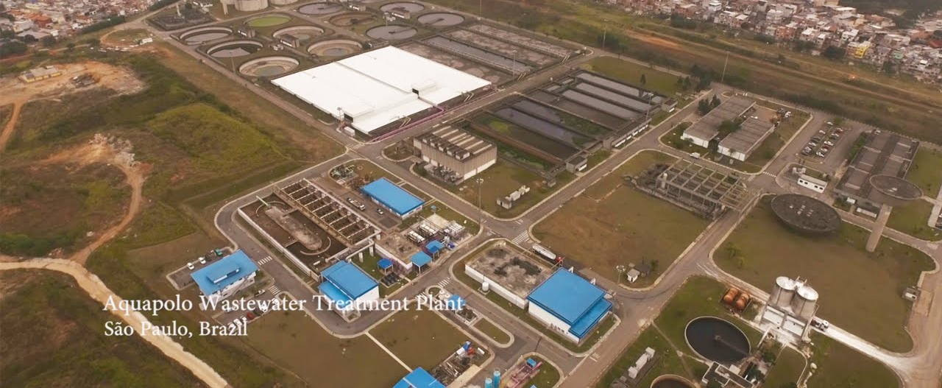
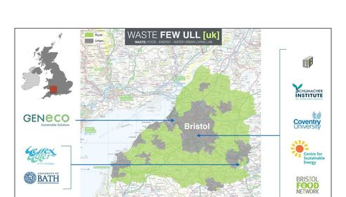
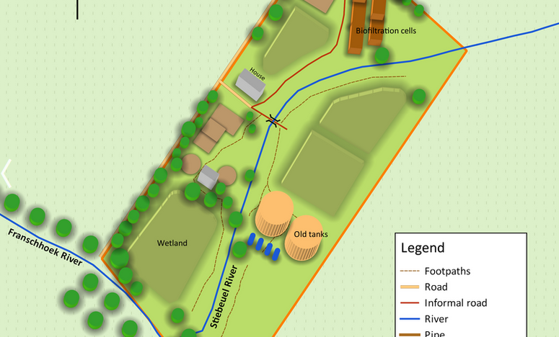
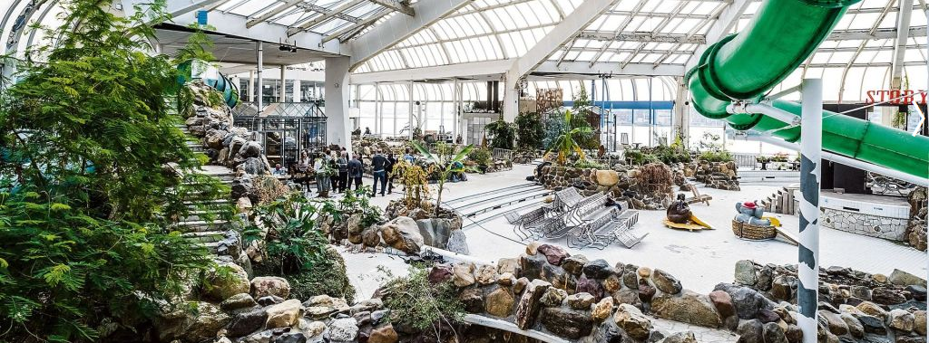

Slide 3


Slide 4

The whole is larger than the sum of its parts

Slide 5
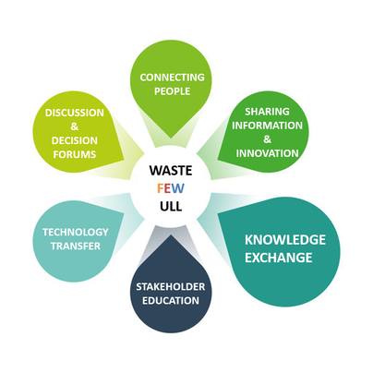

Slide 6
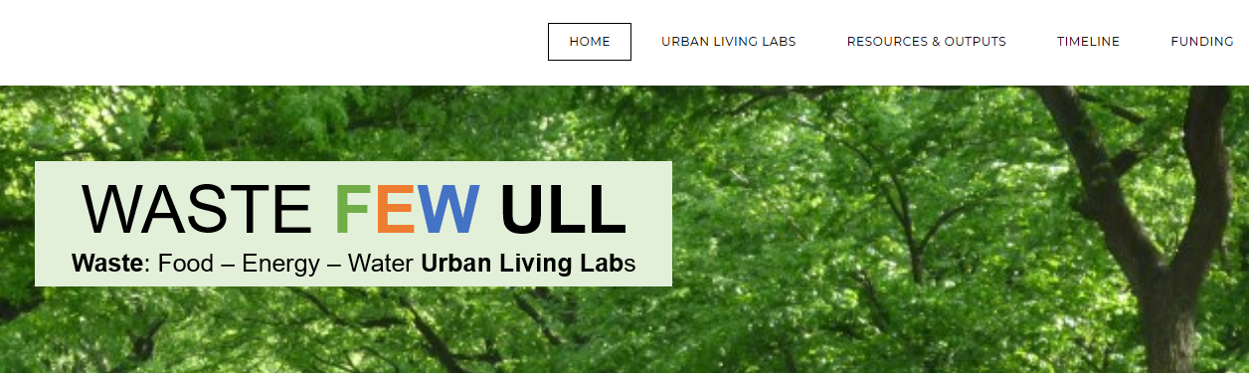

PLEASE CONTRIBUTE
Updates on work
Photos
Blogs and other media (tweeter..)
Education material
Other Materials (papers, reports)

Slide 7
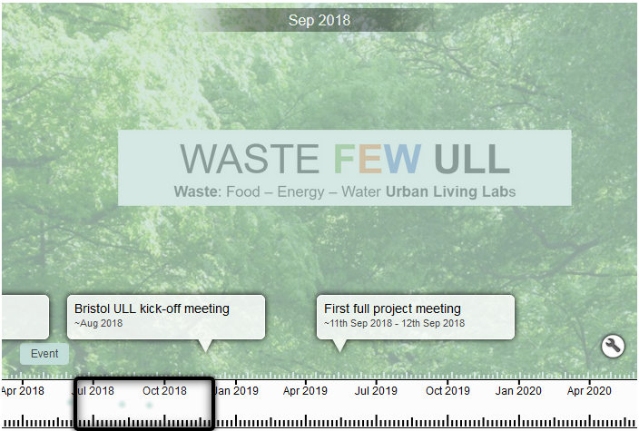
TIME LINE

Slide 8
CONFERENCES
Develop content based on partner strengths and program needs
Monthly web meetings for all leads
Two (possibly 3) all participants in person meetings
One in the UK one in South Africa – maybe one in the USA
Progress updates by groups
Methods practicum and application at all ULLs
Case studies to bring together theory and practice
Discussion of best strategies
Plans for integration through joint publications

Slide 9
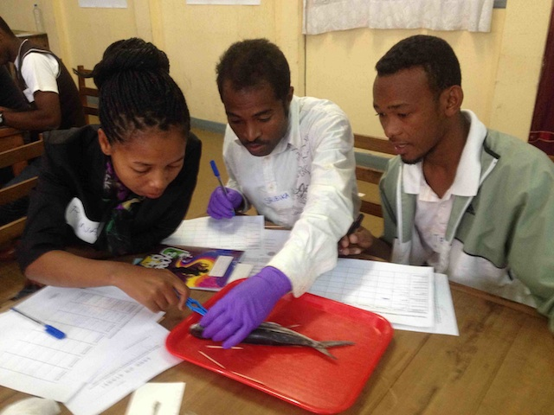
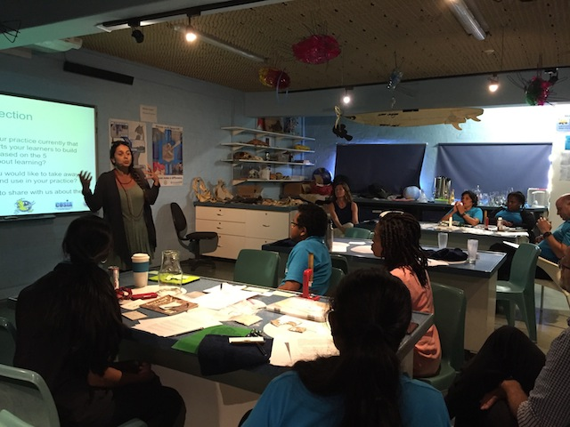
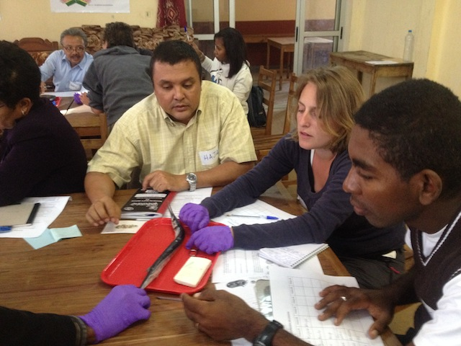
SPECIFIC ULL NEEDS
Individual partner needs tailored to specific stakeholders
Printed materials
Presentations
Public education and outreach
Citizen Science
Visitor Centers, Open House

Slide 10
EXAMPLES
Cape Town ULL (water hub)
Effective education workshop for teachers in the settlement school or Water Hub staff on effective teaching on water resources and water pollution including hands on activity kits (water quality kits).
Citizen Science?
For Blue City - Open house visitors center hand on activities, Workshops for center staff on presenting activities
Involving MS students in K-12 outreach

Slide 11
STUDENTS (EDUCATION)
Hopefully (pending funding)
Funding to support USA students to visit the ULLS for 2 months likely in the summers.
Funding students from ULL’s to come to UCSC if useful for the project to interact with faculty (specifically from the advisory board – agro center, water security, energy, life cycle analysis)

Slide 12
Synthesis papers
comparison of approaches
economic modeling
EXAMPLES

Slide 13
YOUR IDEAS - SUGGESTIONS
What would you like to add?

