Slide 1
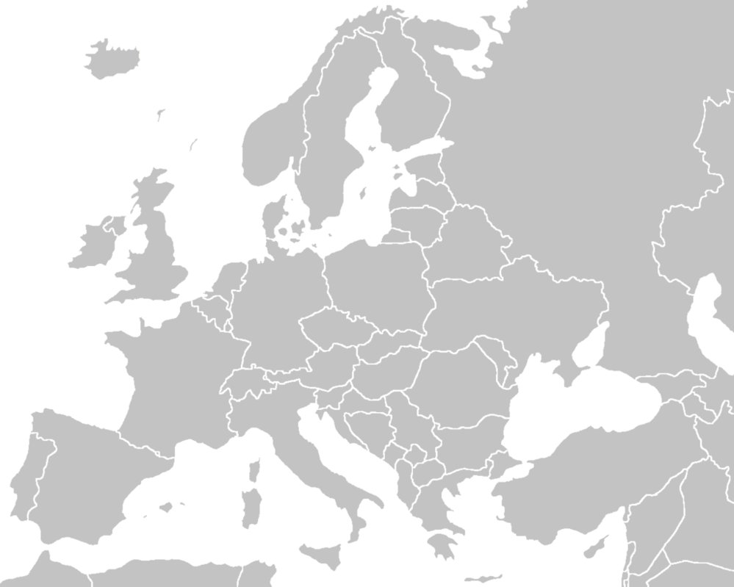
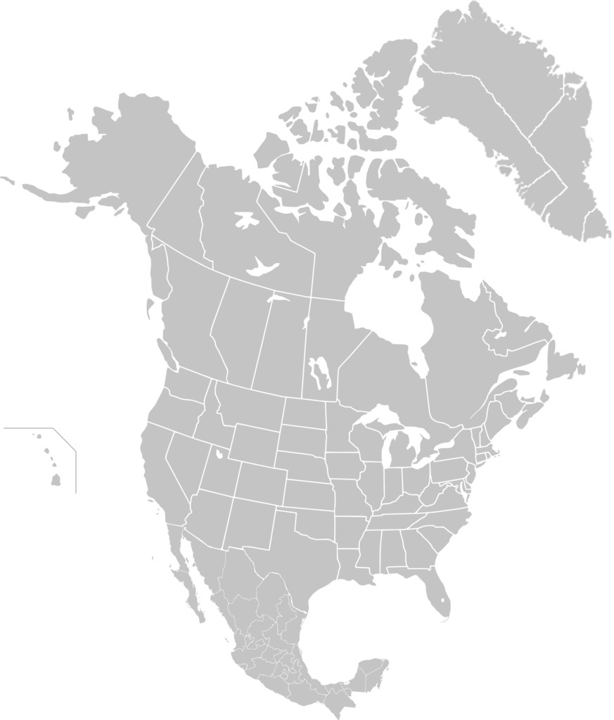
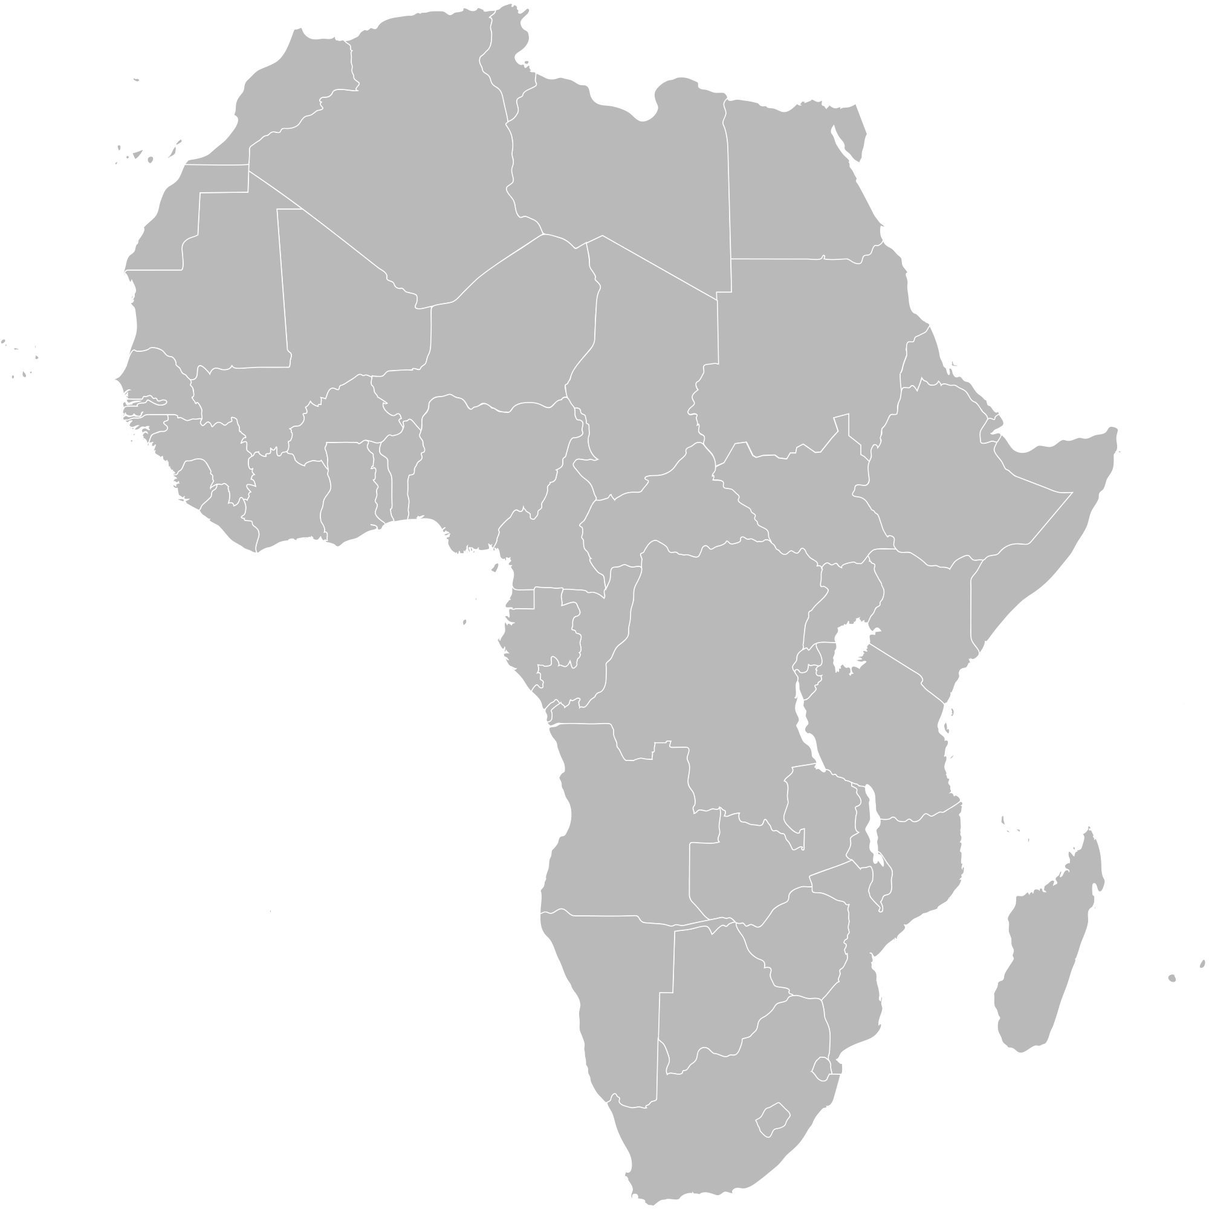
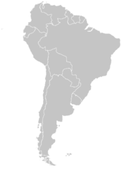
Economic Valuation
Oslo
Pop.620,000
Food waste, plastics, nutrient recapture
Rotterdam
Pop.620,000
Scaling start-up innovation
Bristol
Pop.400,000
Knowledge Exchange
GLOBAL KNOWLEDGE-SHARING PLATFORM
Santa Cruz
Pop.60,000
Technology, transition management + policy
Urban Living Lab
Sao Paolo
Pop. 1.1m
Research Partner
Scaling small-scale solutions
Western Cape
Pop.3.7m / 156,000 / 15,000

Slide 2
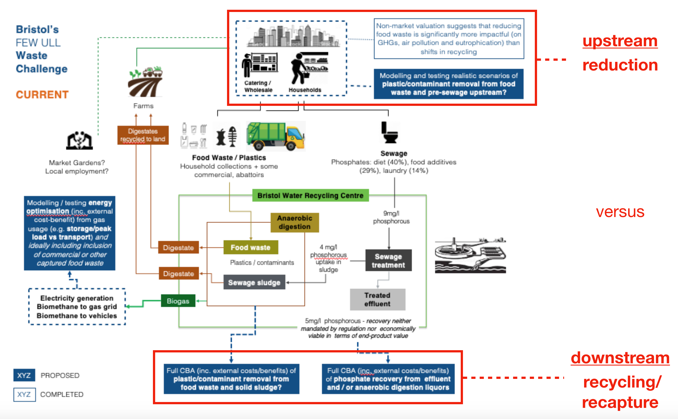
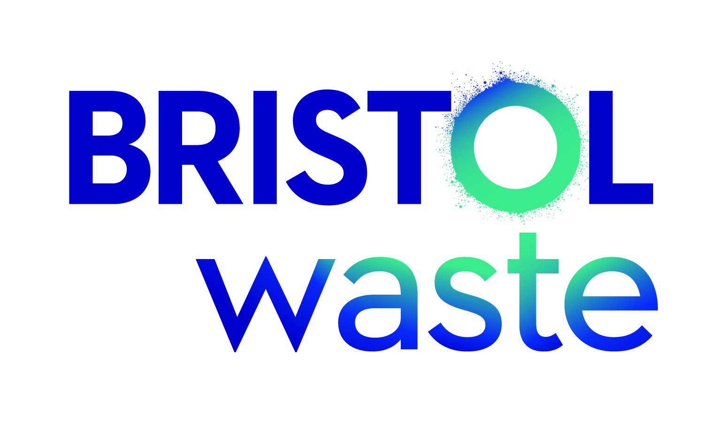
Bristol ULL: Emerging impact strategy
 | Evidence | Who’s interested and why?
 | Non-market valuation (of food waste): reinforces waste hierarchy (socio-enviro benefits of upstream reduction) | Policy-makers (BCC) - Zero Carbon 2030 BFN/RF - Going for Gold Bristol Waste - Slim my Waste WW/GENeco - Infrastructure provider/Innovator
 | Macro-economic valuation: potential ‘economic’ contraction through reduced food waste | Policy-makers (DEFRA) Partners and stakeholders (essential for understanding potential barriers to pathways to impact)
 | Mapping out of systems through engagement: essential context, but limited application for practitioners? | Essential for framing of economic valuation: Partners and stakeholders to develop / validate pathways to impact External others? (depends on what is known by key decision-makers)
 | Plastics/Phosophorous ‘state of the art’ | Internal mainly - possible external policy brief
 | Flows modelled through WW plant | Supporting economic valuation and systems understanding/modelling
 | Market and non-market economic valuation (of plastics and P) | Plastics: WRAP? INCPEN? DEFRA? P: NFU, EA, DEFRA Local control? (e.g. Supermarkets?) Local residents (Going for Gold)
 | Social Return on Investment (of food waste, plastics and P) | Bristol City Council (given Labour Govt and focus on equality)
 | Systems analysis | As above - testing pathways to impact
Decision-Makers
Researchers
Partners
Lay public
Estimated likelihood of interest
High
Med (unsure)
Low
New partners

Slide 3
FAPESP/Belmont Forum Sustainable Urban Global Initiative
Project: Nexos FEW (FEW – Food, Energy, Water) Governance
São Paulo in Natura Lab
“OUR LABORATORY IS THE NATURE”
Prof. Ester Dal Poz
Center for Agricultural Economics (NEA), Institute of Economics (IE),
Management Research Center (CEPAD, FCA)
University of Campinas, Brazil
EXPECTED IMPACTS – PLANNING
A socio-technical approach for IP and for innovation diffusion as expected impacts of sustainability problems
An “ecossystemic services” (Ostrom, E. 1999) assumption, what means SP ULL has to face, promote and foster “situation arenas” of discussions and decision making processes, involving relevant stakeholders, shareholders and policy makers;
IP as collective learning, accountability based, iterative and interactive processes have a strong correlation with the “co-creation” decision-making and policy approach.
SP ULL is not assuming IP and IE as forecasting processes, once this approach has a clear ex post dynamics, as climate or weather conditions.
Lab has an ex ante IP approach, in which the stakeholders and policy makers interactions must create the desired collective transition future. This Lab is not assuming – also – an assessment approach, once it is an ex post one, that do not fits for long term policy making analysis (once ex post IE does not has the mandatory timeline to understand the transition processes.

Slide 4
South African ULL FEW approach: The Water Hub
System analysis
Value chain
Agents of change
Non-market evaluation
Benefits of reduced pollution load and resource wastage. Cleaner rivers, recovery of ecological services and biodiversity.
Local residents affected by degraded conditions; farmers using water for irrigation; local and provincial authorities; natural processes.
Economic evaluation
Circular economy raises potential of urban poor to participate in formal economies through production of market goods: food, compost, recycling of organic waste.
Urban poor; formal businesses in the exchange of local goods and services.
Systems mapping
Stakeholder interest within a system of resource recovery and exchange.
Local residents including NGOs, churches, NPO, social enterprises.
Resource recovery and flows
Nutrient recovery for vegetables production; organic waste diverted form landfill; improved waste management; local control over FEW and waste.
Local residents in formal and informal settlements; tourism industry; farmers; horticulturalists.
Social and environment benefit and return
Job creation; capacity building in FEW management; reduced carbon footprint; improving surface water quality.
Local authority; local residents; agricultural sector; tourism industry.

Slide 5
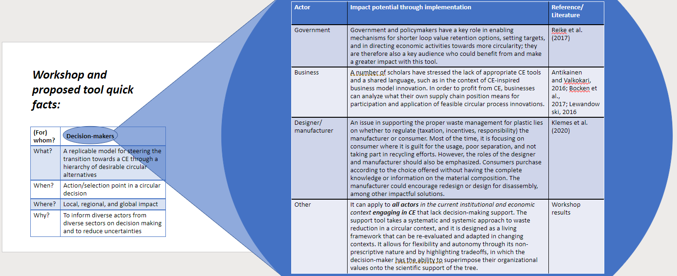
To assess and aim to create impact stemming from Waste FEW ULL, we conducted two workshops to co-create and bring together stakeholders from different sectors and pillars of society around an analysis of decision-making surrounding waste inefficiencies and offer a guiding heuristic as a response to the hypothesis that circular innovations are often created and supported through funding and policy unsystematically.
These workshops allowed the opportunity to discuss and critique its usability, conciseness, and applicability – to give input on the tool, which is still in working form, for how it could support actors in creating impact and what actors would prefer to see so that it is a valuable resource.
See next slide for detailed description:
Impact approach:
Rotterdam ULL

