Slide 1
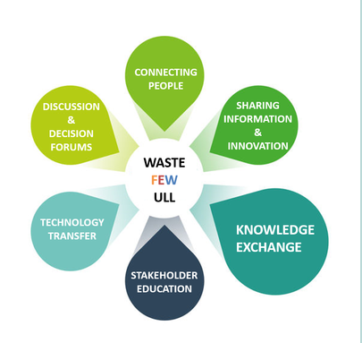
WP7- Communication, Education and Outreach
Adina Paytan
Rotterdam September 2019

Slide 2
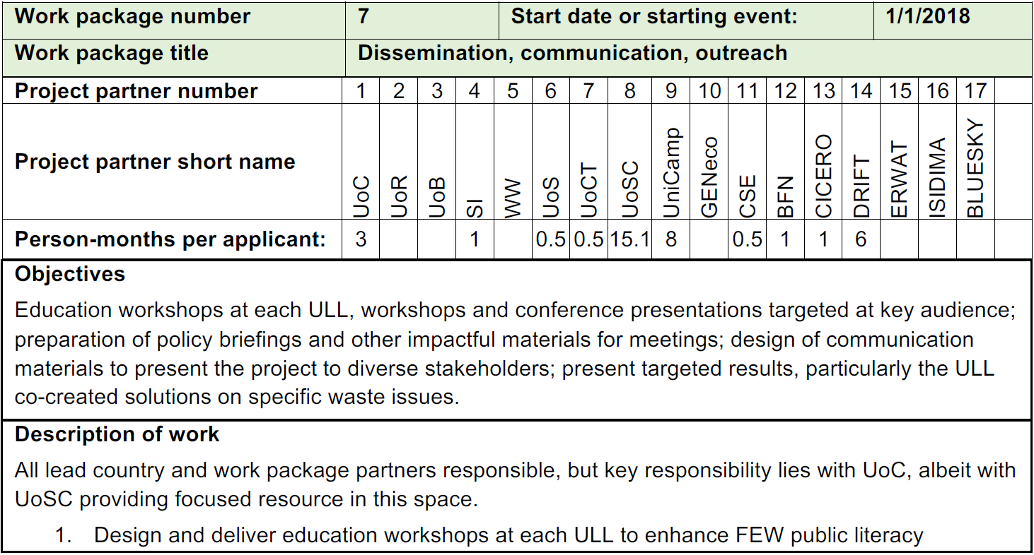
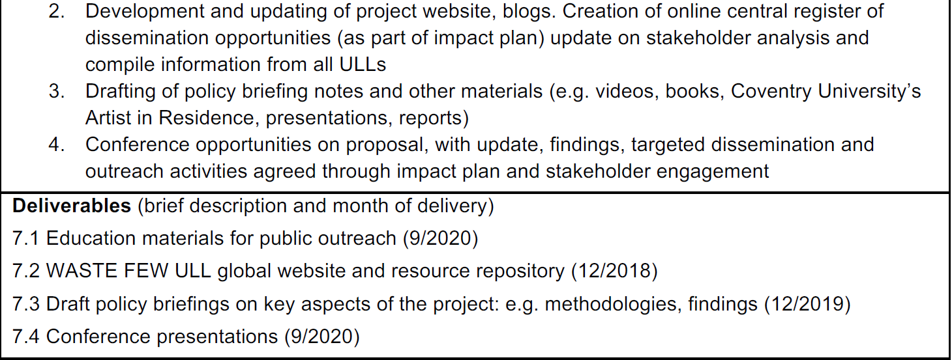

Slide 3
Quickly enter 3 terms that come to mind when you hear
WASTE FEW ULL

Slide 4
Think, Pair, Share
1. Why is communicating our work important?
Who should we communicate our work to?
Have you engaged in efforts to communication your research to various audiences? Who were the audiences?
How did it go?

Slide 5
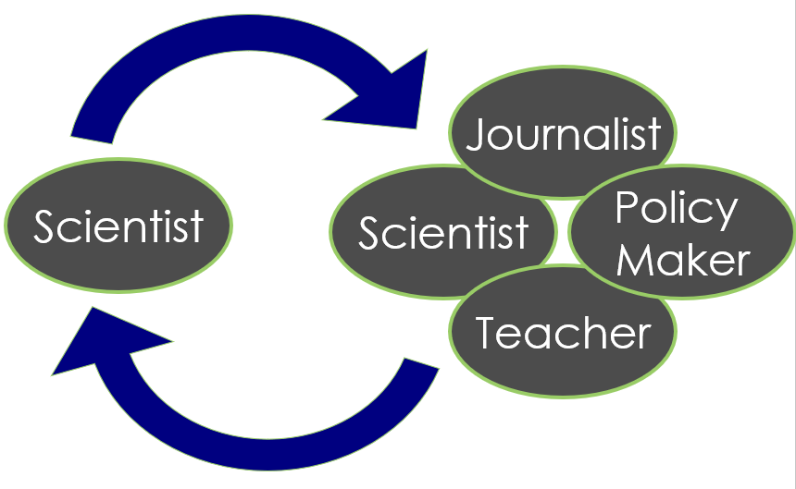
Effective Communication

Slide 6
Effective Communication

Slide 7
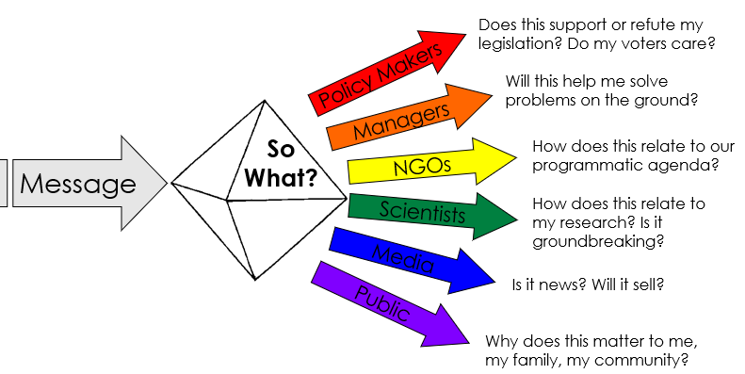
Effective Communication

Slide 8
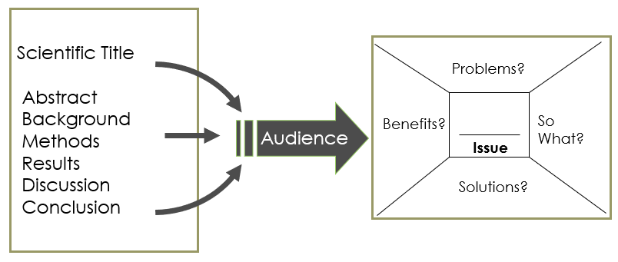
Effective Communication

Slide 9
Some Interesting Facts

Slide 10
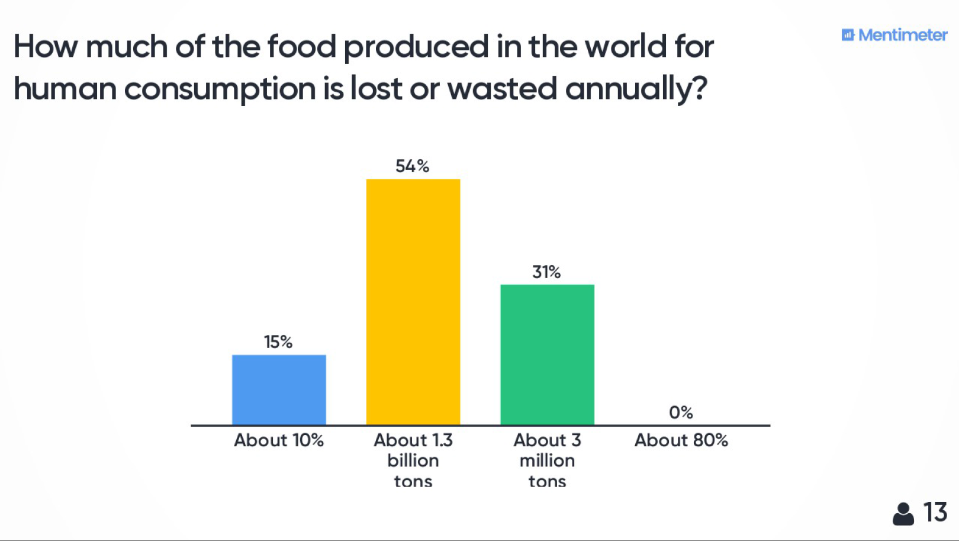

Slide 11
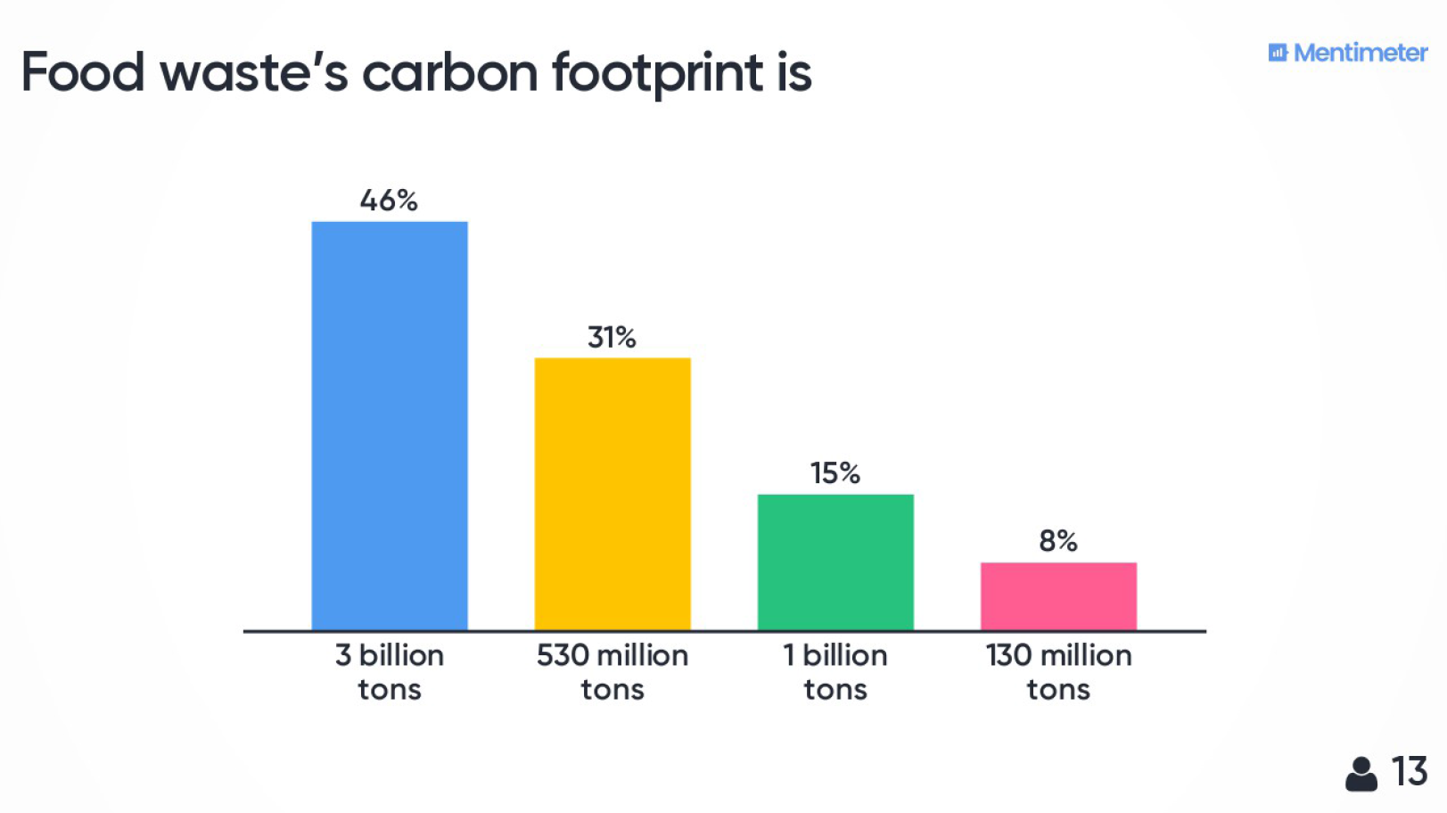

Slide 12
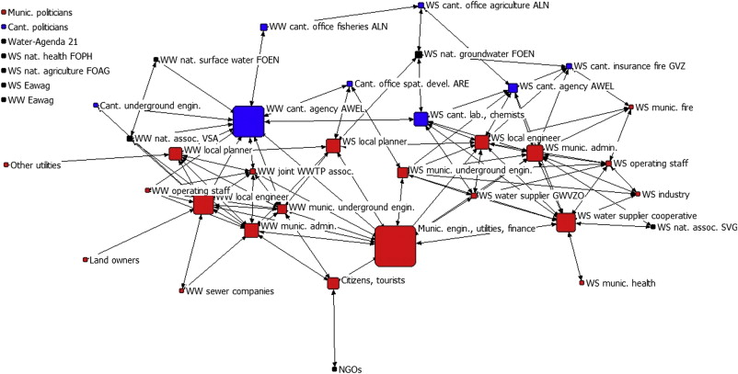
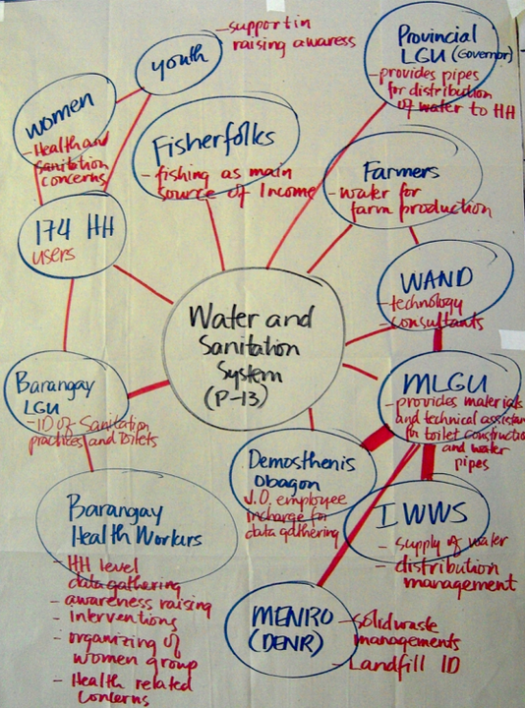
ULL Network Mapping
List all stakeholders that are involved or will be impacted.
Arrange distance/line thickness based on type of involvement.
Use colors to define type of relation to the program.

Slide 13
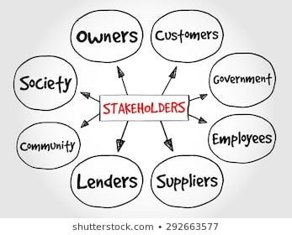
Define your Message(s)
Group the various stakeholders based on interest.
Define what is the message(s) for each specific group.
Use the message box to write the message clearly.
You should support companies that
produce less waste
Reducing waste will increase your profit
Reducing waste is good for the environment
The voters care about sustainability
Reducing waste will increase the
value of our property

Slide 14
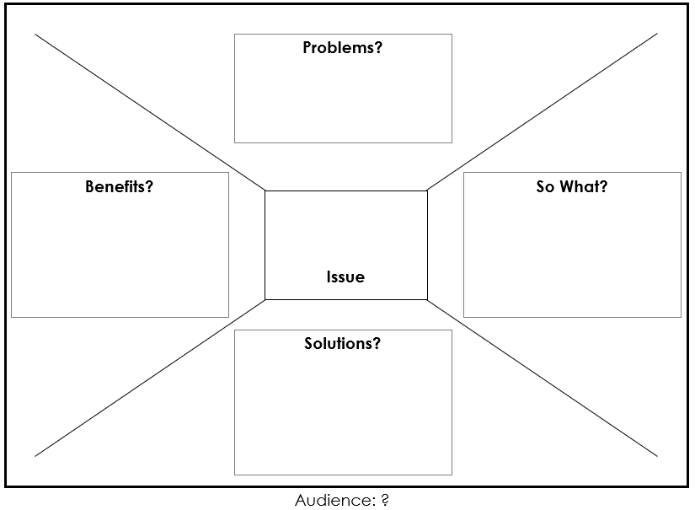
Message Box

Slide 15
Activity Examples
Resources in Food Production (FEW) – Lesson Plans – School students
Fruit Trumps, Pizza Process, Loss and Waste Along the Food Chain
Anaerobic Digestor Debate : Stakeholders discuss waste disposal options
Other Examples
Mayor´s table : Explain citizen and managers about the long-term impacts
related to different waste management strategies
Ways2Sort : Create materials to teach citizens about the importance of your ULL
Virtual city game : Co-create solutions that reduce urban waste
production under circular economy approach

Slide 16
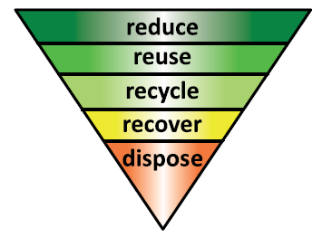
Your Communication Plan
What is your target audience?
How much time can you schedule with them? (logistics)
What would be their preferred media of communication?
Facts Sheets
Workshop
Phone App
Calculator
Posters
Teaching Materials
Reduced waste pocket cards
Cost Benefit Analysis

Slide 17
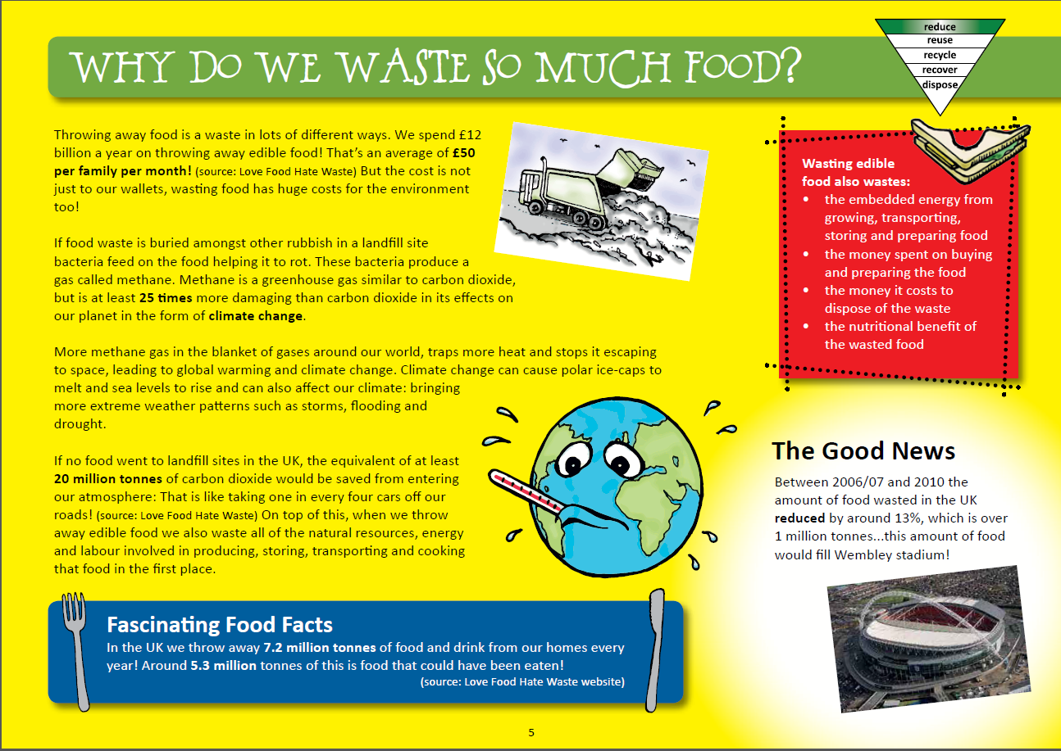
1. Lesson Plans – Formal and Informal Education

Slide 20
Fruit Trumps
(1) You have A selection of fruits from the local supermarket from a variety of origin countries. Determine their place of origin and mark it on the world map.
(2) Use the Global Distances information sheet or your computer (see relevant links) to calculate the distance each fruit traveled.
(3) Complete a ‘Fruit Trumps’ card for each fruit.
Think about these issues and discuss with your group
Transport: Consider how the fruits might have travelled to us - does it state this on the packaging? If not, can you work it out by looking at the possible
routes they have taken on the world map? What are the environmental impacts of this transportation? Do some modes of transport have more impact than others?
Packaging: Do any of the fruits have packaging? What is the purpose of this packaging? What environmental impacts might any packing have?
Plenary: Which fruits have the lowest environmental impact? Why might the same fruits have scored differently on cards made by different people? How can we shop
wisely to reduce our impact on the environment?
Seasonality: Are these fruits available all year or only during certain seasons? If they are available year-round, how is this achieved and what is the
environmental impact of this?
Challenge: to find the ingredients for a meal with the smallest environmental impact.

Slide 21
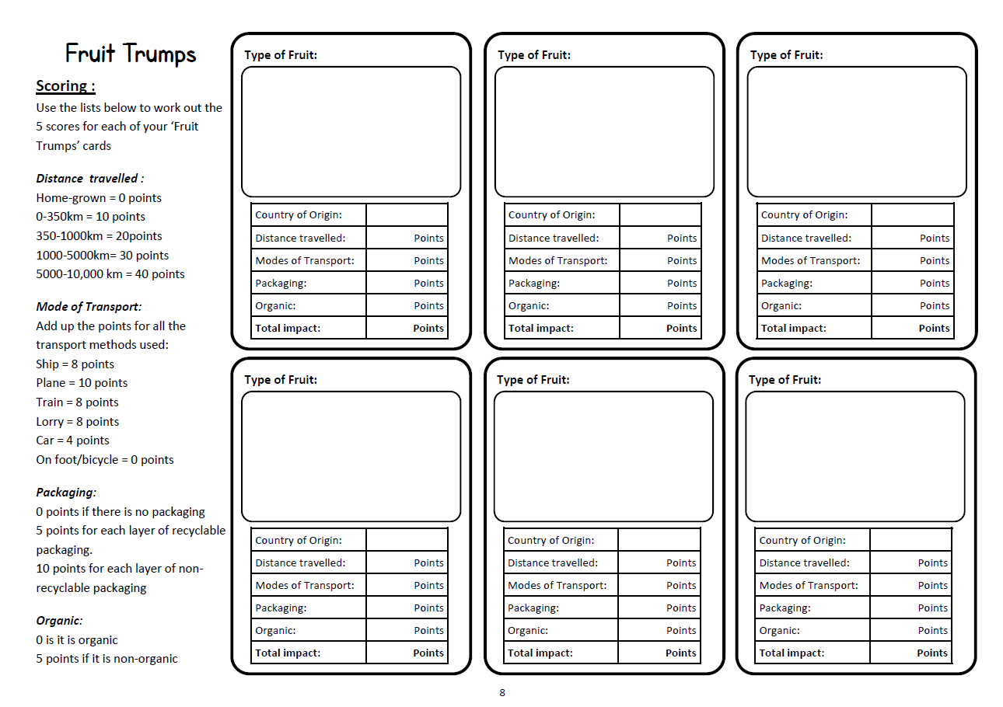

Slide 25
Pizza Processes
List all the main raw ingredients for a pepperoni pizza (e.g. wheat, milk, tomatoes, pork).
Sort the Pizza Web cards into groups relating to each ingredient (e.g. Wheat – flour – dough).
Lay them out with the ready pizza in the centre and the ingredients radiating out.
Use the environmental impact cards to label where in the process of making the pizza the
impact may occur. Write the type of impact in the box (e.g. transport, water, energy etc.).
5. Discuss: Which ingredient of the pizza do you think has the greatest environmental impact and why? How could supermarkets reduce the environmental impact of a pizza? Are there any parts of the process that could be made more environmentally friendly? If we make our own pizza is there less environmental impact? Why is it important to eat all of the pizza once we’ve cooked it? Do some foods have a greater environmental impact than others? How could you change their shopping habits to reduce the impact

Slide 27
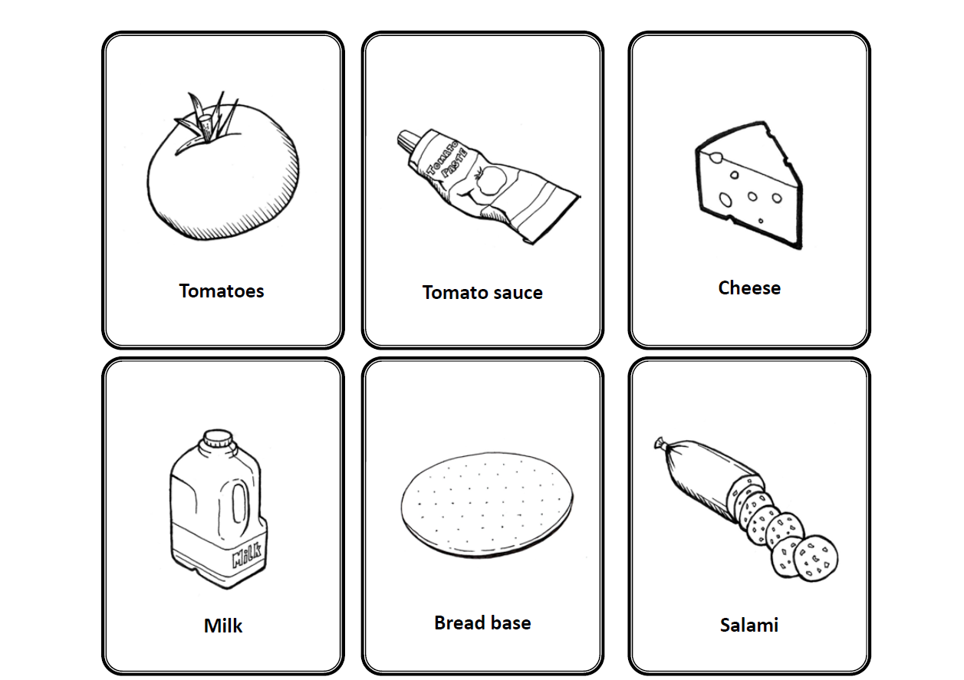

Slide 28
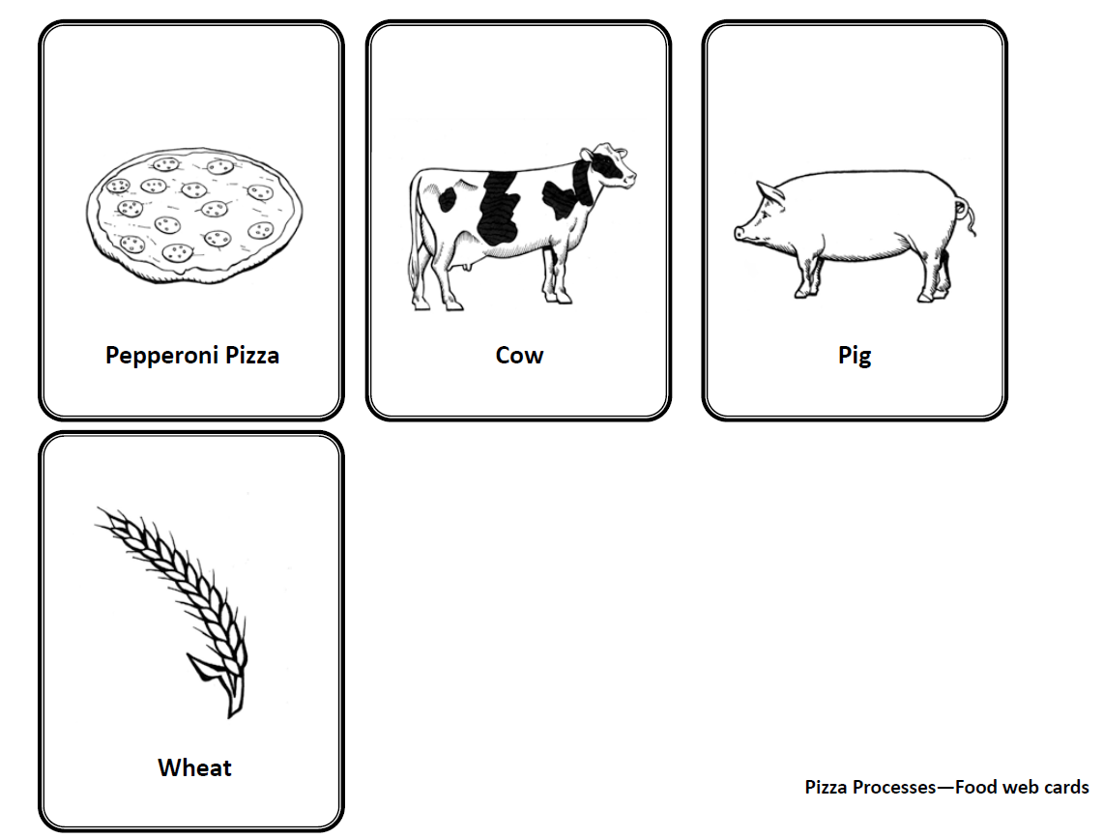

Slide 29
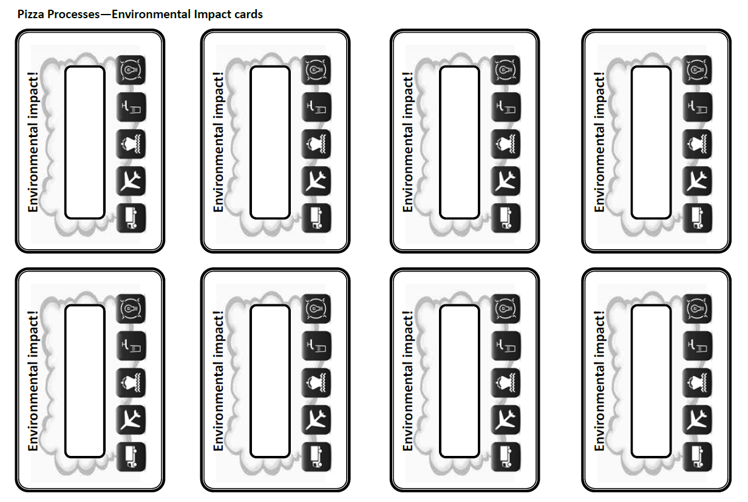

Slide 30
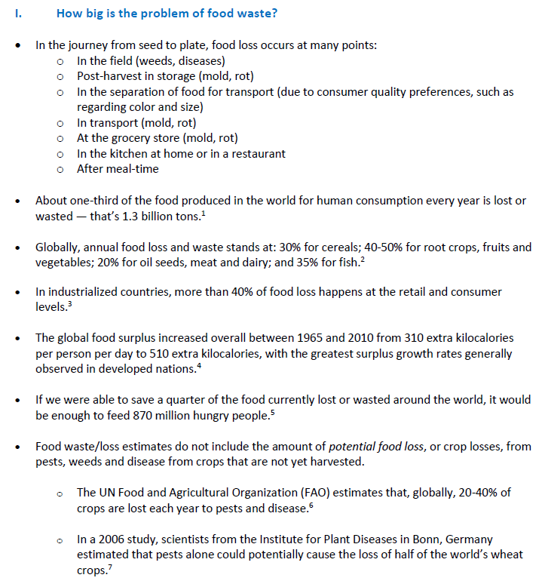
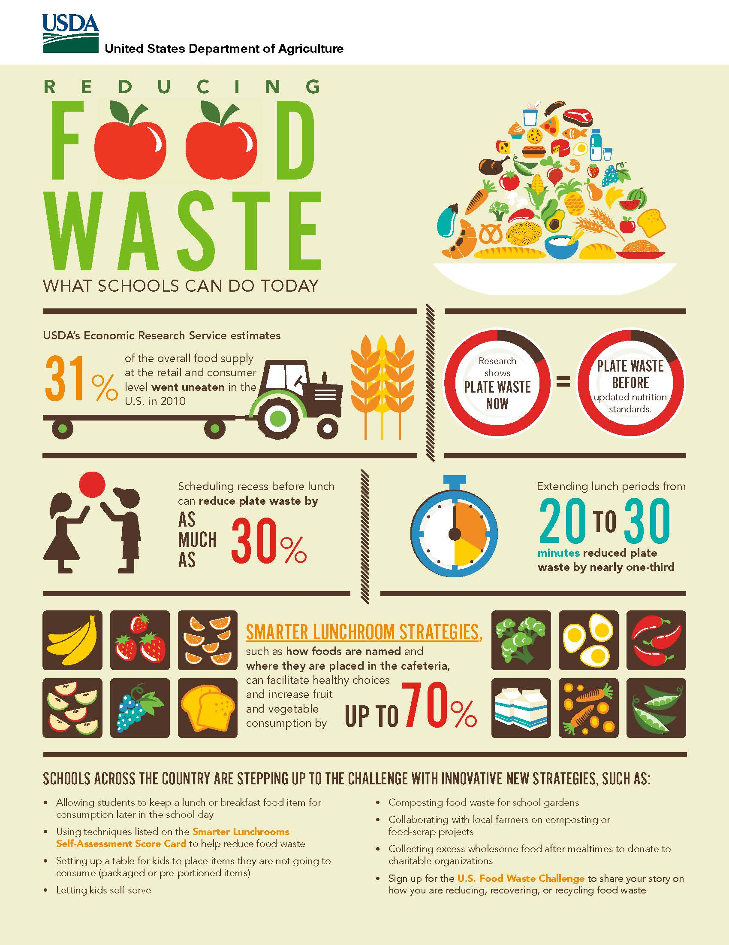
Loss and Waste Along the Food Chain – Some Facts

Slide 31
Loss and Waste Along the Food Chain
Discuss in your group:
If anyone has grown some of your own food- What did you learn?
Were there any surprises?
(2) Why do you think so much food is wasted in the world?
(3) Why is it important not to waste food? Consider: ethics, environment, economy, etc.
(4) Observe the diagram handed out and discuss the different stages of the food chain and define where food loss could be reduced at different steps.
(5) You are provided with four links produced by members of the Food Waste Reduction Alliance. Divide into 4 groups and create a 1-page flyer with five facts about reducing food waste at home/restaurant/hotel (consumer level), in the farm (production), on the way to stores (distribution) and in the stores (retail).
(6) Write a mock tweet with a hashtag regarding what you would say about food waste, where food loss occurs, or any other thoughts regarding food loss.

Slide 32
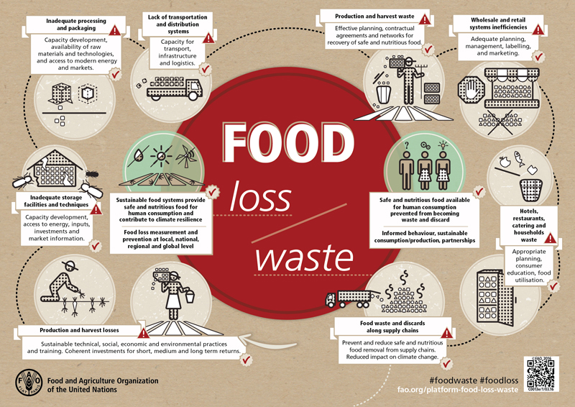

Slide 33
• Food Manufacturers and Food Waste
http://www.foodwastealliance.org/wp-content/uploads/2013/05/2015FWRAToolkit_Web_FINAL.pdf
• Grocery Stores and Food Waste
http://www.foodwastealliance.org/wp-content/uploads/2013/05/2015FWRAToolkit_Web_FINAL.pdf
• Restaurants and Food Waste
http://www.foodwastealliance.org/wp-content/uploads/2013/05/2015FWRAToolkit_Web_FINAL.pdf
• Reducing Food Loss Starting on the Farm
http://191hmt1pr08amfq62276etw2.wpengine.netdna-cdn.com/wp-content/uploads/2016/08/Reducing-Food-Loss-on-the-Farm.jpg

Slide 34
2.
Introduction: A new Anaerobic Digester plant is proposed to be built on the outskirts of your town near an existing landfill site. You represent members of the local community and need to put forward arguments for and against the proposal at a town meeting.
Your aim is to persuade the Director of the County Council to agree with their group.
Debate: Your group (Local council, homeowners, farmers, parish council, local environmental group, local wildlife group) must decide whether you are in favor or against the proposal and formulate a valid argument in support of this view.
You will need to represent these argument in the town meeting.

Slide 35
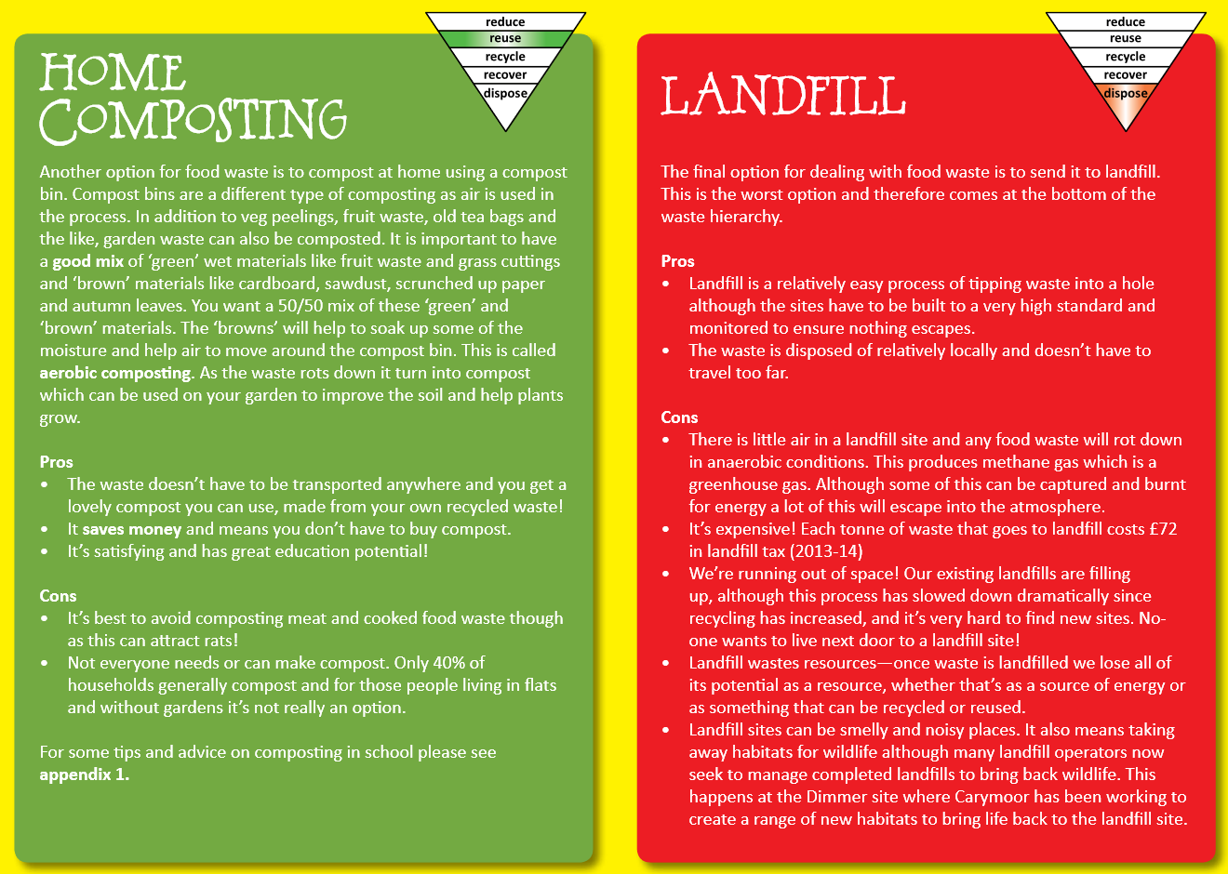

Slide 36
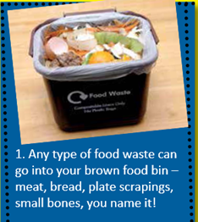
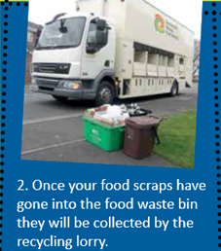
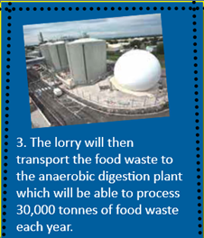
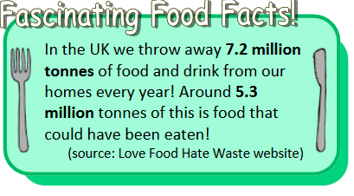

Slide 37
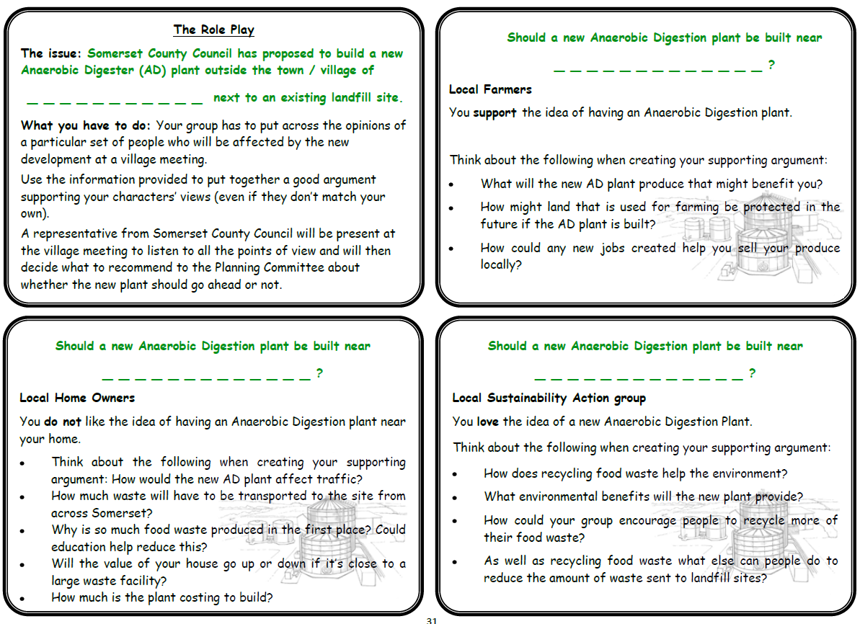

Slide 39
3. Communication Materials
You have some examples of various posters, pamphlets, videos and Apps
Are these effective communication materials?
Where will you use these or similar materials?
Who is the target audience?
Do you see a need for such materials for your ULL?
What would the content of such materials be?

Slide 41
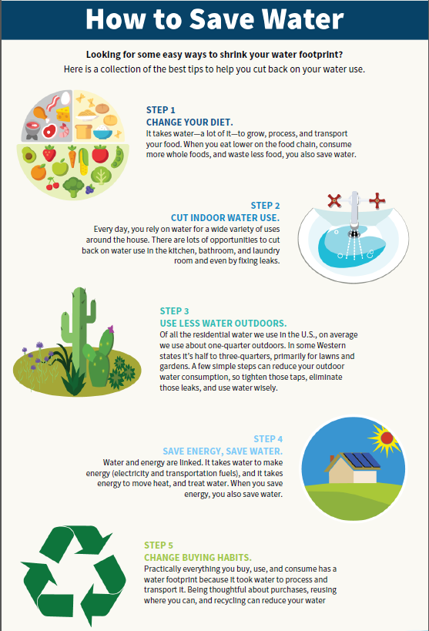
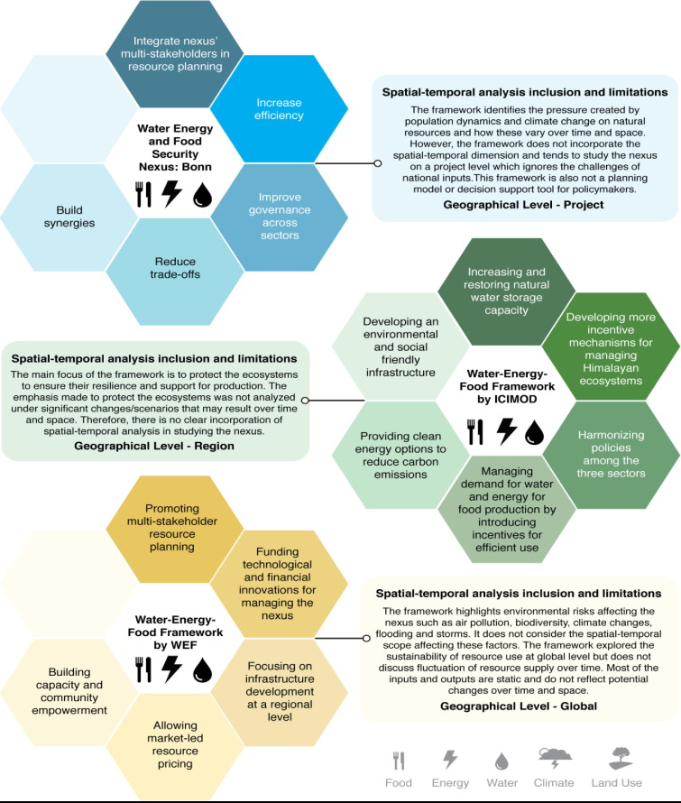

Slide 42
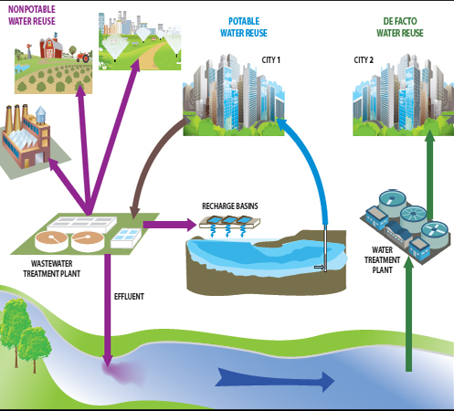
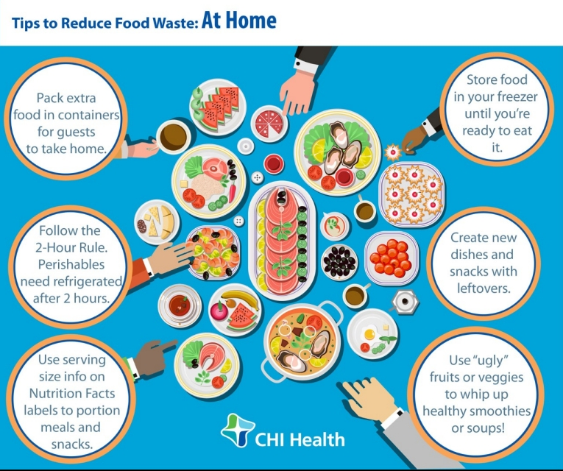
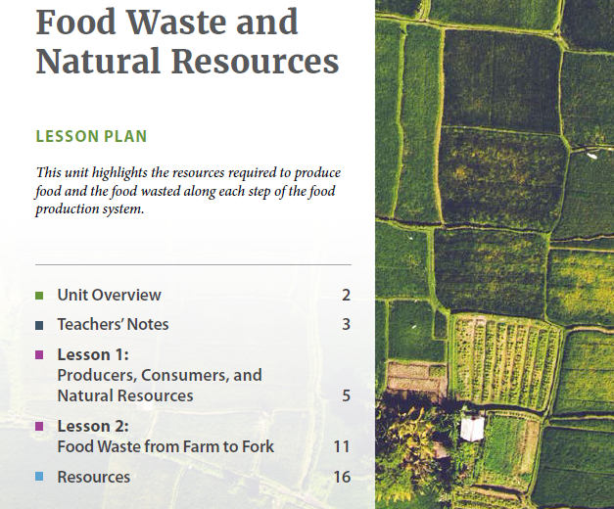
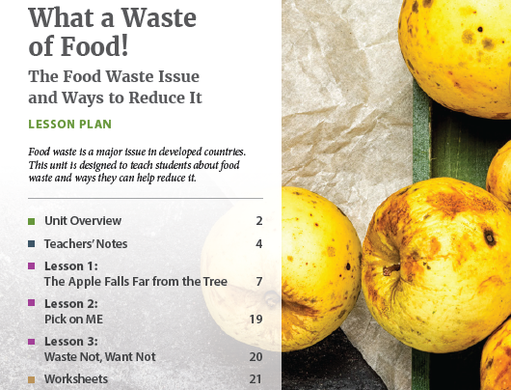

Slide 43
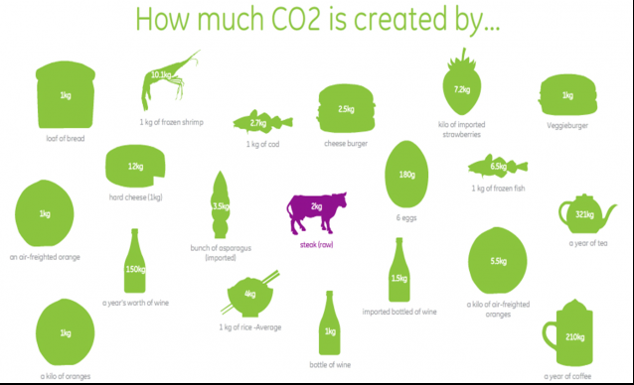
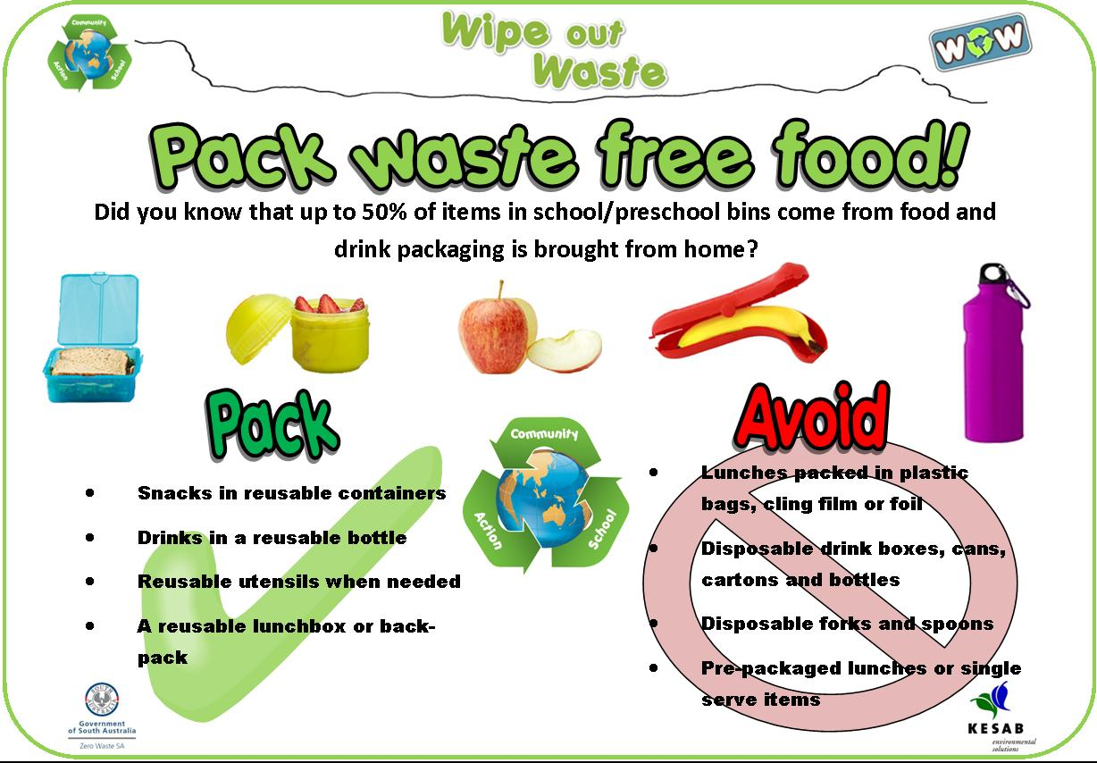
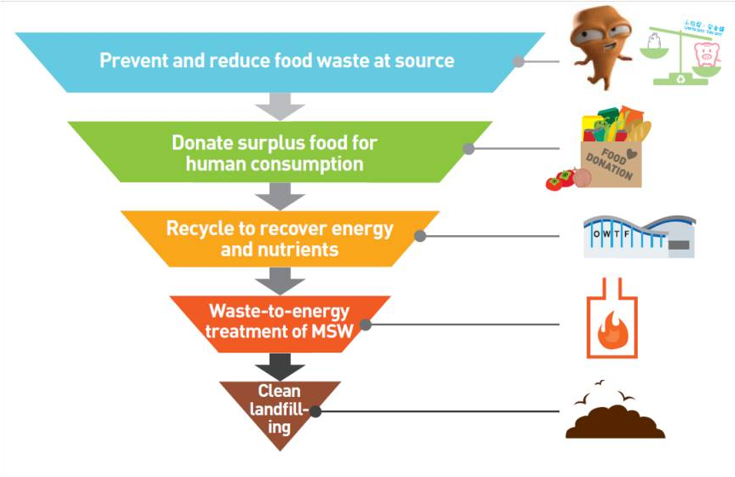

Slide 44
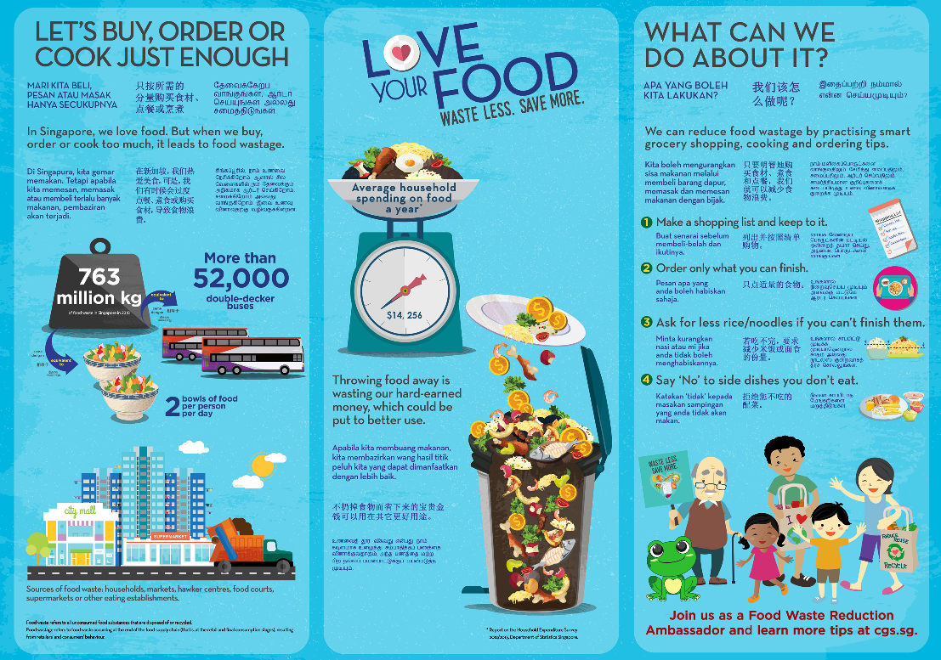

Slide 45
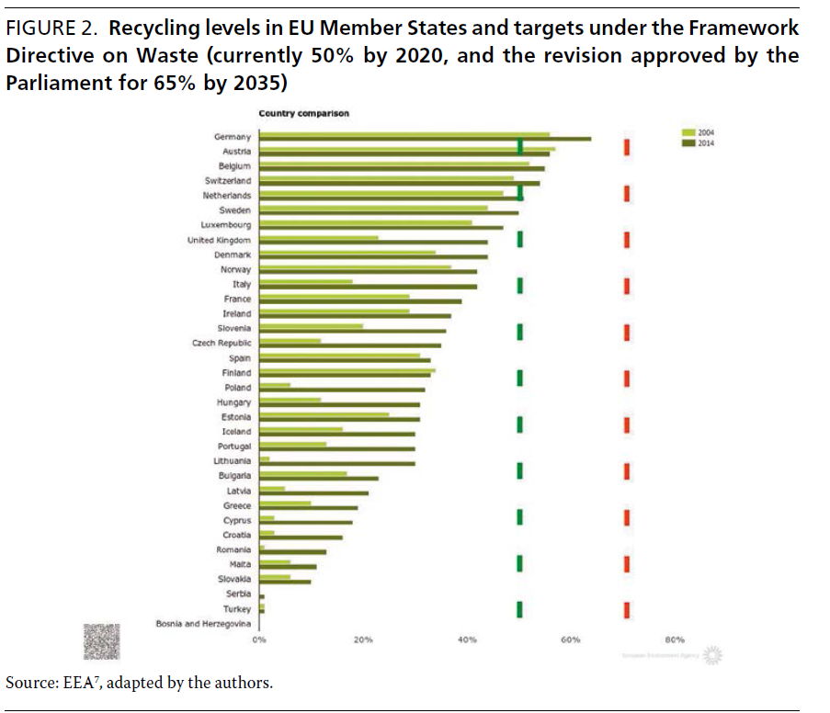
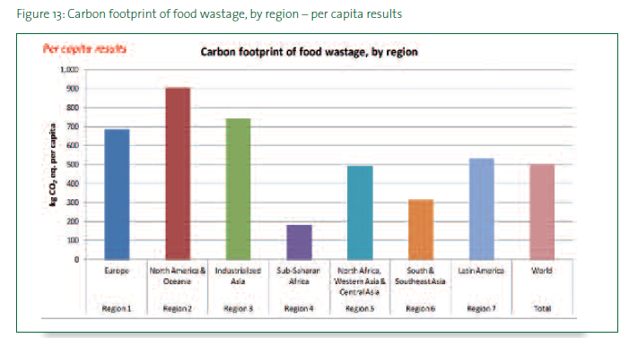
UN-HABITAT, Solid Waste Management in the World’s cities, Vol. 592 (2010).
Eurostat, Municipal waste statistics (2017). http://ec.europa.eu/eurostat/statistics-explained/index.php/Municipal_waste_statistics#Main_statistical_findings.

Slide 46
https://www.watercalculator.org/
https://www.calculators.org/health/green.php/
https://www.itsfresh.com/food-waste-calculator/
https://www.youtube.com/watch?v=kkHlDL6-Ynk
http://www.endfoodwastenow.org/index.php/what-you-can-do
http://eatocracy.cnn.com/2013/01/15/eat-this-list-4-ways-to-combat-food-waste-at-home-andsave-
http://www.pbs.org/america-revealed/teachers/lesson-plan/8/
http://www.unep.org/newscentre/default.aspx?DocumentID=2726&ArticleID=9611
http://www.endfoodwastenow.org
http://www.unep.org/newscentre/default.aspx?DocumentID=2726&ArticleID=9611
http://foodwaste.ch/english-version/
http://www.fao.org/save-food/resources/keyfindings/en/
http://www.fao.org/docrep/018/i3347e/i3347e.pdf
http://www.ecpa.eu/with-or-without
http://www.foodwastealliance.org/
https://www.youtube.com/user/ZeroWasteHome
https://www.youtube.com/watch?v=Em_wyEe9pHY
https://wwfusfwwarriors.knack.com/food-waste-warriors
https://wateruseitwisely.com/kids-activities-and-water-facts/
https://wateruseitwisely.com/100-ways-to-conserve/?view=list
https://www.seametrics.com/blog/water-conservation-facts/

Slide 47
Your Communication Plan
What is your target audience?
How much time can you schedule with them? (logistics)
What would be their preferred media of communication?
Workshop
Phone App
Calculator
Poster
Teaching Materials
Reduced waste pocket cards
Cost Benefit Analysis

Slide 48
Resources
https://waste4think.eu/ecosolutions

