Slide 1
São Paulo Urban Living Lab Brasil FAPESP/Belmont Forum Sustainable Urban Global Initiative
FEW Project Updates
May, 2nd
2019
Ester Dal Poz

Slide 2
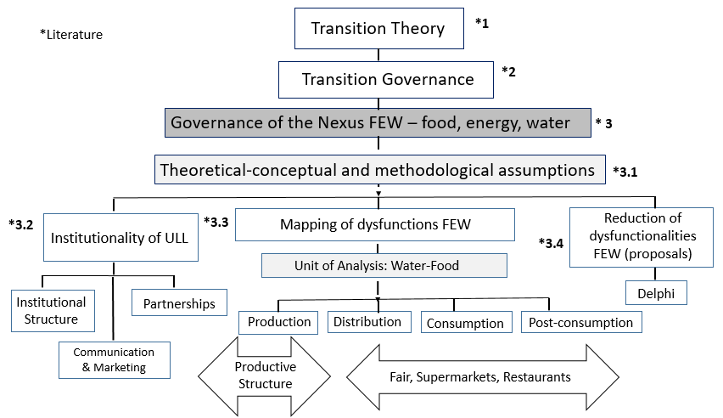
Pipeline

Slide 3
Rationale – Ostrom, 1990 – Create “action situations”

Slide 4
1. Institutionality of the ULL - WINIR – World Interdisciplinary Network on Institutional Research, 2019.
Paper – accepted - “The institutions for institutional transitions”
The so called “transition to sustainable systems” is possibly the major shift to be faced by current civilizations. Transition management shows itself as the management of institutional change (Teisman & Edelenbos, 2004).Multiple initiatives to create and manage Urban Living Laboratories (ULL) have emerged recently as global efforts towards new sustainability standards. This article presents and analyzes, from an Institutional Analysis and Development approach (Ostrom, 2009), the institutional complexity factors related to the dynamics of ULLs. One of the major challenges of Institutions' studies is their identification and detailing (Ostrom, 2011; Märker et al., 2018) An exploratory profile of institutions promoting transition is offered– Those institutions seek to change existing ensembles towards new ruling for the future of resources at the food, water and energy realm – or FEW systems governance.An analytical framework seems to be the first step in understanding the complexity of transition processes and the role and dynamics of innovation.
The duality institution-transition is the unit of analysis of this institutional framework analysis. Considering that both constructs present revolutionary and evolutionary characters, a multi-criteria approach to understand this communion is presented. The matrix of institutional factors - given the transition-institution duality – can support action situation games[CF1] : strategy, object, form, method and logic (Teisman & Edelenbros, 2004). “Strategy”: the action-oriented system through sustainability presents an objective to be achieved; [CF2] “object” : the duality has a formal structure - subject to human behavior; “form”\; the institutionalisation of such laboratories can evolve gradually or by leaps; “method”: the ULLs should promote change and desired future planning; and “logic”: the transition is an actor-managed and policy process. [CF3]
These procedures can provide a framework for ULLs to become entities for policy design, in their non-linear dynamics and socio-technical co-evolutionary character.

Slide 5
New grant
“Permanent Forum” of UNICAMP (Nov/19):
Project communication
Knowledge diffusion
Stakeholders visibility

Slide 6
2. Unit of Analysis – FEW Governance
Urban and peri-urban production chains – Ibiuna and Parelheiros
Sustainable Business Models for producers/associations/ cooperatives
Capacitation cycles offers for producers/ stakeholders/ cooperatives

Slide 7
Parelheiros area: 400 small holders fruit and greens producers (50-50% agroecological/conventional)
House of Agriculture: from the left: Renato Lopez (Unicamp), Iara (Sabesp), Walter Tesch (Environment Secretary of the State of SP), Aline (House of Agriculture), Erika and Ester (Unicamp), Antonio (SP Secretary of Agriculture), Antonio (House of Agriculture and Cristiano (House of Agriculture)

Slide 8
Parelheiros Area: sewage and grey water treatment small plant (Sapiencia Environmental – NGO)
Sewage local treatment in a property: from the left: Erika (UNICAMP), Iara (Sabesp) and Vitor Chaves (Sapiencia)

Slide 9
Renato at a water resource and riparian forest point with - Parelheiros

Slide 10
2. Methodologies of Analysis – FEW Governance
Production chains design
Causal Loops design/validation
Systems Dynamics methodology definition (ABM?): Anylogic
Variables to be used for SD (ABM?), according to the causal loops stocks and flows

Slide 11
3. Policy proposals – as a foresight tool for sustainability
Delphi - Agents expectations data collections (at the same time of the SD data collection), concerning:
Land use/ sewage and grey water from ilegal urban occupancy
Technologies - water and energy; sewage
Other development local/ regional factors: tax and Market incentives; sewage and grey water small holders policy;

Slide 12
REFERENCES
Anylogic. Disponível em: <https://cloud.anylogic.com/>
Cheng, L. (2010) - System dynamics model of Suzhou water resources carrying capacity and its application.
Cheng & Chang. (2011) - System dynamics modeling for municipal water demand estimation in an urban region under uncertain economic impacts.
CORBETT NETO, Thomas. Introdução à Dinâmica de Sistemas. 2003. Disponível em: <http://www.corbett.pro.br/introds.pdf>
Coyle (2010) - Qualitative and quantitative modelling in system dynamics: some research questions.
Davies E.G.R. & Simonovic S.P. (2011) - Global water resources modeling with an integrated model of the social–economic–environmental system
Feng et al. (2016) - Modeling the nexus across water supply, power generation and environment systems Usar para discutir o resultado de diferentes cenários.
Forrester (1994) - System dynamics, systems thinking, and soft OR
ROBERTS, Nancy et al. Introduction to Computer Simulation: The System Dynamics Approach. Chapter 13, Levels and rates. 1983. In: MIT System Dynamics Group´s Road Maps series. Disponível em: < http://sysdyn.clexchange.org/sdep/Roadmaps/RM2/roberts_13.pdf >
Isee System. Disponível em: <https://www.iseesystems.com/resources/help/v1-8/default.htm#03-BuildingModels/1.ModelBuildingTutorial.htm%3FTocPath%3DGetting%2520started%7C5>

