Slide 1
São Paulo Urban Living Lab Brazil
Ester Dal Poz
University of Campinas
@ Bristol – FEW SUGI 1st Meeting
October, 2018

Slide 2
Team - Professors
Ester Dal Poz – Coordinator, Economics of Innovation, FEW Nexus Governance.
Walter Belik – Food Security and FEW Nexus.
Ieda Makyia – Food Value Chains, Water Cycles in Industry.
Eric Cohen – Marketing, Partnerships and Education for Sustainability.
Barbara Teruel –FEW Footprints in Industry.
Luciana Cordeiro – Water Policy and Law.

Slide 3
Team - Students
Post Doctoral Researcher – under selection; Project Management and Delphi Application.
Marcos Rehder – PhD Student; Networks of Innovation for the FEW Nexus.
Camila Favero – PhD Student; Institutional Sustainability Indicators for ULLs.
João Victor Antunes – Undergraduate Student; Energy Flows for Food Production.
Patricia Giannini Beyersdorf – Undergraduate Student; Marketing and Education for Sustainability.

Slide 4
Team – Partners Sabesp – São Paulo State Water and Sewage Co.
Cristina Knörich Ruffo, R&D and Innovation Chair.
Fabiana Rorato Prado, R&D Manager.
Valeria D’amico, Intellectual Property Rights.

Slide 5
Stakeholders (till now)
São Paulo City Food Supply Secretary
São Paulo State Environment Secretary
NGOs (3)
EMBRAPA – Brazilian Agricultural Research Corporation
Fabio Feldman Consultants (Sustainable Development)

Slide 6
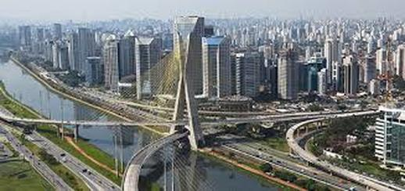
São Paulo City

Slide 7
1. São Paulo City Population: (2018) – 12 mi/inh 2. Metropolitan Area : - Population (2018) - 21,5 mi/inh - São Paulo City + 39 Counties

Slide 8
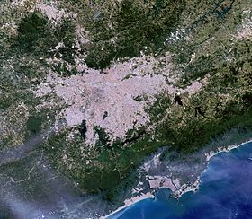

Slide 9
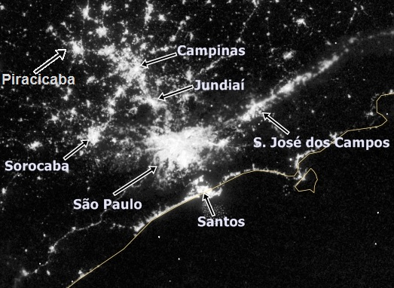

Slide 10
Concerning the two FEW SUGI objectives, in terms of resource inefficiencies: O1. map waste O2. substantially reduce waste

Slide 11
Sao Paulo city ULL general goal.
To be a locus urban sustainability throught innovation*
Search, selection and diffusion of:
sustainable technologies and best sustainable practices,
innovative meanings of consumption,
new civilizing milestones about the environment – from marketing and education
policy making.
*Innovation is seen as technological, social, educational and economic.

Slide 12
Two integrated theoretical frames from Evolutionary and Institutional Economics

Slide 13
Policy Approach
The main theoretical concepts are:
eco-innovation *
“the production, assimilation or exploitation of a product, production process, service or management or business method that is novel to the organisation (developing or adopting it) and which results, throughout its life cycle, in a reduction of environmental risk, pollution and other negative impacts of resources use (including energy use) compared to relevant alternatives”.
Or …. sustainable construction and drivers of change
* René Kemp and Peter Pearson, 2007, Final report MEI project about measuring ecoinnovation, OCDE.

Slide 14
Policy Approach
The main theoretical concepts are:
b) niche management *
transition movement into a more sustainable modes of development, throught evolutionary policy approaches for shaping processes of variation, selection and retention.
co-evolution of technical, environmental and social systems
*Nill, J and Kemp, R. (2009), Evolutionary Approaches for Sustainable Innovation Policies: from niche to paradigm. - Research Policy, 2009 - Elsevier

Slide 15
Institutional Approach
Policy structures and processes for an effective, integrated governance of FEW nexus resources
+
Path dependency and institutional change

Slide 16
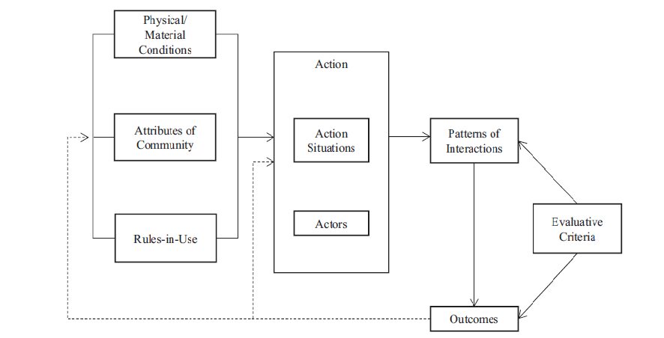
Institutional Approach: frame 1
Ostrom E. Doing Institutional Analysis. Digging Deeper Than Markets and Hierarchies. In: Menard C, Shirley MM, editors. Handbook of New Institutional Economics. Boston: Springer US. 2005.

Slide 17
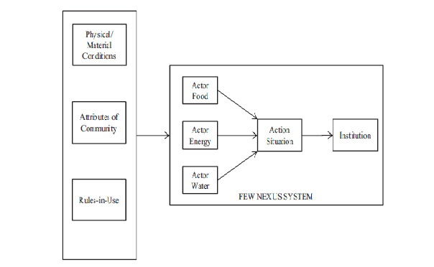
Institutional Approach: frame 2 (adapted for FEW governance)
Ostrom E. Doing Institutional Analysis. Digging Deeper Than Markets and Hierarchies. In: Menard C, Shirley MM, editors. Handbook of New Institutional Economics. Boston: Springer US. 2005; according to Marker et al. (2018). Integrated governance for the food–energy–water nexus – The scope of action for institutional change. Renewable and Sustainable Energy Reviews 97 (2018) 290–300

Slide 18
How to “map and substantially reduce waste”

Slide 19
How to “map and substantially reduce waste”
Pilot cases: Ibiuna and Mogi areas: horticultural production (huge demands on water and energy)
Water and energy footprints (Barbara)
Water policy patterns (Luciana)
Water use best practices and technologies (Ieda)
Stakeholders selection and contacts, communication and education for sustainability (Eric)
Governance of FEW and ULL establishment (Ester and Belik)

Slide 20
How to “ map and substantially reduce waste”
Delphi: a foresight tool
Comunication, planning and implementing process do deal with complex problems

Slide 21
Delphi as a colective priorities definition for future (changes)
Shared visions about future
Socio-economic structures and innovation co-evolution
Lasting negotiation for new demands
Technological regimes shifts, with na accountability condition

Slide 22
Delphi as an active change process
It is a colective process, not only a group of techniques;
It fosters new scenarios through future developments, from the strenghts that can frame shifts;
It is NOT forecasting; a sort of actors shape the intented future, together.

Slide 23
The application of Delphi technique* in this study comprises of the following steps:
(i) identification of water-food related stakeholders
(ii) design of the questionnaires
(iii) distribution and collection of completed questionnaires
(iv) analysis of the results (multi-criteria)
* Martin, B. R. & Johnston, R. Technology Foresight for Wiring Up the National Innovation System: Experiences in Britain, Australia, and New Zealand. Technological Forecasting and Social Change, n. 60, p. 37-54, 1999.

Slide 24
Delphi approach is used primarily when one of the following properties exist:
(1) the problem does not lend itself to precise analytical techniques, but can benefit from subjective judgments on a collective basis;
2) the individuals needed to contribute to the examination of a broad or complex problem have no history of adequate communication and may represent diverse backgrounds with respect to experience or expertise;
(3) more individuals are needed than can effectively interact in a face-to-face exchange;
(4) time and cost make frequent group meetings infeasible;
(5) the efficiency of face-to-face meetings can be increased by a supplemental group communication process;
(6) disagreements among individuals are so severe or politically unpalatable that the communication process must be refereed and/or anonymity assured; and/or
(7) the heterogeneity of the participants must be preserved to assure validity of the results, i.e., avoidance of domination by quantity or by strength of personality (“bandwagon effect”).
Linstone and Turoff (1975)

Slide 25
Governance challenges
1. Intramural
2. Extramural (SUGI partners):
Delphi participation?
Extended scope?

