Slide 1
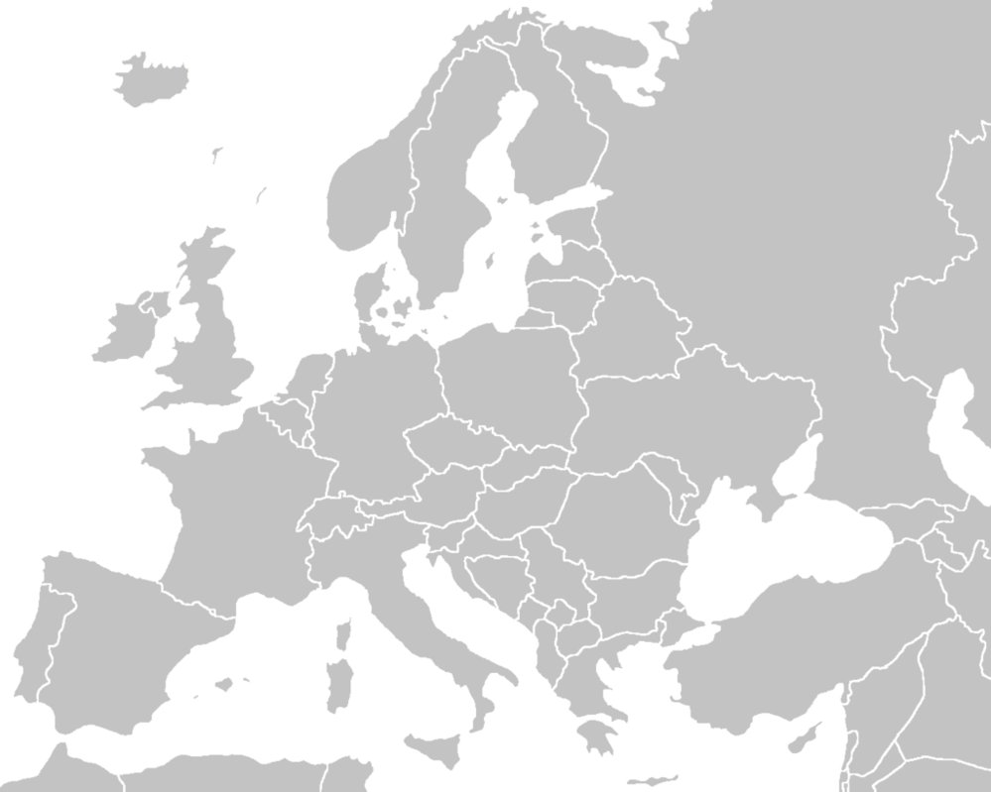
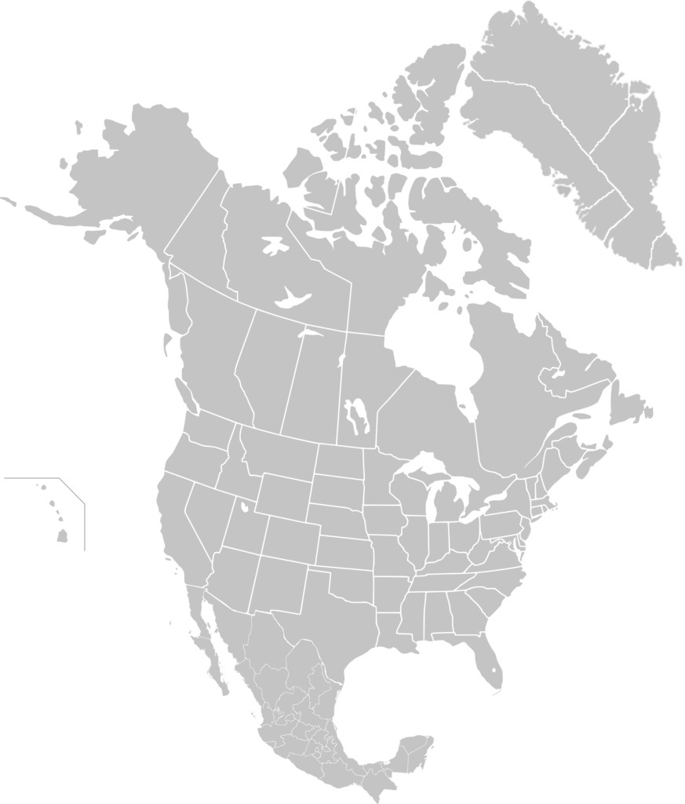
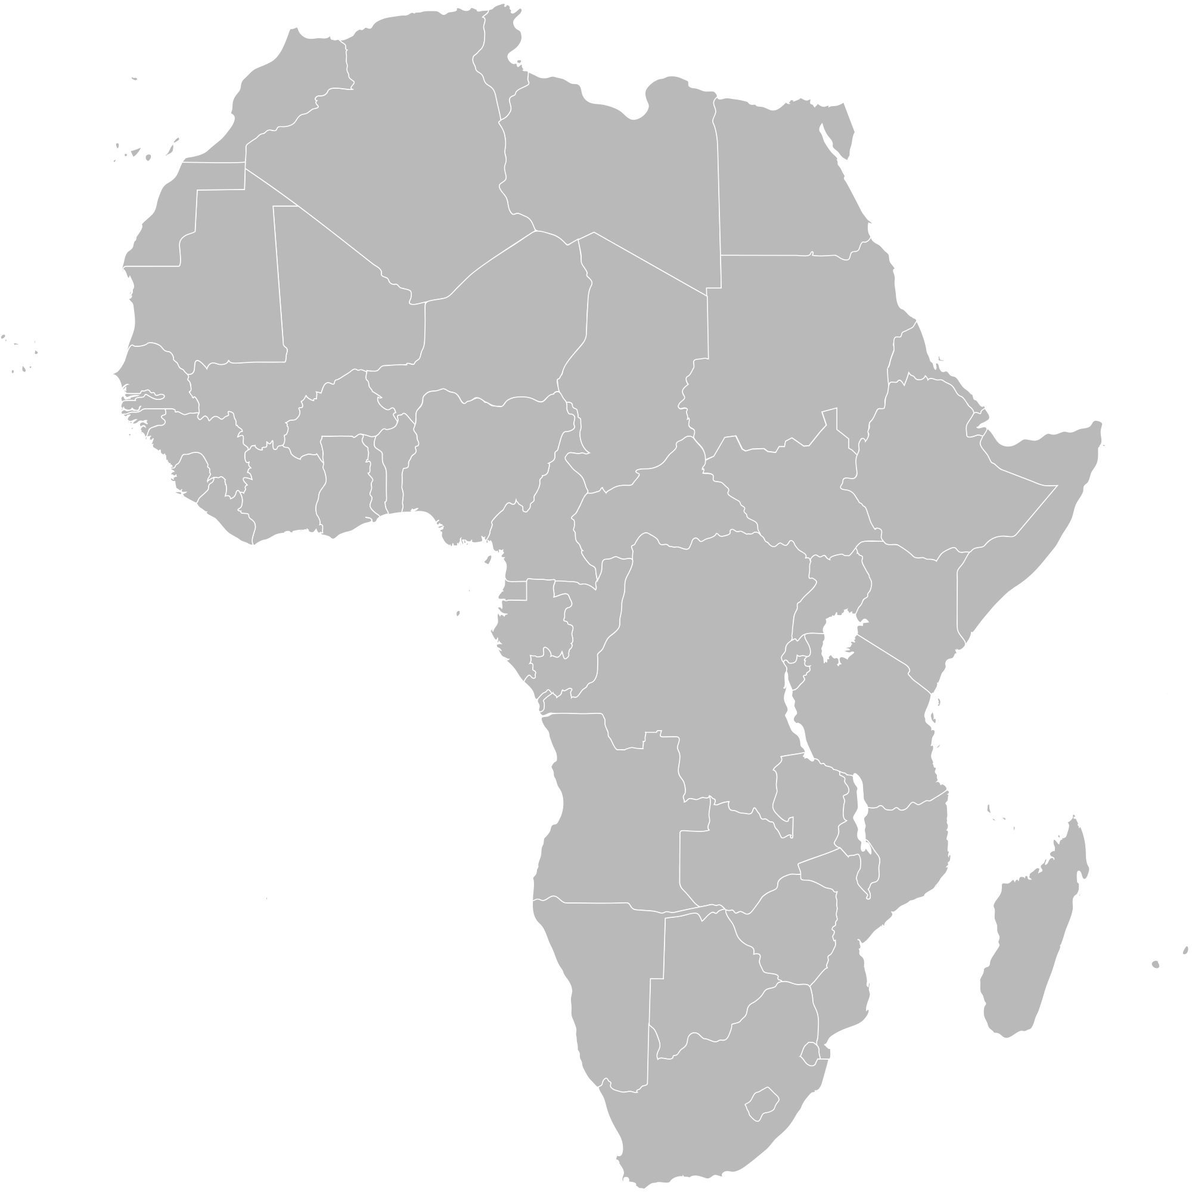
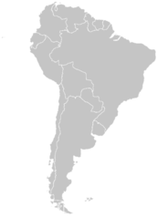
Economic Valuation
Oslo
Pop.620,000
Food waste, plastics, nutrient recapture
Rotterdam
Pop.620,000
Scaling start-up innovation
Bristol
Pop.400,000
Knowledge Exchange
GLOBAL KNOWLEDGE-SHARING PLATFORM
Santa Cruz
Pop.60,000
Technology, transition management + policy
Urban Living Lab
Sao Paolo
Pop. 1.1m
Research Partner
Scaling small-scale solutions
Contact info: https://wastefewull.weebly.com/
Western Cape
Pop.3.7m / 156,000 / 15,000

Slide 2
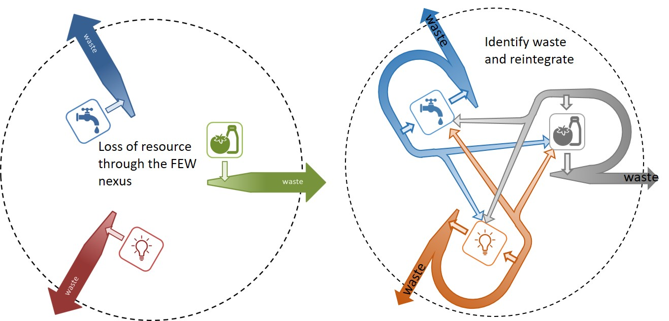
Research interest and relevance
WASTE FEW ULL identifies waste generated in the urban food-energy-water nexus in 4 ULLs across 3 continents
Circular economy, stakeholder engagement, Issues of scale and approach; FEW disconnect
Notes:
The idea is to map and investigate reductions in waste generated in the FEW nexus. Uses ULLs as case studies.
Relevance: identify areas where waste could be reduced, eg
Issues around scale, and approach taken in each ULL. Importance of stakeholder engagement is common across each ULL, varies from environmental organisations, water companies, local authorities, local communities – so even here, the scale is quite different. Disconnect in the FEW nexus itself where can identify 2 of the processes, but not the 3rd.
Produce a “toolbox” containing project information

Slide 3
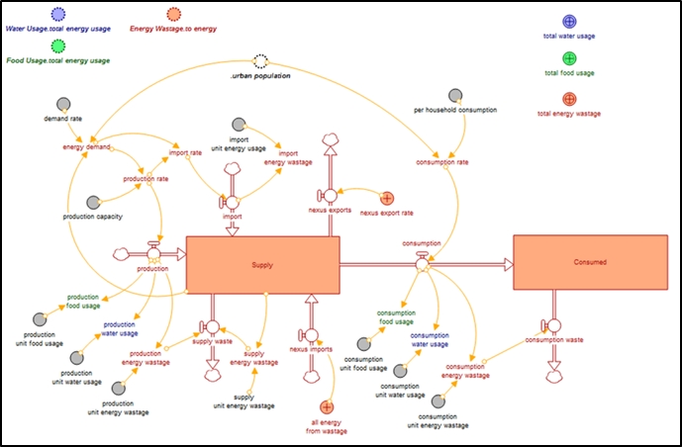
key insights or outputs and how others can make use of them
Notes:
Accept that processes are different internationally and learn from each other. Outputs (eg the “toolbox”) need to reflect these differences and provide a range of recommendations/ approaches.
System Dynamics Modelling attempt to represent the nexus as an integrated system, but they do not operate in isolation, thus feedbacks can cause non-linearly propagating effects.

