Slide 1
Scientific research essential for supporting ground-up nature-based systems: the Water Hub, South Africa
Dr Kevin Winter Future Water Institute, University of Cape Town kevin.winter@uct.ac.za

Slide 2
Monitoring, measuring, managing risk: research, ICT & feedback
URBAN WATER
Nbs treatment of polluted runoff from informal settlement
RESOURCE RECOVERY
Acceptable nutrients concentration
FOOD
Risk assessment: water and soil – food from waste
ENERGY
Non-renewable sources for distributing water
WASTE
Catalyst for community development
Monitoring, measuring, managing risk: research, ICT & feedback
Monitoring, measuring, managing risk: research, ICT & feedback
Monitoring, measuring, managing risk: research, ICT & feedback

Slide 3
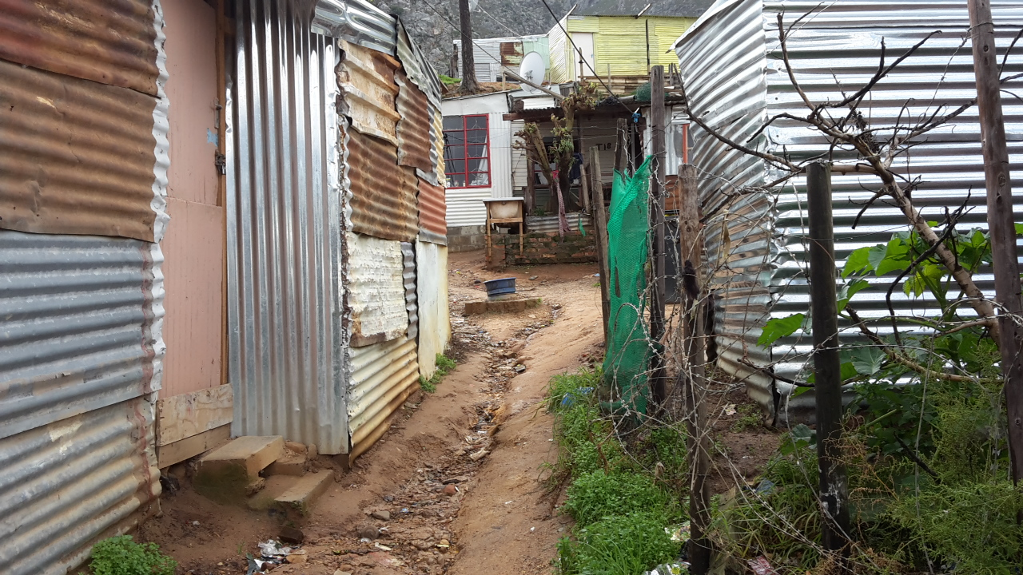
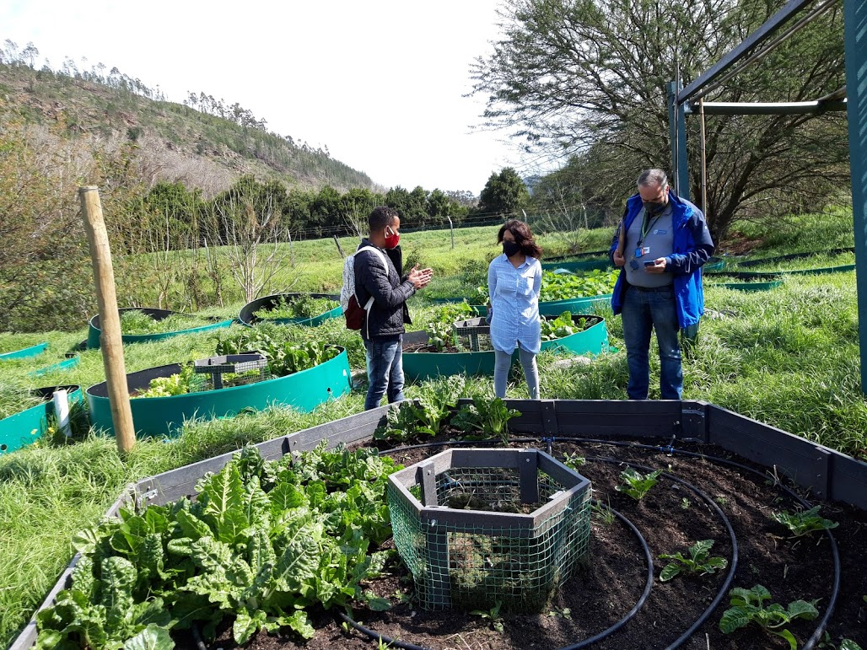
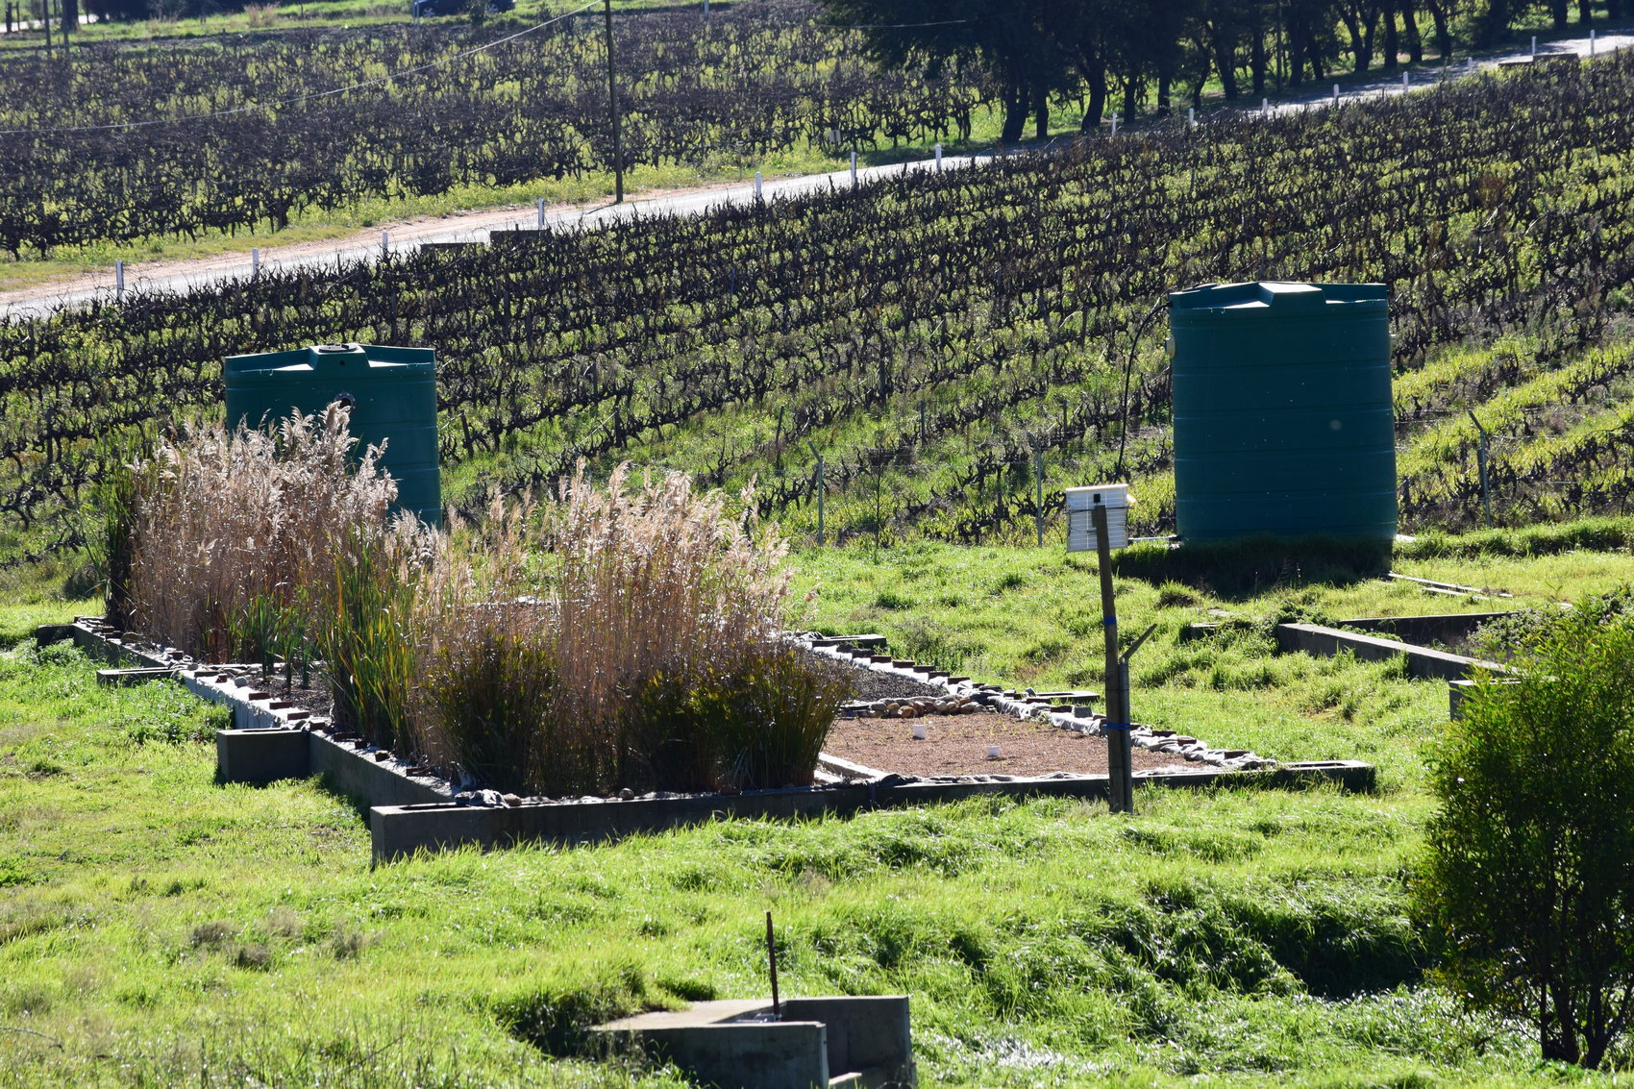
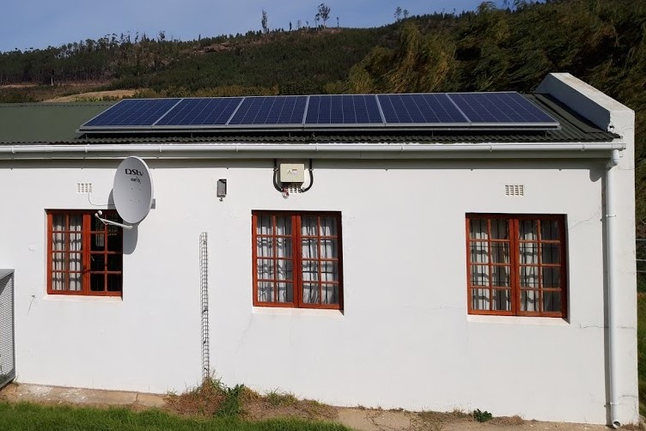
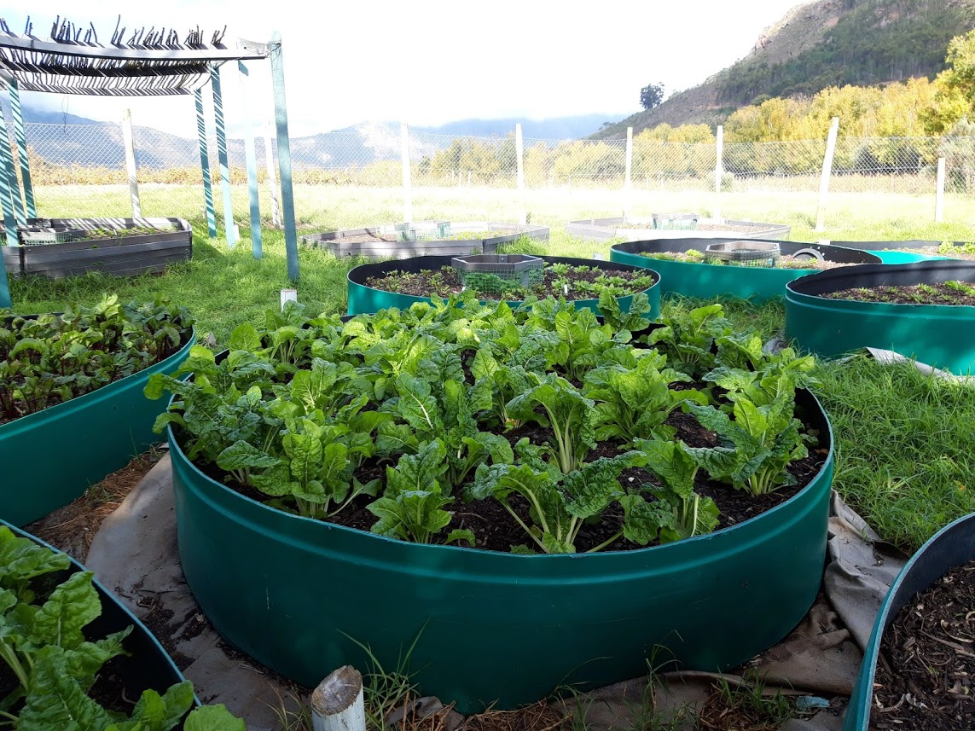
Monitoring, measuring, managing risk: research, ICT & feedback
FEWW
From waste to recovery
Monitoring, measuring, managing risk: research, ICT & feedback
Monitoring, measuring, managing risk: research, ICT & feedback
Monitoring, measuring, managing risk: research, ICT & feedback

