Slide 1
Critical review of the governance of phosphorus and implications for future institutional research
Dr. Bingzi He – Bristol ULL
This literature review is carried out as part of an international research project funded under Belmont Forum/JPI-Europe initiative: Waste Food-Energy-Water Urban Living Lab (WASTE FEW ULL). And thanks for the team collegaues' help.

Slide 2
I. Research Backgrounds and Aim
Governance practices and performance
Changing governance meaning of P: from P pollution to P scarcity and pollution
Cost and benefits: low price of P in comparison to the high price of recycling techniques and limited markets of recyclyed p products
Science: Challenges involved in studying the governance of phosphorus
Lack of clarity on how P flows influence public health and global climate change.
There are difficulties in measuring these impacts accurately.
The approach to collecting accurate data. Challenges could arise from data that are based on self-reported past use contexts of organic and inorganic P-related goods at the individual, regional, national and global levels
The limited research scope of the governance of P, not much on the access to governance of P.
Social Science: Theoretical and policy dynamics
The emerging governance concepts: circual economy and geographic economy
The emerging analytical framewrok: Waste hierarchy and Zero waste hierarchy
Research aim
This review paper aims to further improve the understanding of the governance system of P and associated factors affecting the P nutrition flows mainly from the Social Science perspective.

Slide 3
II. Integrative review method
Significances:
The integrative review method is advantageous to reconceptualize the topic reviewed in the literature and provide a new thinking perspective by reviewing, updating, critiquing, and synthesizing the empirical and theoretical knowledge (Torraco, 2005; 2016).
The existing literature has highlighted the importance of an integrated approach in investigating this complex and science-based P governance topic, especially for 'addressing the multiple aims of environmental protection, food security, farmer livelihood security, cost-effectiveness and long-term availability' (Schröder et al., 2010; Sarvajayakesavalu et al., 2018).
This method is also useful to incorporate up-to-date multiple and cross-discipline knowledge to achieve the research aim.
Data source:
Triangulated secondary data: journal papers; government and corporate documents; research institutes; news and information from other reliable agents.

Slide 4
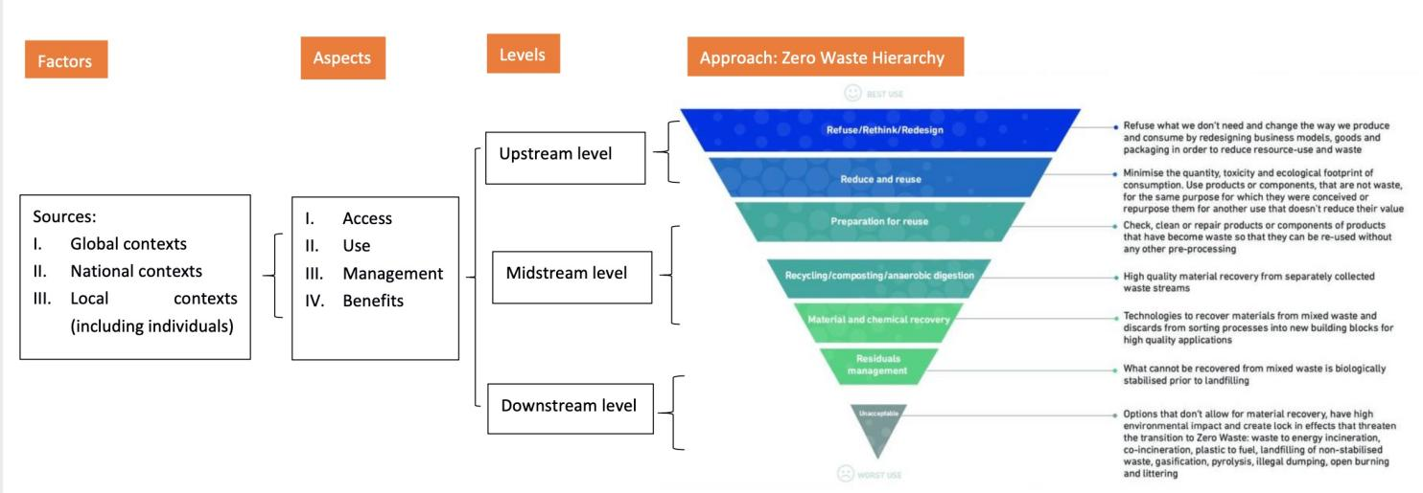
III. Zero Waste Hierarchy and P governance
Figure 1 shows the governance system of P that influences the dynamic of its nutrition flow. It integrates the sources of factors, aspects, levels and the approach of zero waste hierarchy.
Three governance levels:
1) the upstream factors related to stakeholders who can make decisions on the uses of P-related goods according to existing regulations, such as national politicians who deal with the global regulations and traders, central and local governments, individual and organizational buyers wasting and disposing of their foods that contain P;
2) the midstream factors are related to the treatment plants relevant to P-containing materials, such as water companies, wastewater treatment plants and sewage treatment plants, which can directly work on the recycling and recovery of P;
3) the downstream factors related to non-recyclable and non-recapture P-containing materials.
Figure 1: Zero waste hierarchy and P governance (Source: The author)

Slide 5
IV. Theoretical analysis of the reduction of food wastes as a prevention approach to P loss and wastes
The UK:
Limited P sources and Increasing population
P pollution and only one in-use full-scale biological nutrient removal plant with P recovery (the second is under construction) and circular economy
Food wastes and Food hungry issues
Internal |  |  |  |  | External
National: Phosphorus scarcity and pollution;Political choices of governance technologies; Societal attributes |  |  |  |  | International
Factor | Phosphorus | Food wastes (Interventional element) | Economy | Welfare economy | Political economy
Variables | Population | Dietary behavior | Market | State, Market and Social (including the third sector and community/family sector) | (Global forces, such as international relationship and cooperation)
Sub-Variable 1 | Places/communities | Production | Consumption | Resources allocation and re-allocation | (Gobal forces, such as gobal transcations)
Sub-Variable 2 | Individuals | Diet | More food choice rights under a certain economic condition | Land, water and air quality | (Global forces, such as climate change)
Presumable Outcome | Public and planet health | Meeting food aspirations and high quality | Added benefits from exchange activties | Environmental prevention and ecosystem improvement | Global environmental prevention and ecosystem improvement
Table 1: The reduction of food wastes as a prevention to phosphorus scarcity and pollution (Source: The author)

Slide 6
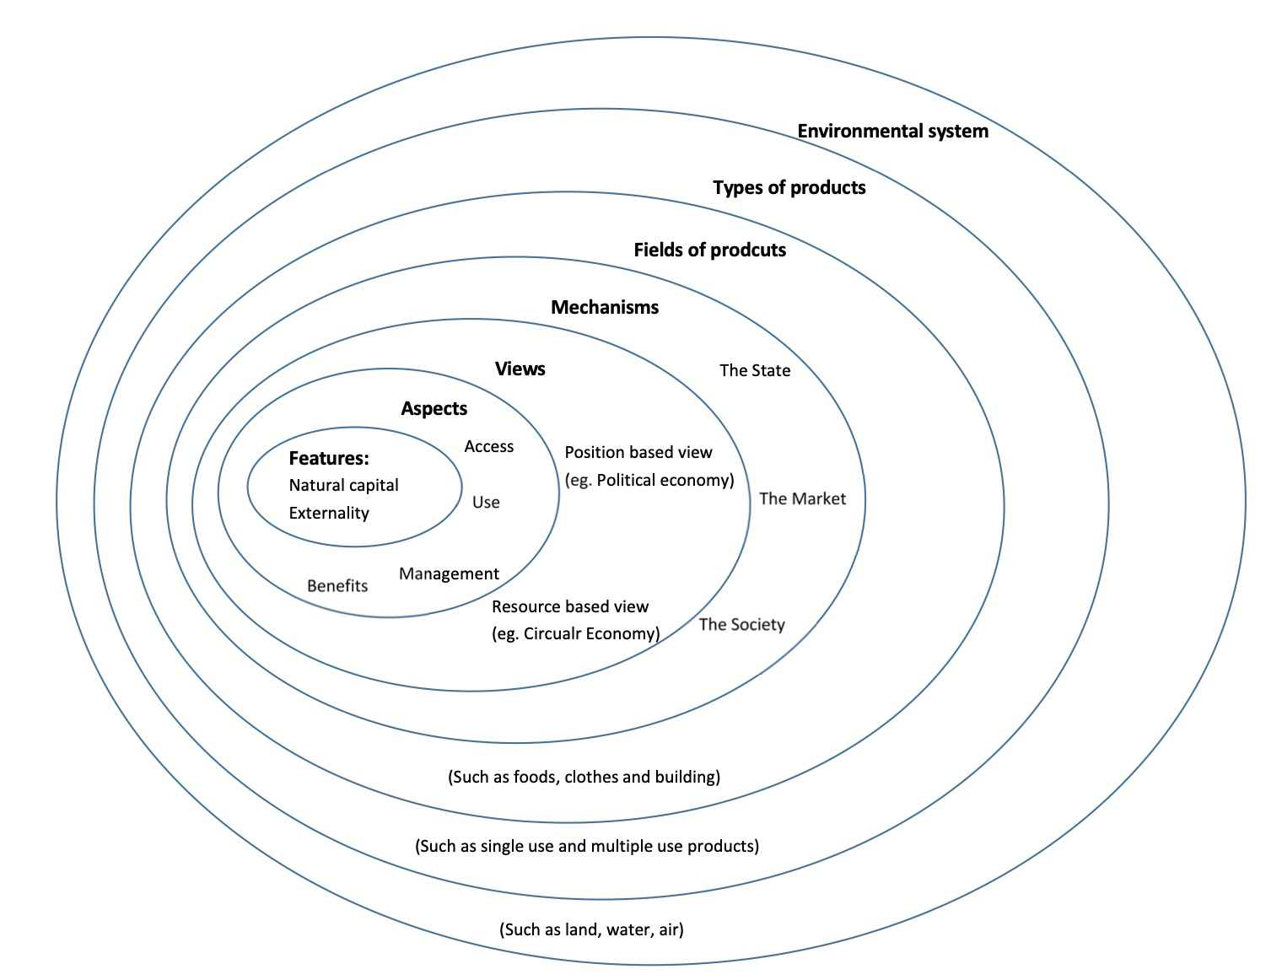
Key messages of the presentation
Theoretical learning:
It is important to consider the upstream-level factors to design the effective governance strategies by thinking the four aspects: access, use, management and benefits.
A rule used in dealing with the governance of P, such as scarcity, is nested in another set of rules, which impacts the first rule. So it is necessary to have a systematic and comprehensive understanding of the governance structure of P.
Figure 2: Analytical framework of the governance structure of P from the social science persepctive (Source: The author)

Slide 7
THANK YOU.
Dr Bingzi He: hebingziemily@gmail.com

