Slide 1
Agent-based modelling of linked circular economies
Matt Johnston
Cape Town, Bristol & Rotterdam

Slide 2
Project Goals
PROBLEM
Waste valorisation in cities risks deepening, rather than ameliorating, social inequalities
QUESTION
How do different constellations of institutionalised power interact with urban FEW waste minimisation?
OBJECTIVES
Analyse selected theory vis-à-vis mainstream urban waste politics
Map a sample of urban waste management entities and their relationships
Simulate system dynamics of waste minimisation in different ideological scenarios

Slide 3
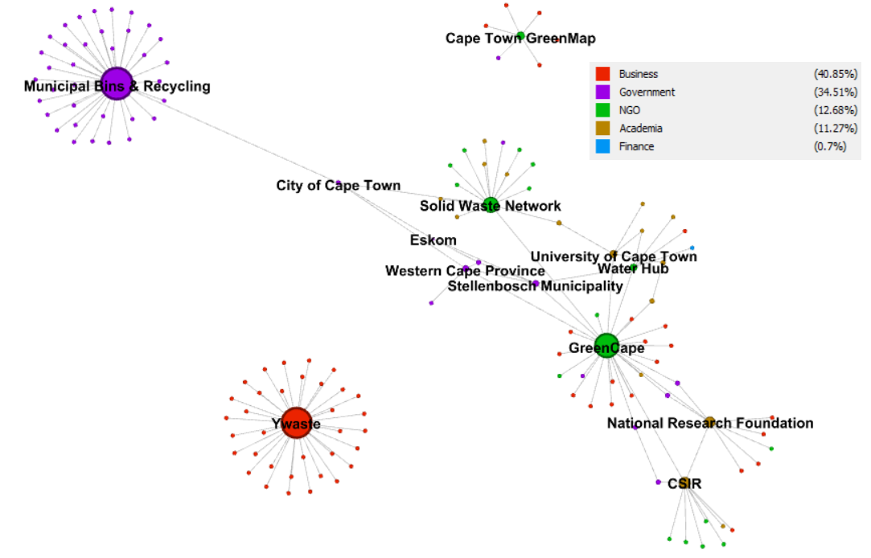
Approach 1
LITERATURE REVIEW
Circular economy theory
Food-energy-water nexus theory
Social philosophy
Political ecology
SOCIAL NETWORK ANALYSIS
Web scrape of institutions working with waste: who are they?
Appraise connections: how do they relate?
Analyse using Gephi: what’s the network structure look like?
Key stakeholders identified – now let’s learn with them.

Slide 4
Approach 2
QUALITATIVE ANALYSIS
Round 1: Use ULL engagements like workshops to read the room
Round 2: Use literature review to calibrate/rebut political impressions
Round 3: Desktop research to appraise the political profile of each city
Round 4: ONGOING – interview known incumbents to calibrate known structure
AGENT-BASED MODELLING
Iteration 1: Dynamics inferred from theory
Iteration 2: Dynamics refined by basic SNA findings
Iteration 3: ONGOING – dynamics further refined by QA findings
Iteration 4: ONGOING – a synthesis of theory, SNA, QA to design scenarios

Slide 5
Results
LITERATURE REVIEW
CE & FEW nexus theory focus on money & matter; risk reproducing inequality
Dissenting institutions using waste as a resource can disrupt power relations
Social philosophies & political ecology offer historical lessons and a critical lens whereby green expansion of ‘legitimate’ institutional power can be scrutinised
Crucial imperative: active coalition of social justice & biophysical sustainability
SOCIAL NETWORK ANALYSIS
Old centres of capital still wield power capable of equitable waste minimisation
ICT permeating urban transitions. Concentrated power curates its public image
Energy & recycling operations dominate networks where competition is possible
Concentrated networks mean transformation can occur rapidly from the core if it allows influence from peripheral agents; but, rigidity shows that it does not

Slide 6
Results
QUALITATIVE ANALYSIS
Dissonances of endogenous and exogenous power. Dysfunctional fiscal relations
Incumbent powers tactically supress the scope and freedom of grassroots agency
Near universal distrust in established institutional capacity / will to transform
Third sector waste agents co-opted into rigidly inequitable power structures
AGENT-BASED MODELLING*
Initial conditions are crucial: temporality, plurality and bird’s eye angle
Economic incentives are effective, but group benefits obscure individual struggles
Re-design of agent behavioural rules fosters abrupt systemic change, but for who?
CE & FEW nexus reduce institutional inefficiencies, but can sustainability = stasis?
* tentative

Slide 7
Conclusions – Next step
Move away from struggle for control of waste commodity frontier
Consumer oriented waste policies of care must confront banality of ‘evil’ –existential realities e.g. plurality, temporality and freedom not to care
Waste valorisation cannot catalyse a consolidation of institutional power. Sustainability must erode ideological foundations of inequality & waste
HOW??
Critical research to scrutinise increasingly dangerous rhetoric of economic emancipation from structural inequality and biophysical sustainability
‘Open up politics, broaden out knowledge, let go material commitments’ – make space for social dissent, difference and disruption in/of waste systems
Circular politics and a local-national, cross-sectoral, public power nexus to challenge hegemonic localisation of eco-modernism that sustains polluters

Slide 8
Key References
MacGregor, S. (2020). Making matter great again? Ecofeminism, new materialism and the everyday turn in environmental politics. Environmental Politics, 30(1-2), 41-60
Schindler, S., & Demaria, F. (2019). “Garbage is Gold”: Waste-based Commodity Frontiers, Modes of Valorization and Ecological Distribution Conflicts. Capitalism Nature Socialism, 31(4), 52 – 59.
Stirling. (2016). Knowing doing governing: realizing heterodyne democracies. In Knowing Governance (pp. 259-289): Springer
Valenzuela‐Levi, N. (2020). Waste Political Settlements in Colombia and Chile: Power, Inequality and Informality in Recycling. Development and Change, 51(4), 1098 – 1122.
Kaika, M. (2017). ‘Don’t call me resilient again!’: the New Urban Agenda as immunology … or … what happens when communities refuse to be vaccinated with ‘smart cities’ and indicators. Environment and Urbanization, 29(1), 89-102.
Samson, M. (2019). Whose Frontier is it Anyway? Reclaimer “Integration” and the Battle Over Johannesburg’s Waste-based Commodity Frontier. Capitalism Nature Socialism, 31(4), 60 - 75.
d'Entreves, M. P. (2019). Hannah Arendt. Stanford Encyclopedia of Philosophy (Fall 2019)
Blühdorn, I. (2019). The legitimation crisis of democracy: emancipatory politics, the environmental state and the glass ceiling to socio-ecological transformation. Environmental Politics, 29(1), 38-57.
Barca, S. (2019). Labour and the ecological crisis: The eco-modernist dilemma in western Marxism(s) (1970s-2000s). Geoforum, 98, 226-235.

Slide 9
Thank you!
Questions?

