Slide 1

Co-Creating Solutions for Innovation
Jean-Luc de Kok (jeanluc.dekok@vito.be)
Flemish Institute for Technological Research (VITO NV)
Bristol - UK
Octobre 12, 2018

Slide 2

H2020-COASTAL
Understanding land-sea interactions in a synthetic way
Improve land-sea synergy & collaboration
Durable platform for land-sea knowledge exchange
Multi-Actor Approach
May 2018 – April 2022; 5 MEUR
29 partners (business, administration, NGO, R&D, ...)
6 case studies (Multi-Actor Labs)

Slide 3
SIX MULTI-ACTOR LABS
3
1
COASTAL
Platform
4
5
6
2

Slide 4
EXPECTED PROJECT IMPACTS
Tools for evidence-based business road maps & policy solutions
Increase of blue growth and rural development
Increased job potential & new business opportunities

Slide 5
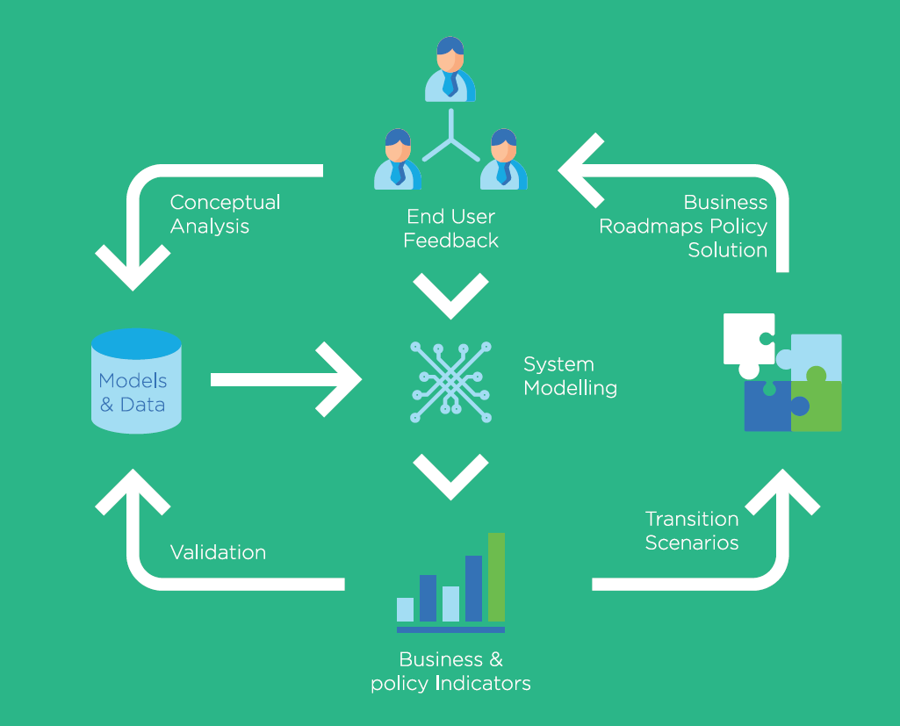
CO-CREATION
WORKFLOW

Slide 6
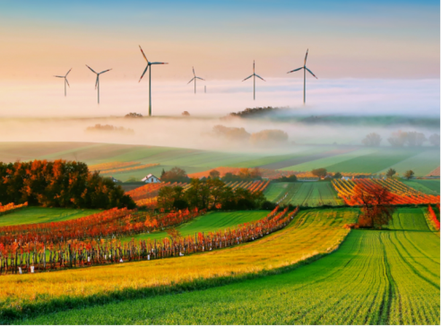
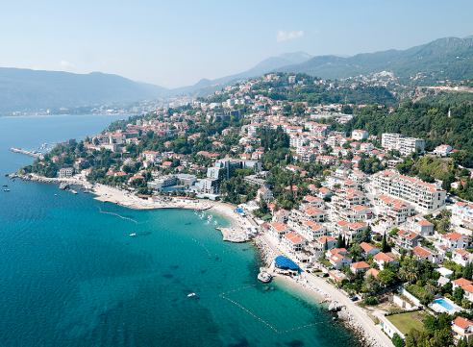
http://avenue-net.com

Slide 7
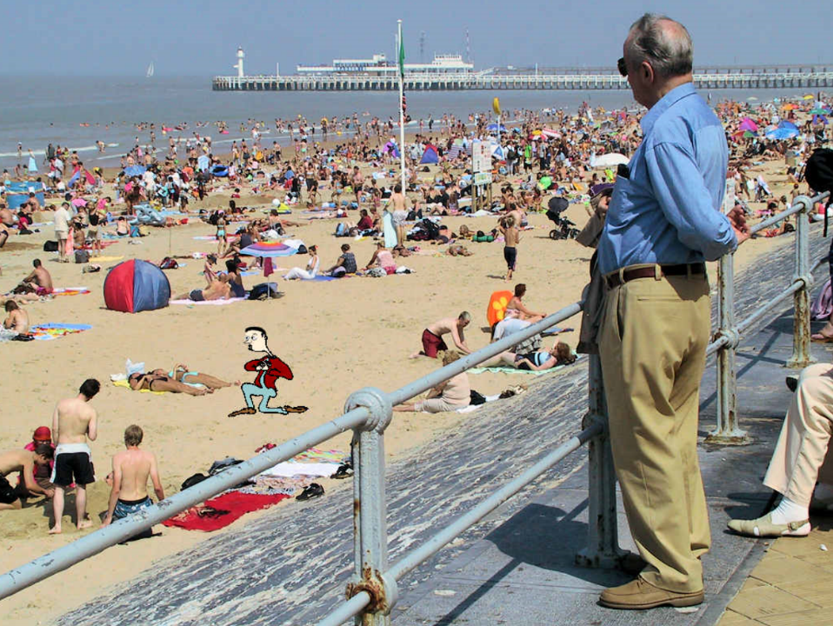
Examining Transition
www.bing.com

Slide 8
Mind Map – Connecting Issues
Coastal
Attractiveness
Pressure
On Space
Number of Tourists
Tourist Capacity

Slide 9
Causal Loop Diagram – Analysing Feedback
-
Coastal
Attractiveness
Pressure
On Space
-
+
+
Number of Tourists
Tourist Capacity

Slide 10
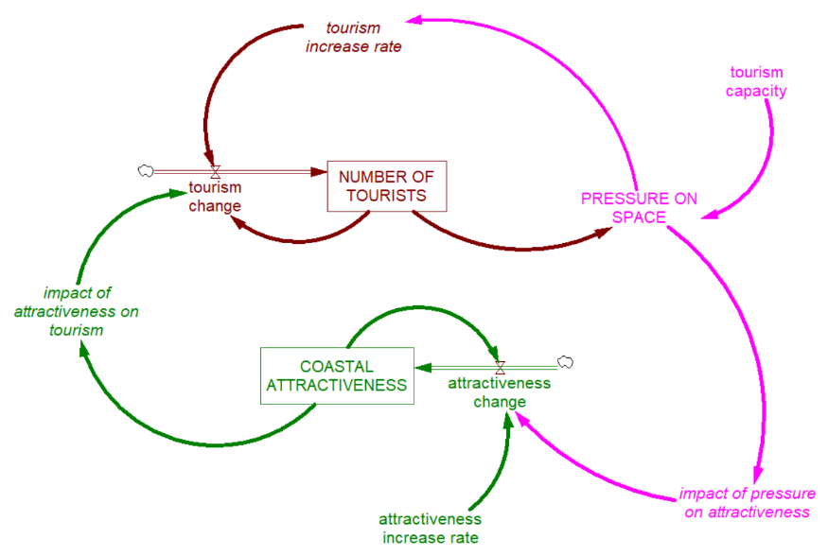
Policy Simulation

Slide 11
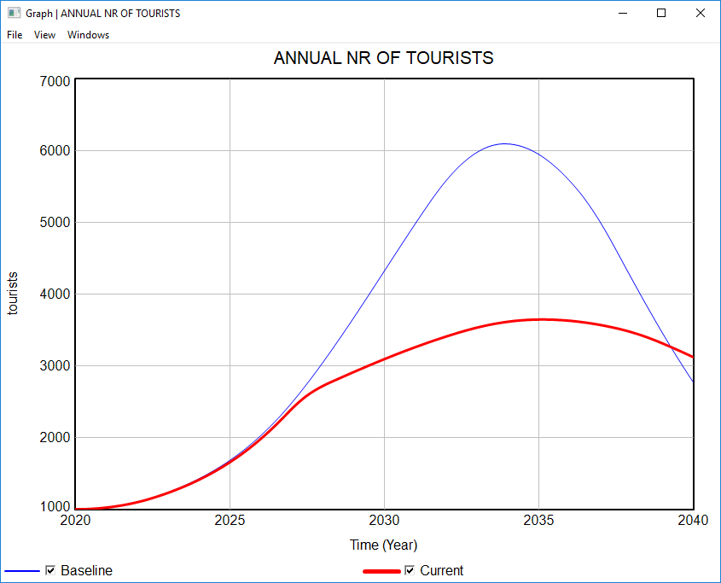

Slide 12
Typical Applications
Understanding failure of markets & businesses
Anticipating ‘tipping points’
Understanding the role of ‘policy resistance’ and counter-intuitive system behavior
...

Slide 13
Integration Platform for Research Models
Environment
Population
Energy
Space
Transport

Slide 14
Post-project Business Model
promotion
COASTAL Knowledge Exchange Platform
new
users
existing
users
new
applications
maintenance & development
COASTAL
toolbox
COASTAL
expertise
COASTAL Services
training
business &
policy analyses
technical support
revenues
(post-project)

Slide 15
More Information
jeanluc.dekok@vito.be
www.h2020-coastal.eu

Slide 16
Mind Mapping Waste (30 - 45 min)
Economic Development
Public Awareness
EURegulations
Lifestyle
?
?
?

