Slide 1
The application of WEF in different parts of world: case studies that illustrate the interconnectedness of WEF in theory and practice
Dr. Richard Nunes, Lecturer
Department of Real Estate and Planning, Henley Business School
University of Reading
WFE Nexus Winter School
Centre of Excellence for Water, AUC (Hani Sewilam – COE Lead Scientist)
January 16-March 31 , 2022
Notes:
https://aucegypt.zoom.us/j/9200252072

Slide 2
Introduction

Slide 3
Water, Food and Energy (WEF) Nexus Index (Egypt)
Simpson G.B., Jewitt G.P.W., Becker W., Badenhorst J., Neves A.R. , Rovira P. and Pascual V. (2020). The Water-Energy-Food Nexus Index, Jones & Wagener <https://www.wefnexusindex.org
Notes:
https://www.wefnexusindex.org/EGY
https://aps.aucegypt.edu/en/articles/735/a-just-transition-towards-a-circular-economy-existing-policies-in-Egypt

Slide 4
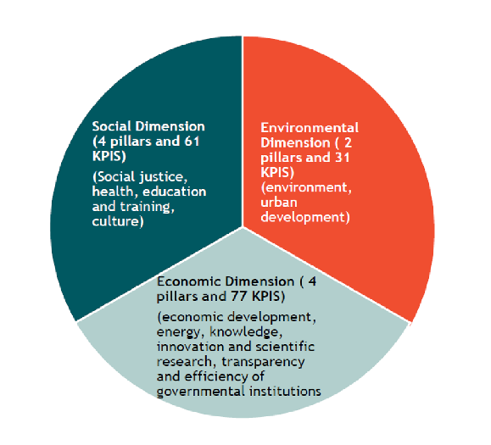
Circular economies and a just transition to FEW (Egypt)
Several CE activities already exist in Egypt: Tagaddod, Bariq, Imkan, IEE UNIDO
The shift (transition) to CE must mitigate the risk of burdening the poor.
New Waste Law (2020) - identifying CE/plastics waste as a key challenge
Sustainable Development Strategy (SDS) 2030, the Sustainable and Green Growth strategy, National Action Plan for Sustainable Consumption and Production (SCP), and the National Solid Waste Management Program (NSWMP)
Dimensions and Pillars of Egypt’s SDS 2030 (Mahmoud et al 2020)
Notes:
https://aps.aucegypt.edu/en/articles/735/a-just-transition-towards-a-circular-economy-existing-policies-in-Egypt
Dimensions and Pillars of Egypt's SDS 2030

Slide 5
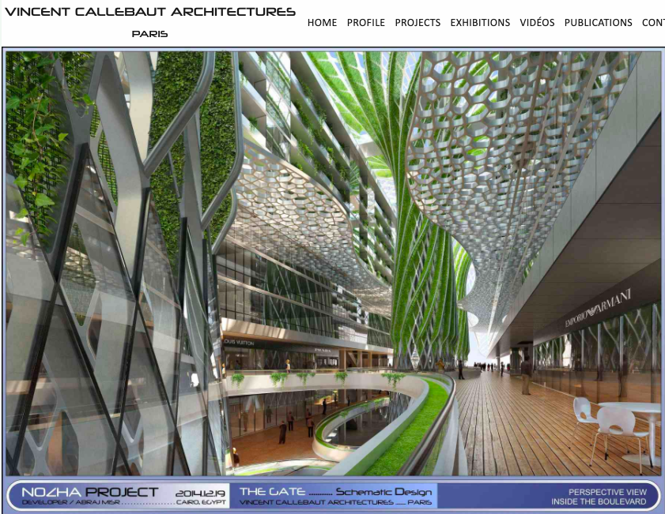
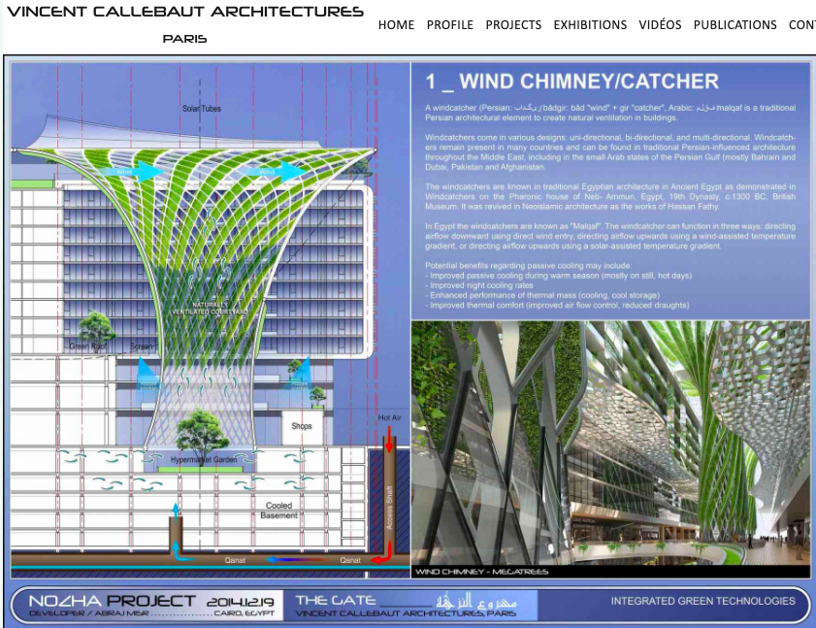
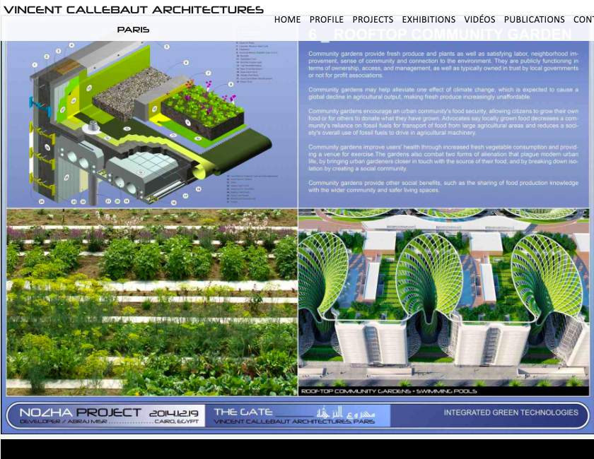
The Gate - Pushing the boundaries of the WEF Nexus?
“vertical green hyper-connected ecosystem” - Enjaz
Notes:
https://vincent.callebaut.org/object/141029_thegate/thegate/projects

Slide 6
Aims of today’s session
Appreciate how WEF is applied at local scale in an urban living lab
Understand why WEF concept needs to be further refined
Gain a better understanding of the challenge of sustaining WEF
Develop new insights into the acceptance and involvement of local community in WEF practice.

Slide 7
Food Energy and Water Nexus: Implications for urban governance (Artioli et al 2017: 216)
[“…] the nexus is an integrative imaginary which implies that integrated governance of water, energy and food systems is more advantageous than a siloed approach (Szerszynski & Galarraga, 2013)”
“[…]operationalisation of the nexus seeks to integrate across systems through technological and institutional change (Villamayor-Tomas, Grundmann, Epstein, Evans, & Kimmich, 2015; Villaroel Walker, Beck, Hall, Dawson, & Heidrich, 2014)”
“[…] implementing this approach reveals that it is not value-neutral (Allouche, 2011; Scollon, 2005) “
“[…] ‘politicise the nexus’ (Williams, Bouzarovski, & Swyngedouw, 2014).“

Slide 8
Waste Hierarchy 2.0
https://zerowastecities.eu/discover/#zw_hierarchy
Notes:
https://zerowastecities.eu/discover/#zw_hierarchy

Slide 9
‘Other recovery’: EU Circular Economy Action Plan (2018)
A monitoring framework on the circular economy (2018)
A circular economy can contribute to climate goals, jobs and growth (aka urban regeneration)
A circular economy is restorative and regenerative by design, and aims to keep products, components, and materials at their highest utility and value at all times. The concept [ . . . ] is a continuous positive development cycle that preserves and enhances natural capital, optimizes resource yields, and minimizes system risks by managing finite stocks and renewable flows. Moreau et al 2017
Notes:
http://ec.europa.eu/environment/circular-economy/index_en.htm

Slide 10
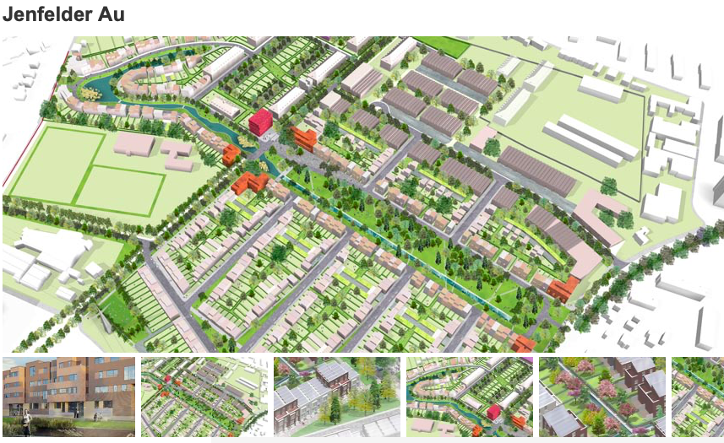
New neighbourhood quarter (approximately the size of Waterman’s View/Barkham Place - Arborfield Green Garden Village (City of Hamburg) 29 Acres, approx. 700 homes Biogas system + Combined Heat Power will supply 30% of heating need, and 50% of electricity need. Phosphorous / Nitrate capture
’Hamburg Water Cycle’ – a waste water concept
Notes:
https://www.urbangreenbluegrids.com/pr
https://www.west8.com/projects/jenfelder_au_formerly_known_as_new_jenfeld/ojects/jenfelder-au-hamburg/
https://www.internationale-bauausstellung-hamburg.de/en/projects/quarter-jenfelder-au/projekt/jenfelder-au.html
Black water, grey water and rain water is collected and processed separately.
Black water is collected via vacuum toilets, and processed in an anaerobic digester that produces biogas, which is supplied to co-generator plant on site. The plant heats / powers up homes that have been design to passive house standards
Grey water from washing is processed recirculated to the district for irrigation and washing and toilet water during times of drought
Rainwater is captured on site via the use of sustainable urban drainage systems.

Slide 11
The context of the unit of analysis of a ‘circular economy’
CE concept carries with itself a diversity of descriptions and different types of arguments for what features should be given the highest priority or weight in its applications. Korhonen et al 2020: 549-550

Slide 12
Tensions between justice and sustainability in a just transition (as applied to a circular economy)
Ciplet and Harrison 2020: 440
Notes:
What tensions and conflicts arise between sustainability and justice goals?

Slide 13
The Gate - Pushing the boundaries of the WEF Nexus?
Go back to the WEF Nexus index and ask yourself: what tensions and conflicts arise between sustainability and justice goals?
“vertical green hyper-connected ecosystem” - Enjaz
Notes:
https://vincent.callebaut.org/object/141029_thegate/thegate/projects

Slide 14
References
Artioli, F., Acuto, M. and McArthur, J., 2017. The water-energy-food nexus: An integration agenda and implications for urban governance. Political Geography, 61, pp.215-223.
Ciplet, D. and Harrison, J.L., 2019. Transition tensions: mapping conflicts in movements for a just and sustainable transition. Environmental Politics.
Mahmoud, M., Rademaekers, K., Hemkhaus, M., Ahlers, J., Van Hummelen, S., Chewpreecha, U., Smith, A., & McGovern, M. (2020). Circular economy in the Africa-EU cooperation - Country report for Egypt. Trinomics B.V., Tomorrow Matters Now Ltd., adelphi Consult GmbH and Cambridge Econometrics Ltd. https://cutt.ly/Qb07lWg
Moreau, V., et al., 2017. Coming full circle: why social and institutional dimensions matter for the circular economy. J. Ind. Ecol. 21 (3), 497-506.
Simpson G.B., Jewitt G.P.W., Becker W., Badenhorst J., Neves A.R. , Rovira P. and Pascual V. (2020). The Water-Energy-Food Nexus Index, Jones & Wagener https://www.wefnexusindex.org

