Slide 1
Dynamics Modelling of Food Waste Impacts on Food-Energy-Water-Climate Nexus in Bristol
Ali Parsa, Marco Van De Wiel, Ulrich Schmutz
Coventry University
Watershed, Bristol, 11th November 2021
Partners
Research team

Slide 2
PhD Research
Title:
Aim:
Studying the interrelation between urban FEW resources for waste minimisation
Question:
What is the impact of FEW waste (and waste minimisation) on other nexus resources and GHG emission?
How can intersectoral policies help to reduce food, energy, water and carbon footprint in urban areas?
Case Studies:
Bristol City
Rotterdam (Blue City)
Cape Town (Stellenbosch Water Hub)
Dynamics Modelling of FEW Nexus in Urban Circular Economies

Slide 3
Methodology
System Dynamics is an approach to understanding the nonlinear behaviour of complex systems over time.
A methodology to build conceptual or simulation models depicting the causal structure of a complex system
To understand how system structures cause/ affect system behaviour.
A computer-aided approach to theory building, policy analysis, and strategic decision support

Slide 4
Methodology (Bristol Case Study)
Quantitative modelling of Bristol food waste
Consumption based approach (i.e. not territorial)
Food waste impacts on energy, water and GHG emissions
Evaluation of policies and implication on policy design

Slide 5
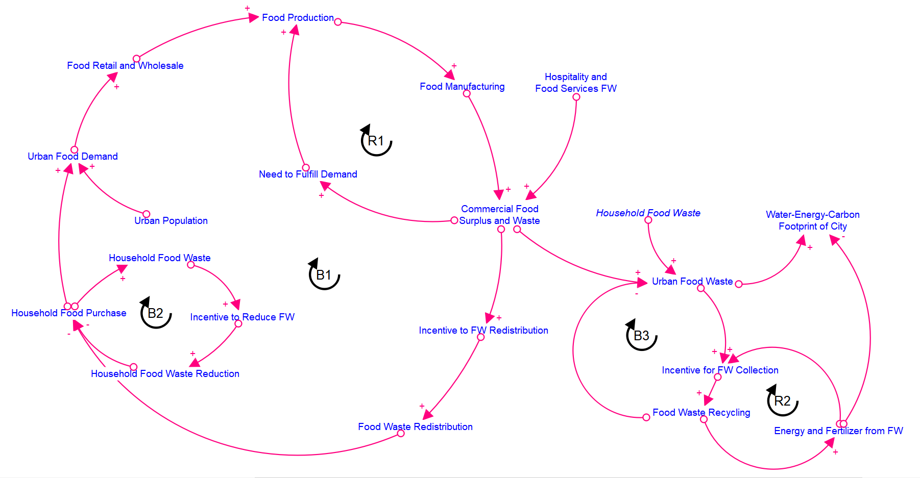
Methodology Causal Loop Diagram of Food Waste
R1: Commercial Food Growth
R2: Food Waste Recycling Growth
B1: Commercial Food Redistribution
B2: Household Food Reduction
B3: Food Waste Recycling Reduction

Slide 6
Methodology Definitions and Assumptions
Food Waste: any food and inedible parts being sent to the following:
Anaerobic Digestion
Composting
Incineration
Land Application
Landfill
Sewer
Not harvested
Unmanaged Disposal
Food Surplus: any food and inedible parts being sent to the following:
Redistribution
Animal feed
Conversion into industrial products

Slide 7
Methodology Definitions and Assumptions
Food Surplus & Waste (FSW)
Sum of wasted food in:
1- Primary Production
2- Food Manufacturers
3- Retail and Wholesale
4- Hospitality and Food Services
5- Household
Energy Footprint
Sum of electricity and fuel use in:
1- Primary Production & transport
2- Food Manufacturing
3- Retail Refrigeration & Transport
4- HaFS Refrigeration & Catering
5- Household Cooking, Cooling, dishwashing & Transport
Water Footprint
Sum of water abstraction/ use in:
1- Agricultural Production
2- Food Manufacturing
3- Retail and Wholesale
4- Hospitality and Food Services
5- Household Cooking & Dishwashing
Carbon Footprint
Sum of GHG emission in:
1- Agriculture Sector, Transport, Packaging & Fertilizer Production
2- Food Manufacturing & Packaging
3- Retail Refrigeration & Transport
4- Hospitality & Packaging
5- Household Cooking, Cooling, dishwashing & Transport

Slide 9
Preliminary Findings
Variable | Volume (k tonne) | Note
Total Bristol food demand | 382 | Sum of household and HaFS food purchase
Household food purchase | 278 | Almost 3/4 of all food purchased in Bristol
HaFS food purchase | 104 | More than 1/4 of all food purchased in Bristol
Total Bristol food footprint | 102 | More than 1/4 of food is wasted in supply chain
Household food waste | 44.5 | 16% of household food purchase is wasted ¹
HaFS food waste | 16.7 | One in six of the 8 billion meals served is wasted ²
Retail food waste | 2.67 | Less than one percent (i.e. 0.7%) of the sector ³
Manufacturing food waste | 9.9 | 2.6% of all manufactured food ¹
Agriculture food waste | 28.2 | 7.2% of agricultural production is wasted ⁴
Quantity of Bristol food demand and food waste generation
Food surplus and waste in the UK – key facts (WRAP, 2021)
Overview of Waste in the UK Hospitality and Food Service Sector (WRAP, 2013)
Quantification of food surplus, waste and related materials in the grocery supply chain (WRAP, 2016)
Food Waste in Primary Production in the UK (WRAP, 2019)

Slide 10
Preliminary Findings
Variable | Volume (MWh)
Average embodied energy per tonne of food | 3.6
Energy embodied per tonne of household food | 2.53
Energy embodied per tonne of HaFS food | 6.51
Total energy footprint of Bristol food consumed | 1.38 M
Total energy footprint of household food | 704 K
Total energy footprint of HaFS food | 678 K
Total energy footprint of Bristol food waste | 252 k
Energy footprint of household food waste | 113 K
Energy footprint of HaFS food waste | 108 K
Energy footprint of retail food waste | 4.4 K
Energy footprint of manufacturing food waste | 10 K
Energy footprint of agricultural food waste | 16.3 K
Total Bristol energy consumption ¹ (20% for comparison!) | 6.875 M
Quantification of Embodied Energy in Bristol Food and Food Waste (pre-treatment)
BEIS Sub-national total final energy consumption in the UK, 2018

Slide 11
Preliminary Findings
Variable | Volume (m3)
Average embodied water per tonne of food | 26.6
Water embodied per tonne of household food | 15.9
Water embodied per tonne of HaFS food | 35.3
Total water footprint of Bristol food consumed | 8.16 M
Total water footprint of household food | 3.65 M
Total water footprint of HaFS food | 4.5 M
Total water footprint of Bristol food waste | 1.49 M
Water footprint of household food waste | 705 K
Water footprint of HaFS food waste | 588 K
Water footprint of retail food waste | 20 K
Water footprint of manufacturing food waste | 71 K
Water footprint of agricultural food waste | 110 K
Total Bristol water abstraction* | 82.8 M
Quantification of Embodied Water in Bristol Food and Food Waste (pre-treatment)
* DEFRA Regional Water Abstraction Tables, 2017 (based on England average)

Slide 12
Preliminary Findings
Variable | Volume (tonne) | Volume (tonne)**
Average embodied emission per tonne of food | 2.24 | 1.98
Embodied CO2e per tonne of household food | 1.89 | 1.72
Embodied CO2e per tonne of HaFS food | 3.2 | 2.7
Total carbon footprint of Bristol food consumed | 873 K | 771 K
Total carbon footprint of household food | 537 K | 488 K
Total carbon footprint of HaFS food | 336 K | 283 K
Total carbon footprint of Bristol food waste | 193 K | 173 K
Carbon footprint of household food waste | 84 K | 76.3 K
Carbon footprint of HaFS food waste | 53.3 K | 45 K
Carbon footprint of retail food waste | 4.5 K | 4 K
Carbon footprint of manufacturing food waste | 15 K | 13.3 K
Carbon footprint of agricultural food waste | 36.6 K | 34.2 K
Total Bristol carbon footprint* | 82.8 M | 82.8 M
Quantification of CO2e Footprint in Bristol Food and Food Waste (pre-treatment)
* BEIS 2005-19 UK Local and Regional CO2 Emissions (2021)
** Second estimate doesn’t include fertilizer production and packaging.

Slide 13
Scenario Building & Policy Analysis (work in progress)
50% per capita reduction in food waste by 2030 vs the UK 2007 baseline (UN SDG 12.3).
20% reduction compared to 2015 based on Courtauld Commitment 2025
50% absolute reduction in GHG emissions associated with food and drink consumed in the UK by 2030 (against a 2015 baseline).
https://exchange.iseesystems.com/public/aliparsa/food-waste

Slide 14
THANK YOU ☺
Acknowledgements
Conveners
The WASTE FEW ULL project was funded by JPI Europe and the Belmont Forum’s Sustainable Urbanization Global Initiative
(UK project funders: ESRC, AHRC, Innovate UK, Research Council Norway, National Science Foundation).
UK Funders
International Funders

